Slide 1
APA Style
(7th Edition)
Tutorial
E. Moore, RN, MSN, FNP

Slide 2
Basic Elements
Student Paper
  Title Page
  Introduction
  Main Body
  References
  Tables, figures, appendices (not required for this paper)
Professional paper elements not required for student papers:
  Author’s note
  Running head
  Abstract

Slide 3
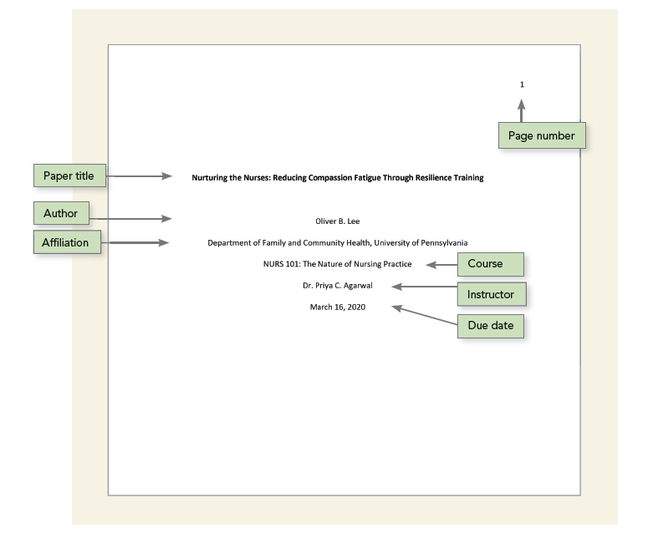
Title Page

Slide 4
Basics
Fonts
Line Spacing
Margins
Paragraph Alignment and Indentation
Notes:
.

Slide 5
APA Headings
Level of heading | Format
1 | Centered, Bold, Title Case Heading Text begins as a new paragraph.
2 | Aligned Left, Bold, Title Case Heading Text begins as a new paragraph.
3 | Aligned Left, Bold Italic, Title Case Heading Text begins as a new paragraph.
4 | Indented, Bold, Title Case Heading, Ending With a Period. Text begins on the same line and continues as a regular paragraph.
5 | Indented, Bold Italic, Title Case Heading, Ending With a Period. Text begins on the same line and continues as a regular paragraph.

Slide 6
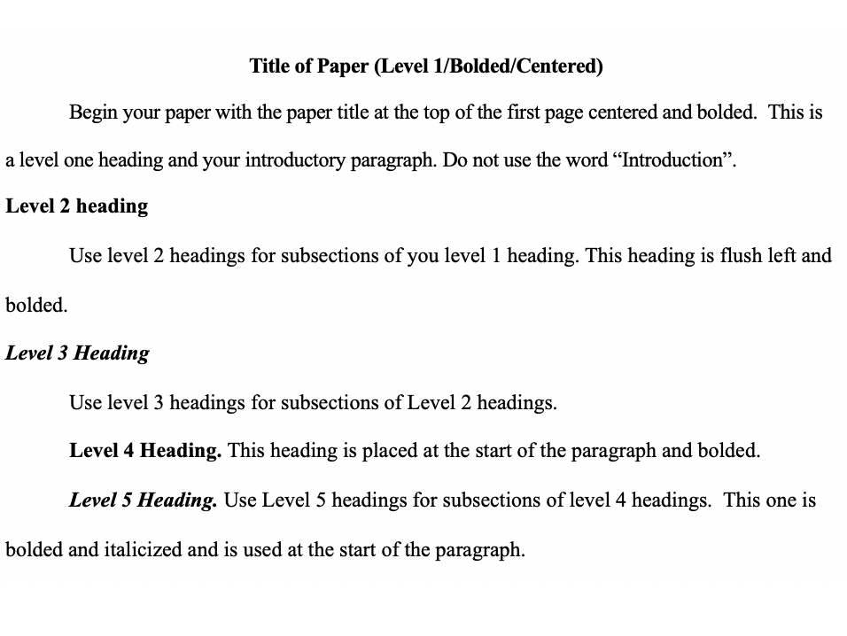
APA Headings Example

Slide 7
Academic Writing Style
Use professional language that matches language in the field
Omit use of “casual” language or “slang”
Write with respect, inclusion, sensitivity
Use “people first language” or “identity-first language”
  Avoid labels such as alcoholics or schizophrenics
Avoid use negative or condescending terminology
  Confined to a wheelchair, domestic violence victim, brain injured
Avoid changing tenses within a paragraph and do not change the tense within a sentence
Use an active voice and personal pronoun – do not refer to yourself in the third person

Slide 8
APA Abbreviations
When abbreviating a term, use the full term the first time you use it, followed immediately by the abbreviation in parentheses.
Example: According to the American Psychological Association (APA), abbreviations are best used only when they allow for clear communication with the audience. APA can be used in this way on subsequent uses.
Exceptions: Standard abbreviations like units of measurement and states do not need to be written out. APA also allows abbreviations that appear as words in Merriam-Webster’s Collegiate Dictionary to be used without explanation (IQ, REM, AIDS, HIV)

Slide 9
APA Numbers
Numbers: write out numbers one through nine
  (one, two, three, four, five, six, seven, eight, nine)
Exception – statistics or mathematical numbers
  example - ok to use “2%” in your sentences
Write out a number that starts a sentence
  Ninety-percent…..not: 90% of patients
  Three thousand participants……

Slide 11
Basic In-Text Citation Style
Author type | Parenthetical citation | Narrative citation
One author | (Luna, 2020) | Luna (2020)
Two authors | (Salas & D’Agostino, 2020) | Salas and D’Agostino (2020)
Three or more authors | (Martin et al., 2020) | Martin et al. (2020)
Group author with abbreviation First citation ª Subsequent citations | (National Institute of Mental Health [NIMH], 2020) (NIMH, 2020) | National Institute of Mental Health (NIMH, 2020) NIMH (2020)
Group author without abbreviation | (Stanford University, 2020) | Stanford University (2020)

Slide 12
In Text Citation Examples
According to Palladino and Wade (2020), “a flexible mind is a healthy mind” (p. 147).
In 2020, Palladino and Wade noted that “a flexible mind is a healthy mind” (p. 147).
In fact, “a flexible mind is a healthy mind” (Palladino & Wade, 2020, p. 147).
“A flexible mind is a healthy mind,” according to Palladino and Wade’s (2020, p. 147) longitudinal study.
Palladino and Wade’s (2020) results indicate that “a flexible mind is a healthy mind” (p. 147).

Slide 13
In-text Referencing – please put the following in an in-text reference
Cardozo, P. (Director). (2003). Real lives of people with depression [Documentary]. Honey Studios. https://www.youtube.com/watch?v=UVaFSbn6lKs
“depressed people are less likely to seek social support if they are male”

Slide 14
Correct Possibilities

Slide 15
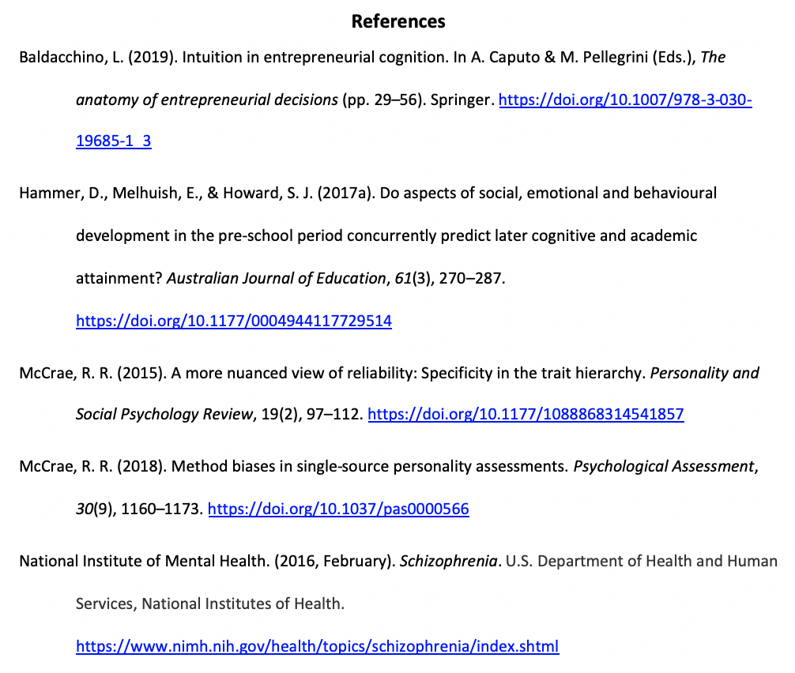
Reference Page Format
Pay close attention to what is capitalized and what is not capitalized!

Slide 16
Digital Object Identifier
A digital object identifier (DOI) is a unique string of letters, numbers, and symbols assigned to a published work to identify content and provide a persistent link to its location on the Internet. The DOI is typically located on the first page of an electronic document near the copyright notice and on the database landing page for the document. When DOIs are available, include them in the reference information. Place the DOI at the end of the reference, and don’t add a period at the end of it. Here’s an example:
Samples on previous slide

Slide 17
DOI vs. URL
If there is no DOI, then you should include the URL
DOI:
Ouyang, K., Cheng, B. H., Lam, W., & Parker, S. K. (2019). Enjoy your evening, be proactive tomorrow: How off-job experiences shape daily proactivity. Journal of Applied Psychology, 104(8), 1003–1019. https://doi.org/10.1037/apl0000391
URL:
American Psychological Association. (2017). Stress in America: The state of our nation. https://www.apa.org/news/press/releases/stress/2017/state- nation.pdf

Slide 18
Book Reference
Edited vs. Unedited
Basic Format for Books
  Author, A. A. (Year of publication). Title of work: Capital letter also for subtitle. Publisher.
  American Psychiatric Association. (2013). Diagnostic and statistical manual of mental disorders (5th ed.). American Psychiatric Association.
Article or Chapter in an Edited Book/Edition Other Than the First
  Author, A. A., & Author, B. B. (Year of publication). Title of chapter. In A. A. Editor & B. B. Editor (Eds.), Title of book (edition, pages of chapter). Publisher.
  O'Neil, J. M., & Egan, J. (2014). Men's and women's gender role journeys: A metaphor for healing, transition, and transformation. In B. R. Wainrib (Ed.), Gender issues across the life cycle (2nd ed., pp. 107-123). Springer.

Slide 19
Secondary Source Citation
(Indirect Source Citation)
Secondary sources are acceptable within academic writing as long as they are kept to a minimum. You should use secondary sources only if you are unable to find or retrieve the original source of information. It is your academic responsibility to attempt to find the primary source and read it yourself.
Rather than citing your textbook, an abstract, or an instructor’s presentation/power points, research these topics on your own and find primary sources.
Be aware that your goal is no secondary sourcing, thus more than a few is a red flag to your reader that you are not doing sufficient research on your own

Slide 20
Citation of Documentary
To cite a documentary properly, you must take the following pieces of information into consideration:
Name of the director(s) in the place of an author
If there is no director, someone else important (executive producer, host, writer, etc)
Publication date
Documentary title
Production company
URL of the site, database, or streaming service that the documentary was found on Name of the production company

Slide 21
AV Reference Online Documentary Single Production
Director, D. D. (Director). (Year of publication). Title of documentary [Documentary]. Production Company. https://www.youtube.com/watch?v=UVaFSbn6lKs
Cardozo, P. (Director). (2003). Real lives of people with depression [Documentary]. Honey Studios. https://www.youtube.com/watch?v=UVaFSbn6lKs

Slide 22
Documentary Reference Practice
Go to Internet Movie Database and search up the film “Bipolar Rock ‘N Roller”
https://www.imdb.com/
Put into APA Style
Director, D. D. (Director). (Year of publication). Title of documentary [Documentary]. Production Company. https://www.youtube.com/watch?v=UVaFSbn6lKs

Slide 23
Correct Format

Slide 24
TV Series Episode or Webisode
Writer, W. W. (Writer) & Director, D. D. (Director). (Date of production). Title of episode (Season number, Episode number) [Description]. In P. P. Producer (Executive Producer), Title of TV Series. Production Company.
Osmond, S. (Director). (2013, May 9). When anxiety attacks [Television series episode]. In S. Gionas (Producer), The agenda with Steve Paikin. TVO. https://www.tvo.org/video/programs/the-agenda-with-steve-paikin/when-anxiety-attacks

Slide 25
Government Authors
Online Publication
U.S. Department of Health and Human Services, National Institutes of Health, National Institute of Mental Health. (2015). NIMH strategic plan for research (NIH Publication No. 02- 2650). http://www.nimh.nih.gov/about/strategic-planning- reports/index.shtml
Web Page (with a retrieval date)
National Institute of Mental Health (2013). Eating disorders. Retrieved March 20, 2015, from http://www.nimh.nih.gov/health/topics/eating- disorders/index.shtml

Slide 26
Put in an in-text reference
National Institute of Mental Health (2013). Eating disorders. Retrieved March 20, 2013, from http://www.nimh.nih.gov/health/topics/eating- disorders/index.shtml
“Researchers are finding that eating disorders are caused by a complex interaction of genetic, biological, behavioral, psychological, and social factors.”

Slide 27
Correct Possibilities

Slide 28
Nonperiodical Web Document or Report
Author, A. A., & Author, B. B. (Date of publication). Title of article. In Title of larger document/website. (Retrieval date if needed, from) http://Web address
Ratini , M (2018). Painkillers and opioid use disorder. WebMD. Retrieved July 25, 2019, from https://www.webmd.com/mental- health/addiction/painkillers-and-addiction-narcotic-abuse#2
Andrew. L. B.( 2014). Depression and suicide. In B. E. Brenner (Ed.) Medscape. Retrieved July 25 , 2019, from http://emedicine.medscape.com/article/805459-overview

Slide 29
Only Need the Reference Once in The Paragraph – Unintentional Plagiarism?
Neurobiological
Enright and Ibrahim (2010) explain that there is a strong genetic link for eating disorders, such as AN. In fact, they report that “heritability in twins is greater than 50%” (Enright & Ibrahim, 2010, p. 347). This genetic vulnerability can, then, lead to “poor affect and impulse control or to an underlying neurotransmitter dysfunction” (Enright & Ibrahim, 2010, p. 347).
Neurobiological
Enright and Ibrahim (2010) contend that individuals with eating discords, such as AN, are likely to “exhibit personality traits of perfectionism, obsessive compulsiveness, and dysphoric mood” (Enright & Ibrahim, 2010, p. 347). These personality traits are likely to be found alongside changed levels of brain serotonin in individuals with AN which, then, contribute to “dysregulation of appetite, mood, and impulse control” (Enright & Ibrahim, 2010, p. 347).

Slide 30
Paragraph Hints
Body paragraphs should be 5 to 8 sentences, but not longer than 10 sentences. You might occasionally need to include a shorter 3 sentence paragraph but this should be rare.
Avoid run-on sentences…. also known as fused sentences. This occurs when two complete sentences are squashed together without using a coordinating conjunction or proper punctuation, such as a period or a semicolon. APA requires concise writing.
Do not put an extra “double space” between paragraphs. Every line in an APA document is double spaced.

Slide 31
Our Textbook – Put Into APA
(pay attention to capitalization and italics)
Go to Chapter 3 and attempt to put into this format
Chapter Author, A. A., & Chapter Author, B. B. (Year of publication). Title of chapter. In A. A. Editor & B. B. Editor (Eds.), Title of book (edition, pages of chapter). Publisher Name.

Slide 32
Correct Format

Slide 33
Journal Articles
Author, A. A., & Author, B. B. (year of publication). Title of article. Title of Journal, volume number(issue number if available), page numbers. http:doiaddress
Note: no capitalization of the article title but the journal title keeps capitalization just as it appears on the website or journal itself
You don’t put it in red, red indicates what is italicized in this reference which is the title of the journal ant the volume number.

Slide 34
Examples
Example with 21+ authors
Kalnay, E., Kanamitsu, M., Kistler, R., Collins, W., Deaven, D., Gandin, L., Iredell, M., Saha, S., White, G., Woollen, J., Zhu, Y., Chelliah, M., Ebisuzaki, W., Higgins, W., Janowiak, J., Mo, K. C., Ropelewski, C., Wang, J., Leetmaa, A., . . . Joseph, D. (1996). The NCEP/NCAR 40-year reanalysis project. Bulletin of the American Meteorological Society, 77(3), 437–471. https://doi.org/10.1175/1520- 0477(1996)077%3C0437:TNYRP%3E2.0.CO;2
e articles:
Burin, D., Kilteni, K., Rabuffetti, M., Slater, M., & Pia, L. (2019). Body ownership increases the interference between observed and executed movements. Plos One, 14(1), Article e0209899. https://doi.org/10.1371/journal.pone.0209899

Slide 35
Let’s Find the Errors
Leucht, C., Heres, S., Kane, J., Kissling, W., Davis, J., & Leucht, S. (n.d.). Oral versus depot antipsychotic drug for schizophrenia [ schizophr Res. 2011]- PubMed- NCBI. National Center for Biotechnology Information. Retrieved April 26, 2013 from http:// www.ncbi.nlm.nih.gov/pubmed/21257294

Slide 36
Here’s the Raw Information
Schizophr Res. 2011 Apr;127(1-3):83-92. doi: 10.1016/j.schres.2010.11.020. Epub 2011 Jan 22. Oral versus depot antipsychotic drugs for schizophrenia--a critical systematic review and meta-analysis of randomised long-term trials.
Leucht C, Heres S, Kane JM, Kissling W, Davis JM, Leucht S.
Journal article format:
Author, A. A., & Author, B. B. (year of publication). Title of article . Title of Online Periodical, volume number(issue number if available), page numbers. doi
National Institute of Mental Health
PubMed

Slide 37
Correct Format

Slide 38
Find the errors. Is this article appropriate to use in your paper? Why or why not?
MacPherson, M. (2009). Psychological causes of Schizophrenia 35(2):284-286. Retrieved from http://www.medscape.com/viewarticle/706242

Slide 39
Raw Information
Schizophrenia Bulletin
Psychological Causes of Schizophrenia
M. MacPhersonDisclosures
Schizophr Bull. 2009;35(2):284-286.
Format: Author, A. A., & Author, B. B. (year of publication). Title of article [Special Description]. Title of Online Periodical, volume number(issue number if available), page numbers. doi

Slide 40
Correct Format

Slide 41
Find the Errors
Javitt, D. C. (2007). Glutamate and schizophrenia: phencyclidine, N- methyl-D-aspartate receptors, and dopamine-glutamate interactions. In Pubmed. Retrieved April 24,2013 from http://www.ncbi.nlm.nih.gov/pubmed/17349858

Slide 42
Raw Information
Int Rev Neurobiol. 2007;78:69-108.
Glutamate and schizophrenia: phencyclidine, N-methyl-D-aspartate receptors, and dopamine-glutamate interactions.
Javitt DC.
Author, A. A., & Author, B. B. (Date of publication). Title of article. Title of Journal, volume number(issue number), page numbers. http:doiaddress

Slide 43
Correct Format

Slide 44
Find the Errors and Put in APA
Student reference:
DJ, H. (2012). Serotonin neurotransmission in anorexia nervosa. Abstract retrieved from PubMed.
Website info, note the doi:
Behav Pharmacol. 2012 Sep;23(5-6):478-95. doi: 10.1097/FBP.0b013e328357440d
Serotonin neurotransmission in anorexia nervosa.
Haleem DJ.

Slide 45
Correct Format

Slide 46
Put into APA
Is this appropriate for your paper?
Why or why not?
Post-traumatic stress disorder (PTSD). (2014). Retrieved from http://www.mayoclinic.com/ health/post-traumatic-stress-disorder/DS00246/DSECTION=symptoms

Slide 47
Correct Format

Slide 48
Put into APA style. Can you find the doi? If so, should you use the url or doi?
Paul Lichtenstein, Benjamin H Yip, Camilla Björk, Yudi Pawitan, Tyrone D Cannon, Patrick F Sullivan, Christina M Hultman. (2009). Common genetic determinants of schizophrenia and bipolar disorder in Swedish families: a population-based study. Retrieved from http://211.144.68.84:9998/91keshi/Public/File/36/373-9659/pdf/1-s2.0-S0140673609600726-main.pdf

Slide 49
Correct Format

Slide 50
Our textbook! Find the Errors…..
Varcarolis, L. (2018). Anxiety and Obsessive-Compulsive Disorders. In Varcarolis' Foundations of Psychiatric Mental Health Nursing (8th ed., pp. 270-293). St. Louis, Missouri: Elsevier.

Slide 51
Correct Format
Look back at your pathos. Did you do this correctly??

Slide 52
Web Resources for APA Style
American Psychological Association:
  http://www.apastyle.org/
Purdue Owl APA:
  https://owl.purdue.edu/owl/research_and_citation/apa_style/apa_formatting_and_style_guide/general_format.html

Slide 53
Finding Research Articles
LAHC Library - http://libguides.lahc.edu/library
PubMed - http://www.ncbi.nlm.nih.gov/pubmed
Google search your subject of interest
National Institute of Mental Health - https://www.nimh.nih.gov/
Evidence-Based Mental Health (open access) - http://ebmh.bmj.com/

Slide 54


