Slide 1
APA Style
Tutorial
E. Moore, RN, MSN, FNP

Slide 2
Basic Elements – Academic Paper
Title Page
Abstract
Introduction
Main Body
References
Author’s note (not required for this assignment)
Appendix (not required for this assignment)

Slide 3
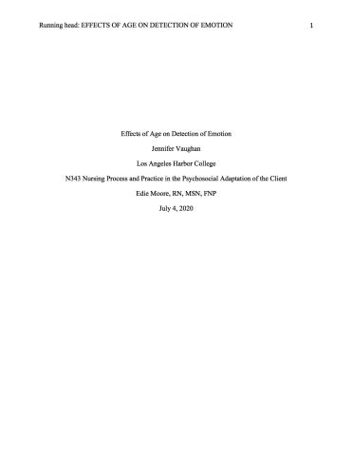
Title Page

Slide 4
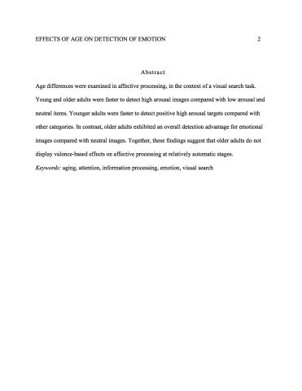
Subsequent Pages

Slide 5
APA Headings
APA Headings
Level | Format
1 | Centered, Boldface, Uppercase and Lowercase Headings
2 | Left-aligned, Boldface, Uppercase and Lowercase Heading
3 | Indented, boldface, lowercase heading with a period.
4 | Indented, boldface, italicized, lowercase heading with a period.
5 | Indented, italicized, lowercase heading with a period.

Slide 6
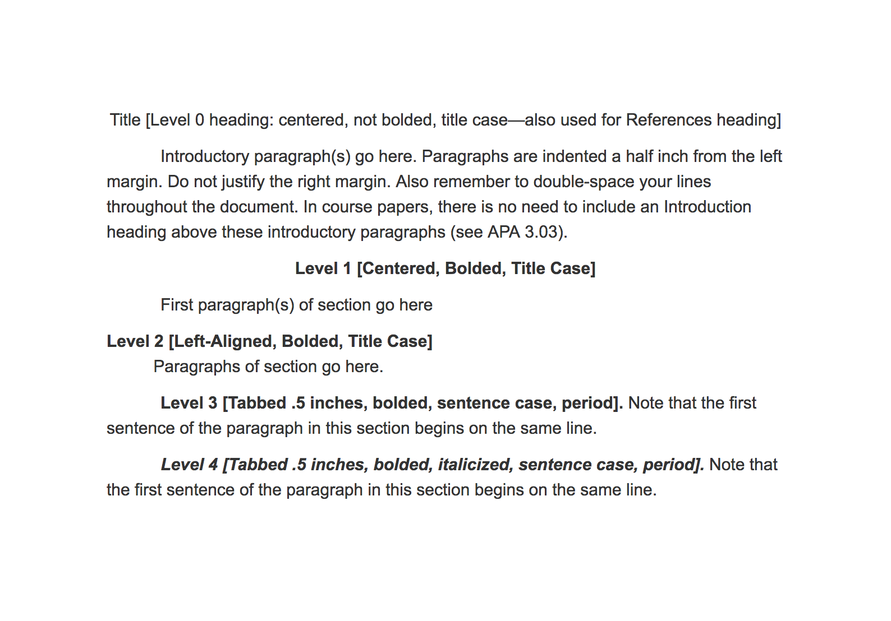
APA Headings Example

Slide 7
In Text Citations
One author
According to Jones (1998), "Students often had difficulty using APA style, especially when it was their first time" (p. 199).
She stated, "Students often had difficulty using APA style" (Jones, 1998, p. 199).
Two authors
Leiter and Maslach (1998) demonstrated
…….as has been shown (Leiter & Maslach, 1998).

Slide 8
In Text Citations
Three, four, or five authors
First time in your paper, put all three: Kahneman, Knetsch, and Thaler (1991) found…..
In all subsequent citations per paragraph, include only the surname of the first author followed by "et al." (Latin for "and others") and the year of publication: Kahneman et al. (1991) found…..
Six or More Authors
Use the first author's name followed by et al. in the signal phrase or in parentheses.
Harris et al. (2001) argued...
(Harris et al., 2001)

Slide 9
In Text Citation Examples
According to Palladino and Wade (2010), “a flexible mind is a healthy mind” (p. 147).
In 2010, Palladino and Wade noted that “a flexible mind is a healthy mind” (p. 147).
In fact, “a flexible mind is a healthy mind” (Palladino & Wade, 2010, p. 147).
“A flexible mind is a healthy mind,” according to Palladino and Wade’s (2010, p. 147) longitudinal study.
Palladino and Wade’s (2010) results indicate that “a flexible mind is a healthy mind” (p. 147).

Slide 10
References
Pay close attention to what is capitalized and what is not capitalized!

Slide 11
Book Reference Edited vs. Unedited
Basic Format for Books
Author, A. A. (Year of publication). Title of work: Capital letter also for subtitle. Location: Publisher.
American Psychiatric Association. (2013). Diagnostic and statistical manual of mental disorders (5th ed.). Arlington, VA: American Psychiatric Association.
Article or Chapter in an Edited Book/Edition Other Than the First
Author, A. A., & Author, B. B. (Year of publication). Title of chapter. In A. A. Editor & B. B. Editor (Eds.), Title of book (edition, pages of chapter). Location: Publisher.
O'Neil, J. M., & Egan, J. (2014). Men's and women's gender role journeys: A metaphor for healing, transition, and transformation. In B. R. Wainrib (Ed.), Gender issues across the life cycle (2nd ed., pp. 107-123). New York, NY: Springer.

Slide 12
Secondary Source Citation (Indirect Source Citation)
Secondary sources are acceptable within academic writing as long as they are kept to a minimum. You should use secondary sources only if you are unable to find or retrieve the original source of information. It is your academic responsibility to attempt to find the primary source and read it yourself.
You may want to site data from our textbook. Thus, it is your responsibility to find the reference at the back of the chapter. Attempt to pull it up directly and cite as a direct reference if you can find it. If you are unable to pull it up, then you can use the secondary/indirect reference citation
Be aware that your goal is no secondary sourcing, thus more than a few is a red flag to your reader that you are not doing sufficient research on your own

Slide 13
Secondary Source Citation (Indirect Source Citation)
According to Culver [Primary source-the one you don’t have] (as cited in Jones [secondary source-the textbook or article you are reading], 2009), learning APA "can be tough, but like any skill, it just takes practice" (p. 23). In addition, the mastery of APA increases an author's chance of scoring well on an assignment (Culver, as cited in Jones, 2009).
In your reference list:
Jones, J. (2009). Scholarly writing tips. Minneapolis, MN: Publishing House.
Example from our book:
In Giegling, Genius, Benninghoff, and Rujescu’s work (as cited in Herzog, 2014),
Then you would cite Herzog (our textbook- only -in your reference list)

Slide 14
Digital Object Identifier
A digital object identifier (DOI) is a unique string of letters, numbers, and symbols assigned to a published work to identify content and provide a persistent link to its location on the Internet. The DOI is typically located on the first page of an electronic document near the copyright notice and on the database landing page for the document. When DOIs are available, include them in the reference information. Place the DOI at the end of the reference, and don’t add a period at the end of it. Here’s an example:
Author, A. (year). Title of article. Journal Title, X, xxx–xxx. doi:xxxxxx

Slide 15
DOI vs. URL
If there is no DOI, then you should include the URL
DOI:
Caddy, C., Amit, B. H., McCloud, T. L., Rendell, J. M., Furukawa, T. A., McShane, R.,… Cipriani, A., (2015). Ketamine and other glutamate receptor modulators for depression in adults. Cochrane Database of Systematic Reviews. doi: 10.1002/14651858.CD011612.pub2
URL:
Kenneth, I. A. (2000). A Buddhist response to the nature of human rights. Journal of Buddhist Ethics, 8, 222-234. Retrieved from http://www.cac.psu.edu/jbe/twocont.html

Slide 16
Citation of Documentary
To cite a documentary properly, you must take the following pieces of information into consideration:
Documentary title
Name of the directors, producers (not executive producers) or writers
URL of the site, database, or streaming service that the documentary was found on Name of the production company
Publication date
City or country where the production company is based

Slide 17
AV Reference Online Documentary Single Production (vs. episode in a series)
Producer, P. P. (Producer), & Director, D. D. (Director). (Date of publication). Title of documentary [Documentary]. Country of origin: Studio or distributor. Retrieved from https://www.youtube.com/watch?v=UVaFSbn6lKs
LaVoo, G., & Brown, E. T. (Producers), & Cardozo, P. (Director). (2003). Real lives of people with depression [Documentary]. United States: Honey Studios. Retrieved from https://www.youtube.com/watch?v=UVaFSbn6lKs

Slide 18
Give examples of how to put this in a in-text reference
LaVoo, G., & Brown, E. T. (Producers), & Cardozo, P. (Director). (2003). Real lives of people with depression [Documentary]. United States: Honey Studios. Retrieved from https://www.youtube.com/watch?v=UVaFSbn6lKs
“depressed people are less likely to seek social support if they are male”

Slide 19
Correct Possiblities

Slide 20
Documentary – Single episode in a documentary series
Writer, W. W. (Writer), & Director, D. D. (Director). (Date of broadcast or copyright). Title of episode [Documentary series episode]. In P. Producer (Producer) Title of series. City, state of origin: Studio or distributor.
Eder, S. (Writer/Director). (2002). Flight from despair: Depression and mania [Documentary series episode]. In S. Eder (Producer), Fires of the mind. Princeton, NJ: Films for the Humanities & Sciences. Retrieved from https://www.youtube.com/watch?v=MdYc-CAMeEY

Slide 21
Government Authors
Online Publication U.S. Department of Health and Human Services, National Institutes of Health, National Institute of Mental Health. (2015). NIMH strategic plan for research (NIH Publication No. 02-2650). Retrieved from http://www.nimh.nih.gov/about/strategic-planning- reports/index.shtml
Web Page National Institute of Mental Health (2013). Eating disorders. Retrieved March 20, 2015, from http://www.nimh.nih.gov/health/topics/eating- disorders/index.shtml

Slide 22
Put in an in-text reference
National Institute of Mental Health (2013). Eating disorders. Retrieved March 20, 2013, from http://www.nimh.nih.gov/health/topics/eating- disorders/index.shtml
“Researchers are finding that eating disorders are caused by a complex interaction of genetic, biological, behavioral, psychological, and social factors.”

Slide 23
Correct Possiblilities

Slide 24
Nonperiodical Web Document or Report
Author, A. A., & Author, B. B. (Date of publication). Title of article. In Title of larger document/website. Retrieved (date if needed) from http://Web address
Melinda Ratini (2018). Painkillers and opioid use disorder. In WebMD. Retrieved July 25, 2019 from https://www.webmd.com/mental- health/addiction/painkillers-and-addiction-narcotic-abuse#2
Andrew. L. B.( 2014). Depression and suicide. In B. E. Brenner (Ed.) Medscape. Retrieved July 25 , 2019 from http://emedicine.medscape.com/article/805459-overview

Slide 25
Only Need the Reference Once in The Paragraph – Unintentional Plagiarism?
Biological
Enright and Ibrahim (2010) explain that there is a strong genetic link for eating disorders, such as AN. In fact, they report that “heritability in twins is greater than 50%” (Enright & Ibrahim, 2010, p. 347). This genetic vulnerability can, then, lead to “poor affect and impulse control or to an underlying neurotransmitter dysfunction” (Enright & Ibrahim, 2010, p. 347).
Neurobiological
Enright and Ibrahim (2010) contend that individuals with eating discords, such as AN, are likely to “exhibit personality traits of perfectionism, obsessive compulsiveness, and dysphoric mood” (Enright & Ibrahim, 2010, p. 347). These personality traits are likely to be found alongside changed levels of brain serotonin in individuals with AN which, then, contribute to “dysregulation of appetite, mood, and impulse control” (Enright & Ibrahim, 2010, p. 347).

Slide 26
Paragraph Hints
Body paragraphs should be 5 to 8 sentences, but not longer than 10 sentences. You might occasionally need to include a shorter 3 sentence paragraph but this should be rare.
Avoid run-on sentences…. also known as fused sentences. This occurs when two complete sentences are squashed together without using a coordinating conjunction or proper punctuation, such as a period or a semicolon. APA requires concise writing.
Do not put an extra “double space” between paragraphs. Every line in an APA document is double spaced.

Slide 27
APA Abbreviations
When abbreviating a term, use the full term the first time you use it, followed immediately by the abbreviation in parentheses.
Example: According to the American Psychological Association (APA), abbreviations are best used only when they allow for clear communication with the audience. APA can be used in this way on subsequent uses.
Exceptions: Standard abbreviations like units of measurement and states do not need to be written out. APA also allows abbreviations that appear as words in Merriam-Webster’s Collegiate Dictionary to be used without explanation (IQ, REM, AIDS, HIV)

Slide 28
APA Numbers
Numbers: write out numbers one through nine
(one, two, three, four, five, six, seven, eight, nine)
Exception – statistics or mathematical numbers
example - ok to use “2%” in your sentences
Write out a number that starts a sentence
Ninety-percent…..not: 90% of patients
Three thousand participants……

Slide 29
Our Textbook – Put Into APA (pay attention to capitalization)
Go to Chapter 3 and attempt to put into this format
Chapter Author, A. A., & Chapter Author, B. B. (Year of publication). Title of chapter. In A. A. Editor & B. B. Editor (Eds.), Title of book (edition, pages of chapter). Location: Publisher.

Slide 30
Correct Format

Slide 31
Let’s Find the Errors
Leucht, C., Heres, S., Kane, J., Kissling, W., Davis, J., & Leucht, S. (n.d.). Oral versus depot antipsychotic drug for schizophrenia [ schizophr Res. 2011]- PubMed- NCBI. National Center for Biotechnology Information. Retrieved April 26, 2013 from http:// www.ncbi.nlm.nih.gov/pubmed/21257294

Slide 32
Here’s the Raw Information
Schizophr Res. 2011 Apr;127(1-3):83-92. doi: 10.1016/j.schres.2010.11.020. Epub 2011 Jan 22. Oral versus depot antipsychotic drugs for schizophrenia--a critical systematic review and meta-analysis of randomised long-term trials.
Leucht C, Heres S, Kane JM, Kissling W, Davis JM, Leucht S.
Now put into APA……

Slide 33
Correct Format
Give examples of above in an in-text reference

Slide 34
Correct Possibilities

Slide 35
Find the errors. Is this article appropriate to use in your paper? Why or why not?
MacPherson, M. (2009). Psychological causes of Schizophrenia 35 (2):284-286. Retrieved from http://www.medscape.com/viewarticle/706242

Slide 36
Raw Information
Schizophrenia Bulletin
Psychological Causes of Schizophrenia
M. MacPhersonDisclosures
Schizophr Bull. 2009;35(2):284-286.
Format: Author, A. A., & Author, B. B. (year of publication). Title of article [Special Description]. Title of Online Periodical, volume number(issue number if available), page numbers. doi

Slide 37
Correct Format

Slide 38
Find the Errors
Javitt, D. C. (2007). Glutamate and schizophrenia: phencyclidine, N-methyl-D-aspartate receptors, and dopamine-glutamate interactions. In Pubmed. Retrieved April 24,2013 from http:// www.ncbi.nlm.nih.gov/pubmed/17349858

Slide 39
Raw Information
Int Rev Neurobiol. 2007;78:69-108.
Glutamate and schizophrenia: phencyclidine, N-methyl-D-aspartate receptors, and dopamine-glutamate interactions.
Javitt DC.
Author, A. A., & Author, B. B. (Date of publication). Title of article. Title of Journal, volume number, page numbers. Http address or doi

Slide 40
Correct Format

Slide 41
Find the Errors and Put in APA
Student reference:
DJ, H. (2012). Serotonin neurotransmission in anorexia nervosa. Abstract retrieved from PubMed.
Website info, note the doi:
Behav Pharmacol. 2012 Sep;23(5-6):478-95. doi: 10.1097/FBP.0b013e328357440d.
Serotonin neurotransmission in anorexia nervosa.
Haleem DJ.

Slide 42
Correct Format

Slide 43
Put into APA Is this appropriate for your paper? Why or why not?
Post-traumatic stress disorder (PTSD). (2014). Retrieved from http://www.mayoclinic.com/ health/post-traumatic-stress-disorder/DS00246/ DSECTION=symptoms

Slide 44
Correct Format

Slide 45
Put into APA style. Can you find the doi? If so, should you use the url or doi?
Paul Lichtenstein, Benjamin H Yip, Camilla Björk, Yudi Pawitan, Tyrone D Cannon, Patrick F Sullivan, Christina M Hultman. (2009). Common genetic determinants of schizophrenia and bipolar disorder in Swedish families: a population-based study. Retrieved from http:// 211.144.68.84:9998/91keshi/Public/File/ 36/373-9659/pdf/1-s2.0-S0140673609600726- main.pdf

Slide 46
Correct Format

Slide 47
What do you think about this reference? Is it appropriate? Why or why not?
Mahmood, F. (2008, January 17). Bipolar disorder. In Srendip. Retrieved February 17, 2013, from http:// serendip.brynmawr.edu/exchange/node/1899

Slide 48
Correct the Format
Barton DA, Esler MD, Dawood T, et al. Elevated Brain Serotonin Turnover in Patients With Depression: Effect of Genotype and Therapy. Arch Gen Psychiatry. 2008;65(1):38-46.
Here it the information from the website: http://www.ncbi.nlm.nih.gov/pubmed/18180427
Arch Gen Psychiatry. 2008 Jan;65(1):38-46. doi: 10.1001/archgenpsychiatry.2007.11.
Elevated brain serotonin turnover in patients with depression: effect of genotype and therapy.
Barton DA, Esler MD, Dawood T, Lambert EA, Haikerwal D, Brenchley C, Socratous F, Hastings J, Guo L, Wiesner G, Kaye DM, Bayles R, Schlaich MP, Lambert GW.

Slide 49
Correct Format

Slide 50
Our textbook! Find the Errors…..
Halter, M. (2018). Anxiety and Obsessive-Compulsive Disorders. In Varcarolis' Foundations of Psychiatric Mental Health Nursing (8th ed., pp. 270-293). St. Louis, Missouri: Elsevier.

Slide 51
Correct Format All should have correct on your paper!!!

Slide 52
Web Resources for APA Style
American Psychological Association:
http://www.apastyle.org/
Purdue Owl APA:
https://owl.english.purdue.edu/owl/resource/560/01/
Red Deer College Library:
http://rdc.libguides.com/content.php?pid=51657&sid=379147
Los Angeles Harbor College Library Webpage:
http://libguides.lahc.edu/apa

Slide 53
Finding Research Articles
LAHC Library - http://libguides.lahc.edu/library PubMed - http://www.ncbi.nlm.nih.gov/pubmed
Evidence-Based Mental Health (open access) - http://ebmh.bmj.com/
Google search your subject of interest

