Slide 1
Stress Responses and Stress Management
Chapter 10

Slide 2
Objectives
Recognize
Recognize the short- and long-term physiological consequences of stress.
Compare and contrast
Compare and contrast Cannon’s (fight-or-flight) and Selye’s (general adaptation syndrome) models of stress.
Describe
Describe how responses to stress are mediated through perception, individual temperament, social support, support groups, culture, spirituality, and religion.

Slide 3
Case Study
Maggie, a college student, is experiencing stress in her life.
“I don’t know what to do,” she says. “I mean, this is supposed to be this awesome, exciting time in my life—finally going to college. I love college. I love being a student. But honestly, trying to juggle my schoolwork, job responsibilities, and single parenting is starting to make me feel pulled in a million directions at once!”

Slide 4
Adverse Childhood Experiences
ACEs: Sensitize people to stress in later life; These include:
Any form of psychological, physical, and sexual abuse
Violence against a parent, particularly the mother
Living with people with substance use disorders, mentally ill, or ever incarcerated

Slide 5
Early Stress-Response Theories

Slide 6
Fight-or-Flight Response
Body prepares for situation that individual perceives as threat to survival
Increased blood pressure, heart rate, respirations, and cardiac output
New research indicates that men and women have different neural responses to stress

Slide 7
General Adaptation Syndrome (GAS)
Alarm or acute stress stage
Activates sympathetic nervous system
Activates HPA axis to stay on alert
Resistance or adaptation stage
Sustained and optimal resistance to the stressor; recovery, repair, and renewal may occur.
Exhaustion stage
Resources are depleted; the stress may become chronic

Slide 8
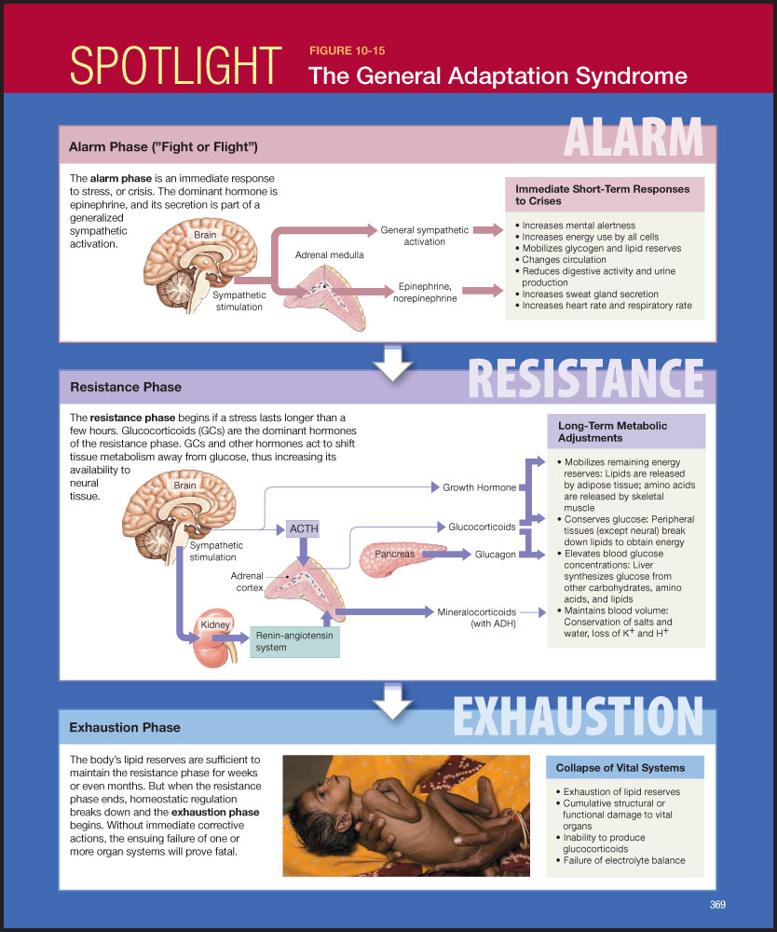

Slide 9
Bad Stress Versus Good Stress?
Distress: Negative draining energy that results in anxiety, depression, confusion, helplessness, hopelessness, and fatigue.
Eustress: Normal physiological positive energy that motivates individuals and results in positive feelings and purposeful movement

Slide 10
Case Study
Maggie, our college student, is aware that she needs help. On the three afternoons a week before she starts classes, she has lunch with her 2-year-old daughter on campus than goes to a yoga class right on campus that also provides child care. After yoga, her sister picks up her daughter, and Maggie goes on to class.
“I’m trying,” Maggie says. “It’s still not easy, and I still feel a bit overloaded, but this is at least making some difference! It’s a start, a step.”

Slide 11
Case Study/ Audience Response Questions
Which stage of GAS is Maggie most likely experiencing?
Alarm
Resistance
Exhaustion
Life-stressors

Slide 12
Immune System Stress Responses
Interaction between nervous system and immune system during alarm phase of GAS
Hypothalamic-pituitary-adrenal axis
Sympathetic-adrenal-medullary axis
Excess cytokines causes systemic inflammation
Negatively affects body’s ability to produce protective factors
Links exist among stress (biopsychosocial), the immune system, and disease

Slide 13
Reactions to acute and chronic stress
Acute Stress | Chronic Stress
Uneasiness and concern | Anxiety/Panic attacks
Sadness | Major depressive disorder
Loss of appetite | Anorexia or overeating
Suppression of the immune system | Increased opportunistic infections
Increased metabolism/use of body fats | Insulin resistant diabetes
Increased cardiovascular tone | Risk of heart attack, stroke, sudden death
Increased cardiopulmonary tone | Increased respiratory problems

Slide 14
Mediators of the Stress Response
Stressors
Physiological (environmental/physical)
Psychological (stressful events)
Perception
Individual temperament
Social support
Support groups
Culture
Spirituality and religion

Slide 15
Audience Response Questions
Which reaction to stress is healthy?
Distress
Eustress
Stressor
None of the above.

Slide 16
Nursing Management of Stress Responses

Slide 17
Nursing Management of Stress Responses
Measuring stress
Recent Life Changes Questionnaire
Perceived Stress Scale

Slide 18
Nursing Management of Stress Responses (Cont.)
Assessing coping styles
Health-sustaining habits
Life satisfaction
Social supports
Effective and healthy responses to stress

Slide 19
Case Study
As Maggie continues to develop ways to manage stress in her life she works at developing these four coping styles as much as possible. Already, the yoga class and lunch with her daughter has become an effective and healthy response to stress that is also health-sustaining.
In the area of social support, she relies not just on her sister but on a group of single-parent students she finds on campus who meet to share things that work for them.

Slide 20
Managing Stress Through Relaxation Techniques
Biofeedback
Deep breathing exercises
Guided imagery
Progressive relaxation
Meditation
Mindfulness

Slide 21
Managing Stress Through Relaxation Techniques (Cont.)
Physical exercise
Cognitive reframing
Journaling
Humor
Assertiveness Training

Slide 22
More Effective Stress Busters
Sleep
Reduction or cessation of caffeine intake
Music
Pets
Massage

Slide 23
Audience Response Questions
In GAS, which stage occurs first?
Alarm
Resistance
Exhaustion
Exposure

