Slide 1
Mental Health and Mental Illness
Chapter 1

Slide 2
Objectives
Define
Define mental health and mental illness.
Describe
Describe the continuum of mental health and mental illness.
Discuss
Discuss risk and protective factors for mental illness and mental health.
Explore
Explore the role of resilience in the prevention of and recovery from mental illness and consider resilience in response to stress.
Identify
Identify how culture influences the view of mental illnesses and behaviors associated with them.

Slide 3
Mental Health
•A state of well-being
•Able to recognize own potential
•Cope with normal stress
•Work productively
•Make contribution to community

Slide 5
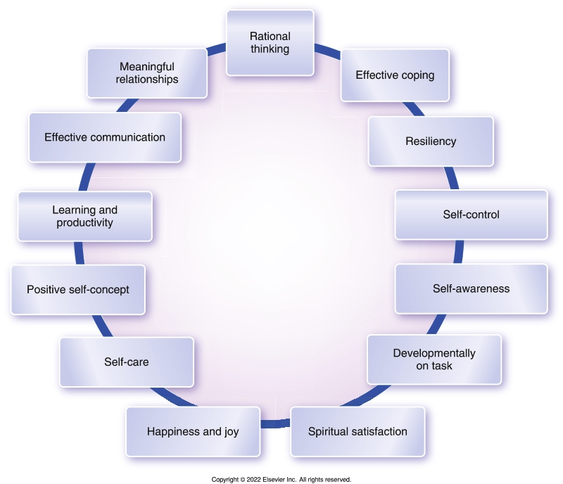
Attributes of Mental Health

Slide 6
Mental Illness
Psychiatric disorders with definable diagnoses
Significant dysfunction in mental functioning related to
Developmental
Biological
Physiological disturbances
Culturally defined
Diagnostic and Statistical Manual of Mental Disorders, 5th ed. (DSM-5)
Root of most mental disorders lies in intercellular abnormalities
Mental illness versus physical illness

Slide 7
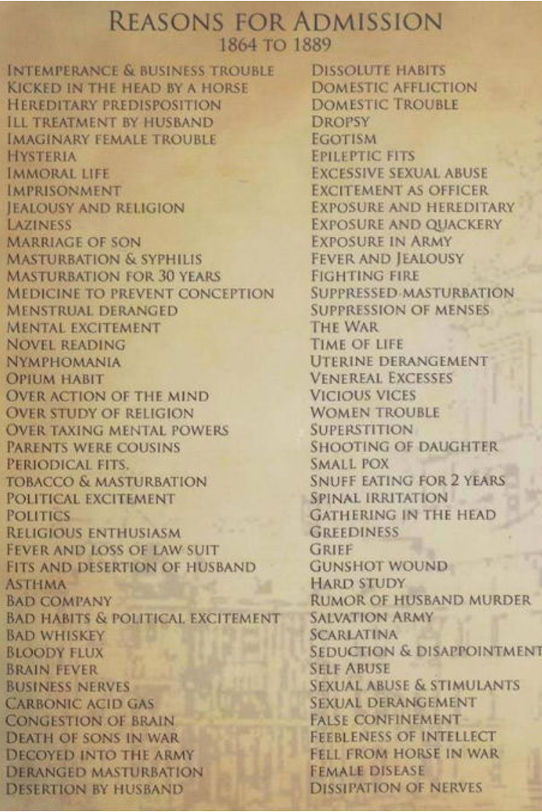
This Photo by Unknown author is licensed under CC BY.

Slide 8
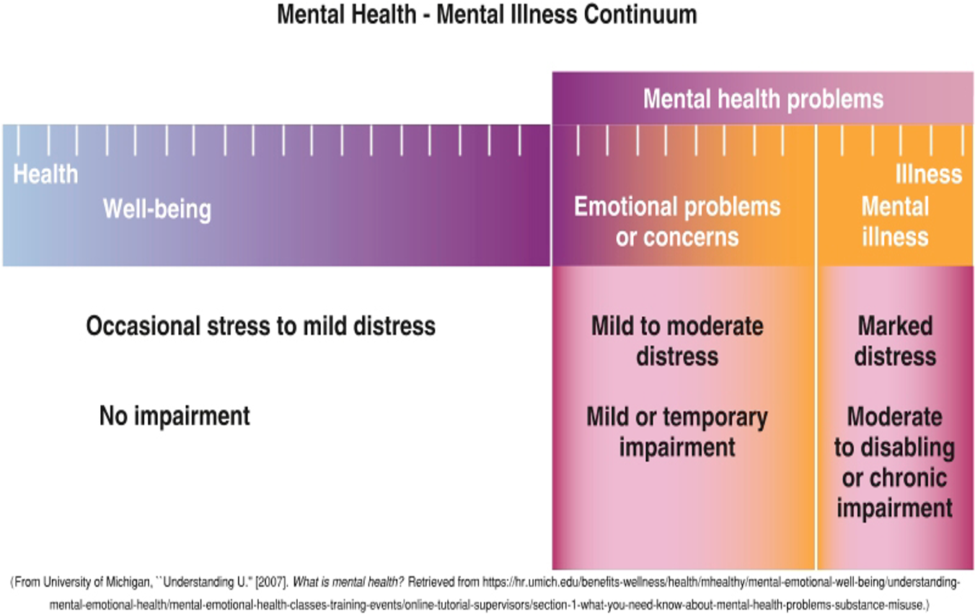
Mental Health Continuum
Mental Health versus Mental Illness
A real middle ground exists: Stress and discomfort from everyday life
Conceptualized as points along a mental health continuum

Slide 9
Case Study
Mrs. M comes to the clinic reporting a feeling of hopelessness. She works full time and is dealing with a troubled teenage son and her elderly parents. She confides in you that she “can’t deal with her life right now.”
Discuss attributes you might screen for to quickly assess her overall mental health.
This Photo by Unknown author is licensed under CC BY-NC-ND.

Slide 10
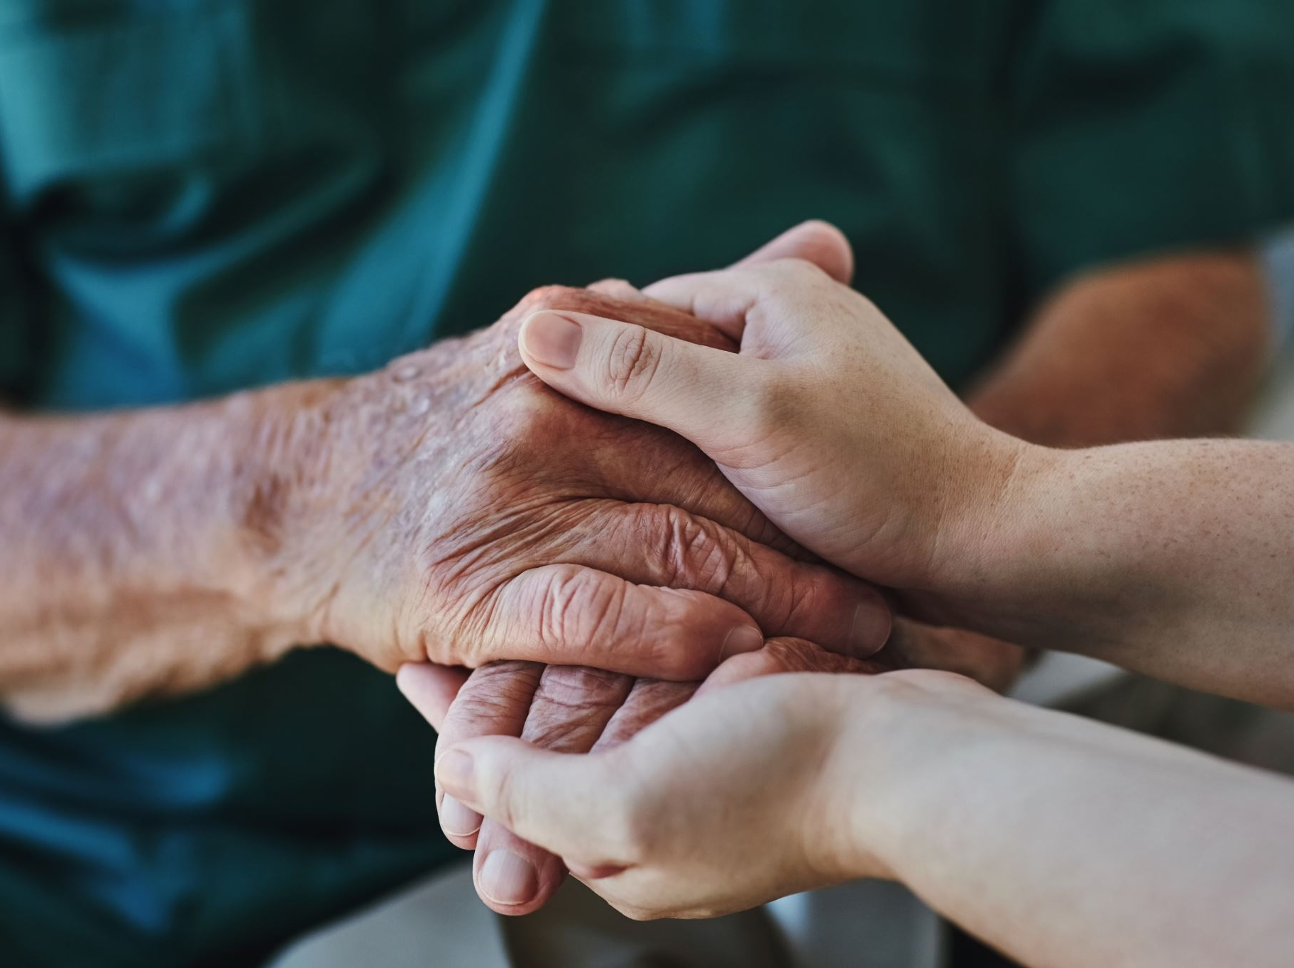
Individual Attributes and Behaviors
Resilience
Ability and capacity to secure resources needed to support well-being
Characterized by
Ability to secure needed resources
Capacity for regulating one’s own emotions and overcoming negative, self-defeating thoughts
Optimism
Essential to recovery

Slide 11
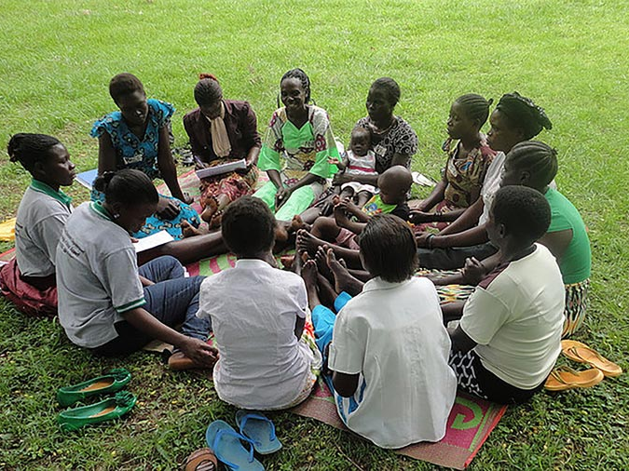
Risk and Protective Factors
Social and economic circumstances
Family
Schools and peer groups
Socioeconomic status
Educational advancement
Environmental factors
Political climate & cultural considerations
Social & economic policies
This Photo by Unknown author is licensed under CC BY-NC-ND.

Slide 12
Diathesis-Stress Model
Diathesis—biological predisposition
Stress—environmental stress or trauma
Most accepted explanation for mental illness
Combination of genetic vulnerability and negative environmental stressors
Assertion: Most psychiatric disorders result from a combination of genetic vulnerability and negative environmental stressors

Slide 13
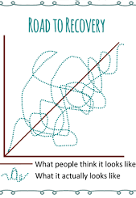

Slide 14
Audience Response Question
According to SAMHSA, in 2019 how many Americans experienced a mental health illness?
10%
25%
20%
60%

Slide 15
Audience Response Question
What characteristic would indicate a potential block to resilience?
A. Pessimism
B. Creativity
C. Emotional regulation
D. Sense of mastery

Slide 16
Audience Response Question
Which of the following mental health challenges has the highest annual prevalence in the United States?
Major depressive disorder
Schizophrenia
Anxiety disorders
Bipolar disorder

Slide 17
Audience Response Question
How should we refer to a newly admitted patient with schizophrenia?
The schizo patient
The schizophrenic patient
The patient in room 528
The person with schizophrenia

Slide 18
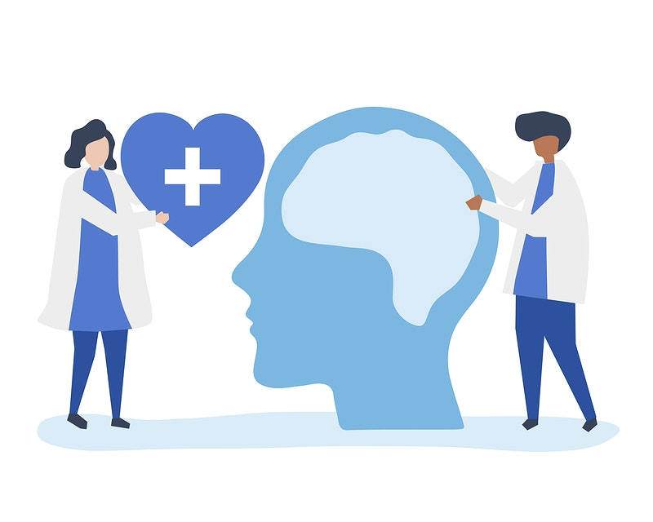
Psychiatric Mental Health Nursing
Promoting mental health through assessment, diagnosis, and treatment of behavioral and mental disorders
Use nursing, psychosocial, neurobiological theories and research
Work with people throughout the life span
Employed in a variety of settings and among varied populations

Slide 19
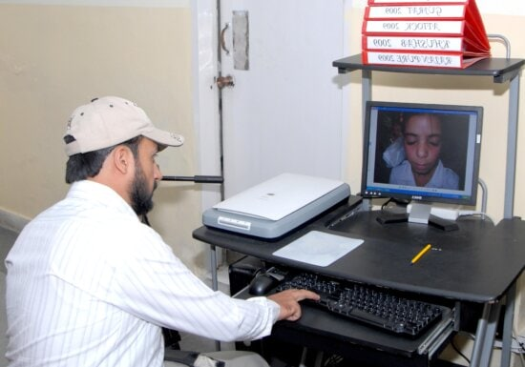
Electronic Healthcare
Telehealth became widely accepted due to the COVID-19 pandemic
Able to reach underserved populations
Able to reach patients in rural areas
Reduces the barriers due to stigma
Can serve those who are homebound due to physical or mental disabilities

Slide 20
Psychiatric-Mental Health Nurse Education Levels
Basic Level
Psychiatric mental health registered nurse (PMH-RN)
2 years full-time work, 2000 clinical hours, 30 hours continuing education, followed by certification exam to add “BC” to the RN title (RN-BC)
Advanced Practice
Psychiatric-mental health advanced practice registered nurse (PMH-APRN)
Master of Science (MSN) or Doctor of Nursing Practice (DNP)

Slide 21
National Patient Safety Goals for Behavioral Health Care
Identify
Identify individuals served correctly
Use two identifiers
Use
Use medicines safely
Prevent
Prevent infection
Always follow universal precautions
Identify
Identify individuals served safety risks
Assess for suicidal ideation

Slide 22
Mental Health Resources
National Alliance on Mental Illness(NAMI)
NAMI works to educate, support, advocate, listen and lead to improve the lives of people with mental illness and their loved ones.
Mental Health America (MHA)
The nation's leading community-based nonprofit dedicated to addressing the needs of those living with mental illness and to promoting overall mental health.
Project Return Peer Support Network (PRPSN)
PRPSN’s diverse programs are on the cutting edge of peer provided services and are designed to support people at various places in their recovery process.
Warm Line-(English and Spanish) 888-448-9777
Substance Abuse and Mental Health Services Administration (SAMHSA)
An agency within the U.S. Department of Health and Human Services that leads public health efforts to advance the behavioral health of the nation. SAMHSA's mission is to reduce the impact of substance abuse and mental illness on America's communities.
National suicide and crisis lifeline – changed to 988
Many other local agencies including
Didi Hirsh Mental Health Services – free mental health and substance use disorder treatment
LA County Department of Mental Health – focuses on severe mental illness and underserved youth

