Slide 1

Substance-Related and Addictive Disorders
Chapter 22

Slide 2
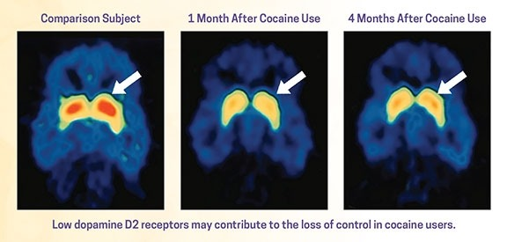
National Institute on Drug Abuse (NIDA)
What Is Addiction?
  Chronic relapsing brain disease involving functional changes to brain circuits that disrupt normal health brain function
  Not a disorder of choice
  Similar to diabetes, asthma, heart disease, it can be managed successfully
  Relapse is not a failure- treatment needs to be reinstated, adjusted, or altered

Slide 3
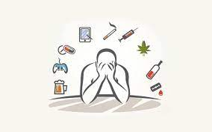
Substance Use Disorder (SUD)
Pathological use of a substance that leads to a disorder of use.
Characterized by
  Compulsive substance seeking and use
  Substance use despite harmful consequences
  Tendency to relapse

Slide 4
Substances That Lead to
Use Disorders
Alcohol
Caffeine
Cannabis
Hallucinogen
Inhalant
Opioid
Sedative-hypnotic
Stimulant
Tobacco
Other: Process addictions—Gambling, shopping, sex, etc.

Slide 5
Concepts Central to Addictive Use Disorders
Intoxication
Tolerance
Withdrawal
Synergistic effects
Antagonistic effects

Slide 6
Risk Factors
Genetic factors
Neurobiological factors
Environmental factors

Slide 7
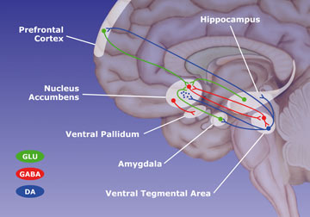
The Brain Reward Pathway

Slide 8
Epidemiology
Substance Use Disorder
  22 million people have SUD
  45 million are directly impacted by SUD
  23 million people are in recovery
  1 in 3 households are impacted by SUD
  Marijuana and pain relievers are the most commonly used substances
  Fentanyl

Slide 9
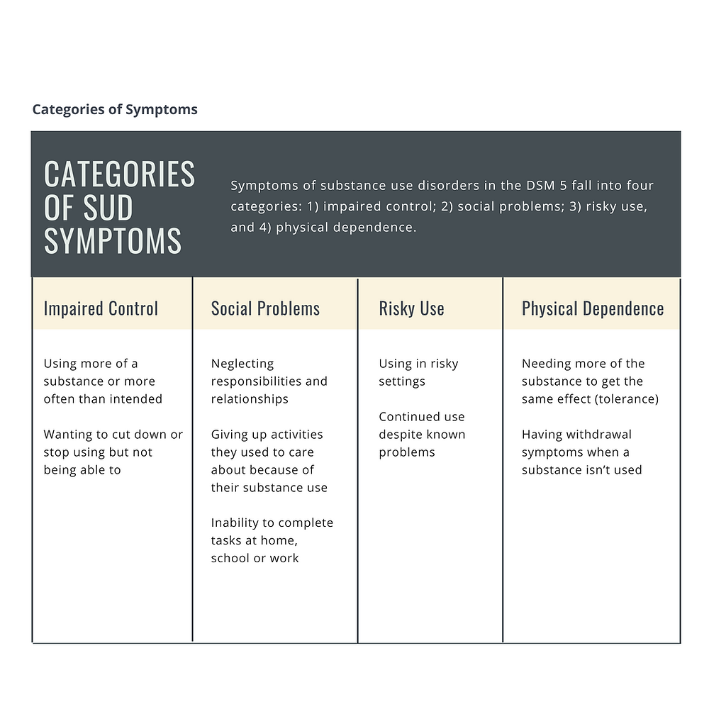

Slide 10
Comorbidity
Co-occurring disorder
  Any combination of two or more substance use disorders and mental disorders
  Occurs in approximately 50% of those with SUD and visa versa
  Schizophrenia
  Bipolar disorder
  Attention deficit disorder
  Borderline and antisocial personality disorders
  Anxiety disorders
  Depression
    High risk for suicide
  Eating disorders
  Compulsive behavior

Slide 11
Comorbidity (cont.)
Social comorbidity
  Crime
  Auto accidents/deaths
  Suicide
  Rape and domestic abuse
  Individual and family dysfunction
  Work productivity
  Social relationships

Slide 12
Medical Comorbidity
Cocaine abusers
Extreme weight loss
Malnutrition
Myocardial infarction
Stroke
Intravenous drug users
Infections and sclerosing of veins
HIV, Hepatitis C
Intranasal users
Sinusitis, perforated nasal septum
Smoking a substance
Respiratory problems

Slide 13
Medical Comorbidity (cont.)
Alcohol
  Peripheral neuropathy
  Alcoholic myopathy and cardiomyopathy
  Esophagitis, gastritis, and pancreatitis
  Alcoholic hepatitis
  Cirrhosis of the liver
  Leukopenia
  Thrombocytopenia
  Cancer (head and neck)
  Tuberculosis

Slide 14
Wernicke-Korsakoff syndrome
(Alcohol Amnestic disorder)
Wernicke’s encephalopathy
Early phase of the syndrome
Degenerative brain disorder cause by lack of thiamine (B1)
Symptoms include mental confusion, vision impairment, stupor, coma, hypothermia, hypotension, and ataxia
Korsakoff’s psychosis
Late phase of the disorder
Also caused by lack of thiamine
The heart, nervous and vascular system are involved
Symptoms include amnesia, confabulation, attention deficit, disorientation and visual impairment

Slide 15
Wernicke-Korsakoff Syndrome (Cont.)
Treatment
Thiamine replacement
Proper hydration and nutrition
Prognosis
Most symptoms can be reversed if detected and treated promptly
Improvement in memory function is slow and, usually, incomplete
Without treatment, these disorders can be disabling and life-threatening.

Slide 16
Alcohol Use in the Elderly
Hidden epidemic in the elderly
20% of hospitalized elderly patients have serious EtOH problems (compared to 10% in the normal population)
May be r/t stress of aging, retirement, widowhood, loneliness, isolation
Risk Factors: male, single, less than a high school education, low income, smoking
Treatment protocols
Signs of alcohol abuse

Slide 17
Medical Comorbidity
Continued
Marijuana (Cannabis sativa)
  Lung inflammation
    50% more tar than cigarettes
    Lung cancer?
  Increases heart rate
  Use during gestation/lactation
  Affects brain development in teens
  Mental effects
  Quality of life
  Addictive?

Slide 18
Medical Marijuana
Active ingredients
Cannabinoids (CBD)
Tetrahydrocannabinol (THC)
FDA Approval
Conditions of interest
Pain (neuropathic pain)
Nausea and vomiting
Glaucoma
AIDS wasting syndrome
Cancer
Multiple sclerosis
Seizure

Slide 19
Case Study
Antony, 20, was found badly beaten and semi-conscious in an alley. He had passed out and vomited and was brought by police to the ED with a blood alcohol level of 0.15%. When he awakened, he looked around the ED environment and panicked and struggled to get up. When the staff calmed him down, he struggled not to cry and said, “Why didn’t you just leave me there? Why didn’t you just let me die?”

Slide 20
Effects of Alcohol
Sedative – CNS depressant
Absorbed in mouth, stomach, small intestine
95% broken down by the liver
Excreted through lungs, kidneys, skin
Metabolize 30 ml ETOH every 90 minutes
Absorption varies
Weight, intake of food, liver function

Slide 21
Alcohol Intoxication
BAL (mg %) Effect in Nontolerant Drinker
.01-.06 Change in mood, behavior, and impaired judgment
.06-.10 Loss of inhibition, extroversion, depth perception impaired, reasoning impaired
.11-.20 Staggering, ataxia, emotional lability, reaction time/speech impaired
.21-.29 Stupor, blackouts, motor skills impaired
.30-.39 Severe depression, unconsciousness, breathing and heart rate impaired
0.40 Coma
0.50 Death from respiratory depression

Slide 22
Alcohol - Signs of Intoxication and Withdrawal
Alcohol poisoning
Large amounts of alcohol consumed quickly or over time
Alcohol withdrawal
Signs develop within a few hours after cessation
Peaks at 24 to 48 hours
Alcohol withdrawal delirium
Medical emergency
Can result in death, even if treated

Slide 23
Alcohol Withdrawal
Withdrawal
Early signs a few hours after decreasing alcohol
Signs peak after 24 to 48 hours then rapidly disappear
Signs and symptoms
Nausea/vomiting
Diaphoresis
Hyper alertness, insomnia
Tremor and jerky movements
Irritability, anxiety
Easily startled
BP, pulse , temperature all rise

Slide 24
Alcohol Withdrawal Delirium
Signs and symptoms:
Tachycardia, diaphoresis, elevated blood pressure
Disorientation and delirium
Visual or tactile hallucinations
Hyperexcitability to lethargy
Paranoid delusions, illusions, agitation
Fever (100° F to 103° F)
Grand Mal seizures
To reduce patient's anxiety
Orient to time and place
Clarify illusions to reduce patient's terror

Slide 25
Acute alcohol withdrawal treatment
Benzodiazepines
Lorazepam
Chlordiazepoxide
Diazepam
Clinical Institute Withdrawal Assessment Alcohol Scale Revised (CIWA-AR)
Used in patients suspected of being at risk for alcohol withdrawal
Can administer every 1-2 hours until clinical suspicion is realized or disproven

Slide 26
Psychopharmacology:
Treatment alcohol use disorder
Naltrexone (ReVia/Vivitrol)
Reduces or eliminates alcohol craving
Acamprosate (Campral)
Helps patient abstain from alcohol
Disulfiram (Antabuse)
Alcohol-disulfiram reaction causes unpleasant physical effects
Topiramate (Topamax)
Works to decrease alcohol cravings

Slide 27
Audience Response Question
A nurse is assigned the care of four patients who are detoxifying from alcohol. The patient with which symptom would be the nurse’s highest priority?
Fine motor tremors
Diaphoresis
Diarrhea
Hallucinations and delusions

Slide 28
Opiates use disorder
Morphine
Heroin
Codeine
Fentanyl
Methadone
Meperidine
Intoxication Effects
Miosis (‘pinned’ pupils) Decreased respiration Hypotension Bradycardia Slurred speech Drowsiness (‘on the nod’) Psychomotor retardation Initial: euphoria Later: dysphoria Impaired: Concentration Judgment Memory
Withdrawal Effects
Yawning Insomnia Irritability Rhinorrhea Panic Diaphoresis Cramps Nausea and vomiting Muscle aches Chills and fever Lacrimation Diarrhea

Slide 29
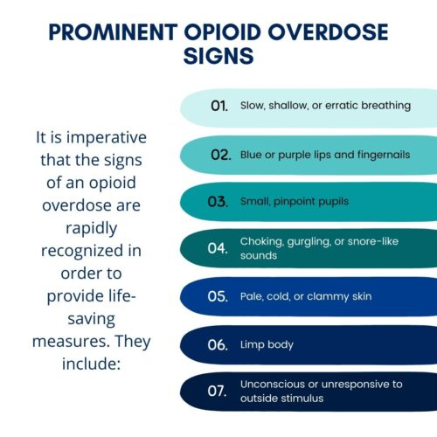

Slide 30
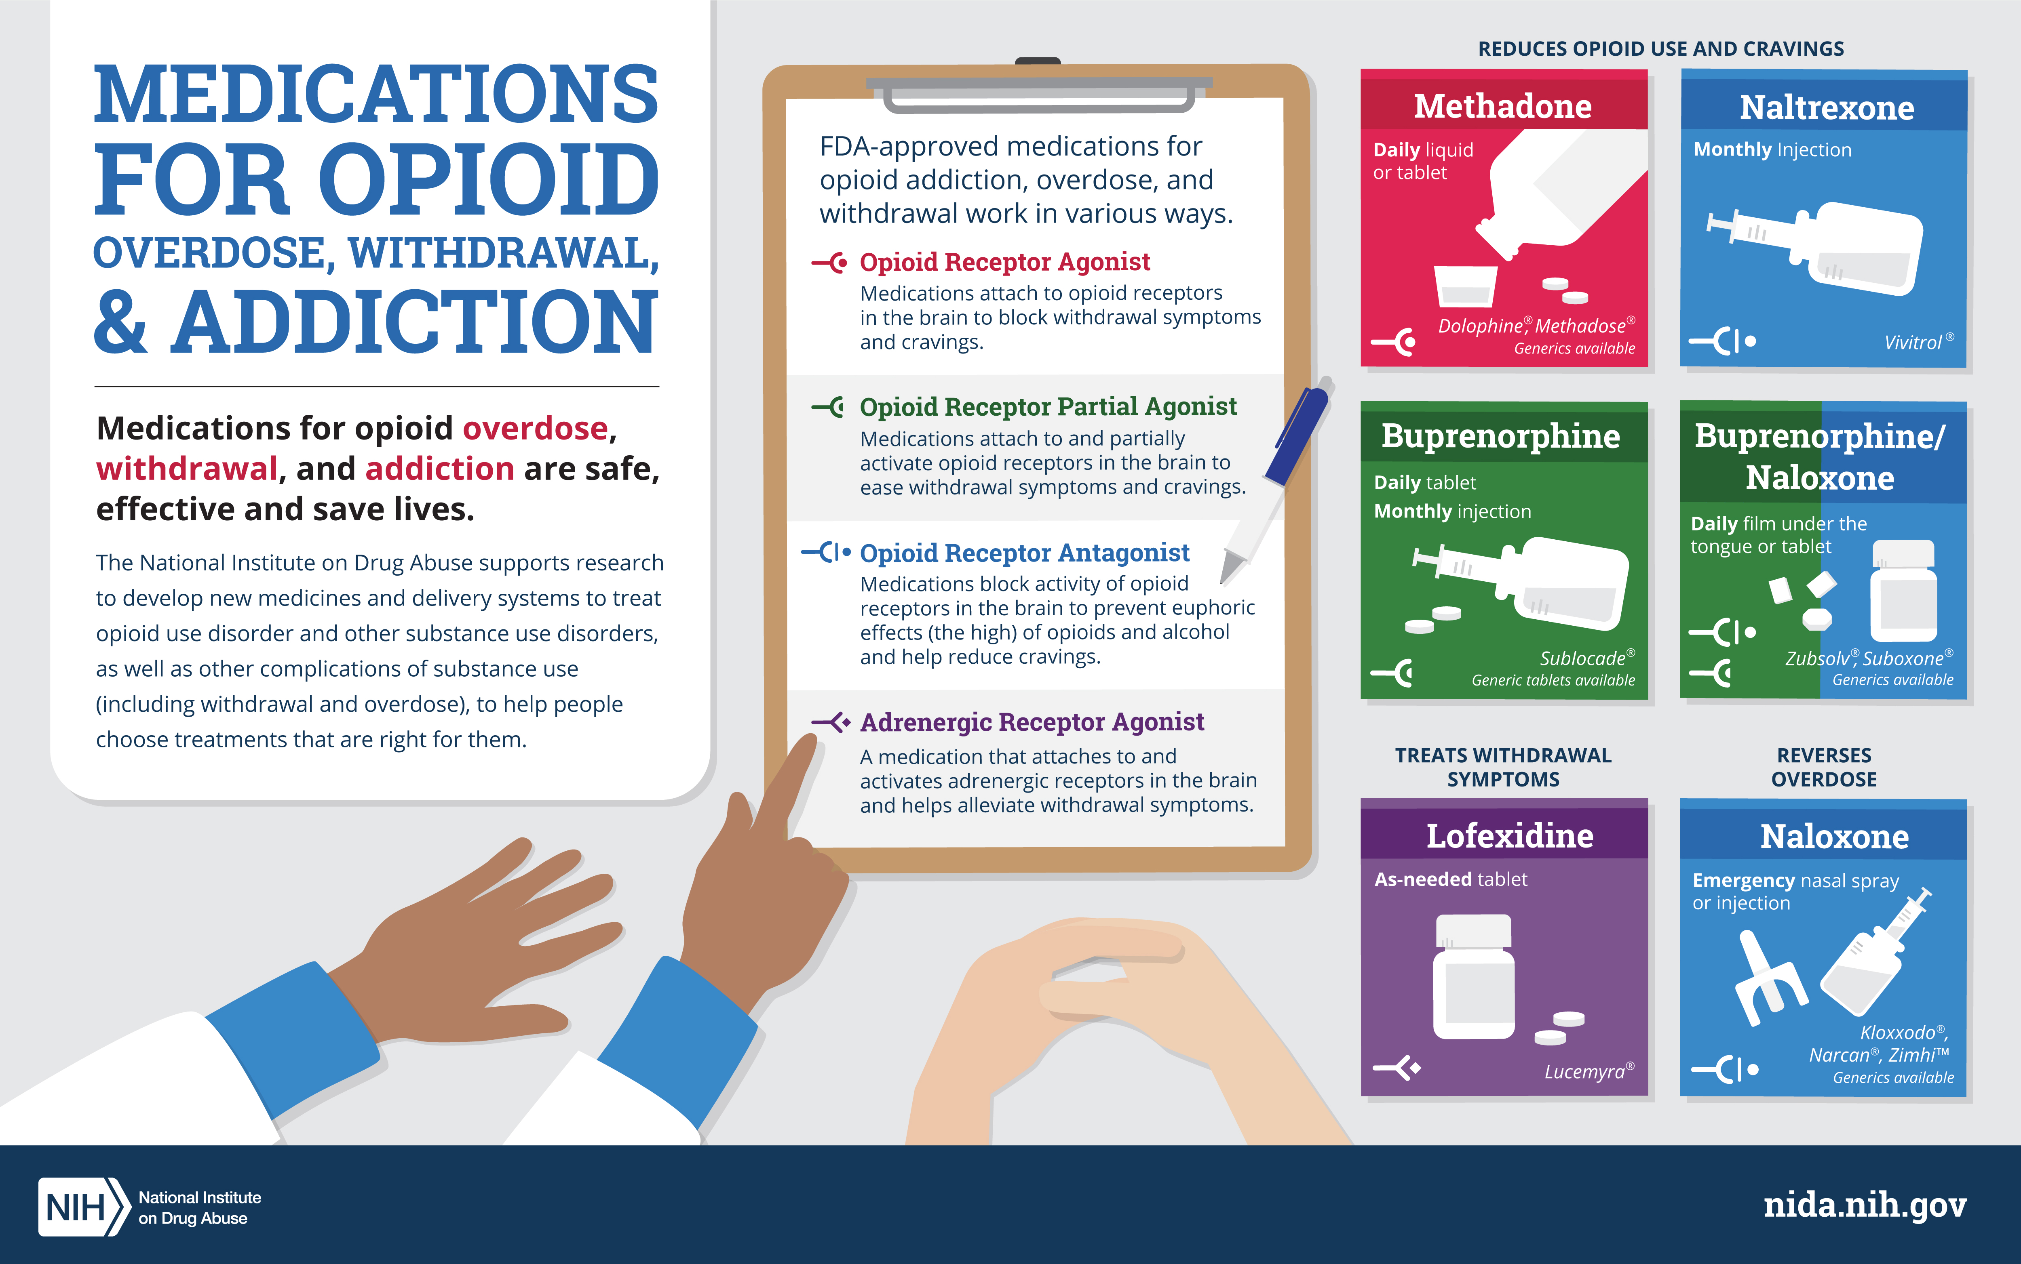

Slide 31
Audience Response Questions
A person has recently abused morphine. The person’s pupils would most likely be
  dilated
  constricted
  asymmetrical
  unresponsive to light

Slide 32
CNS Depressants:
Benzodiazepines, Sedative-Hypnotics, Barbiturates, ETOH
Intoxication
Slurred speech, incoordination, ataxia, drowsiness, disinhibition of sexual and aggressive impulses (GABA effect), impaired judgment, attention and memory disturbances
Withdrawal
Nausea, vomiting
Tachycardia
Diaphoresis
Anxiety, irritability
Tremors (hands, fingers, eyelids_
Grand mal seizures

Slide 33
CNS Depressants:
Benzodiazepines, Sedative-Hypnotics, Barbiturates, ETOH (Continued)
Overdose
  Cardiovascular or respiratory depression
  Coma
  Shock
  Convulsions
  Death
Treatment
  Caution: abrupt withdrawal can lead to death
  Withdrawal: Carefully titrated detox with similar drug
  Overdose: Gastric lavage

Slide 34
CNS Stimulants: Cocaine, Crack,
Methamphetamine and Amphetamines
Intoxication
Dilated pupils
Tachycardia, elevated blood pressure
Nausea, vomiting
Insomnia
Assaultive, potential for violence
Impaired judgment, social and occupational functioning
Euphoria, paranoia, delusions, hallucinations, psychosis
Severe to panic levels of anxiety
Overdose
Respiratory distress
Ataxia
Hyperpyrexia
Convulsions
Coma
Stroke, Myocardial Infarction
Death

Slide 35
CNS Stimulants: Cocaine, Crack,
Methamphetamine and Amphetamines (Continued)
Withdrawal
Fatigue, lethargy
Depression
Agitation, disorientation
Apathy
Anxiety
Sleeplessness
Craving
Treatment
Symptomatic, supportive

Slide 36
Hallucinogens
(Cont.)
LSD, Mescaline, Psilocybin
Intoxication
Pupil dilation
Elevated pulse, temperature, respiration
Diaphoresis
Palpitations
Tremors
Incoordination
Paranoia, fear of going crazy, grandiosity, depersonalization
Synesthesia, hallucinations
Overdose
Psychosis
Brain damage
Death
Treatment
Supportive, anxiolytics
Minimal stimuli
Speak slowly and clearly in a low voice
Have one person stay with patient to “talk down” and reassure

Slide 37
Hallucinogens
(Cont.)
PCP
Intoxication
Vertical or horizontal nystagmus
Increased BP, pulse, temperature
Ataxia
Muscle rigidity, chronic jerking
Seizures
Belligerence, assaultive, impulsiveness, lability
impaired judgment, social, occupational function
Hallucinations, paranoia
Bizarre behavior, regression
Overdose
Psychosis
Hypertensive crisis
Respiratory arrest
Hyperthermia
Seizures

Slide 38
Hallucinogens
(Cont.)
PCP
Treatment
  Acidify urine (cranberry juice, ascorbic acid, ammonium chloride)
  Minimal stimuli
  Do not attempt to talk down!
  Speak slowly, clearly, low voice
  Administer diazepam (muscle spasms, seizure risk), haloperidol (psychotic behavior)
  Medical interventions: hyperthermia, hypertension, respiratory distress, hypertension
  Caution: gastric lavage may cause laryngeal spasms or aspiration

Slide 39
Inhalants
Volatile solvents
Spray paint
Glue
Cigarette lighter fluid
Propellant gases used in aerosols
Intoxication
Excitation followed by drowsiness, disinhibition, staggering, lightheadedness, and agitation
Overdose
Damage to CNS
Sudden death (V-fib)
Treatment
supportive

Slide 40
Other Disorders
Tobacco
Withdrawal is distressing
Withdrawal treatment: behavioral therapy, hypnosis, nicotine replacement therapies; bupropion or verenicline
Gambling disorder
Gamblers Anonymous (GA)
Possible treatment with SSRIs, bupropion (Wellbutrin), mood stabilizers, and anticonvulsants

Slide 41
Audience Response Question
A patient is admitted to the ED experiencing respiratory distress due to opioid overdose. As soon as his respiration is stabilized, which drug should be administered?
  Naloxone
  Bupropion
  Methadone
  Clonidine

Slide 42
Case Study
Antony is admitted to your psych unit from the ED. History reveals co-occurring disorders of both major depressive disorder and substance use disorder. His history reveals he grew up in group homes when early evidence of childhood depression was labeled as “moodiness” by foster parents and he was categorized as “hard to place.” He performed poorly in school because he couldn’t concentrate and turned early to drugs as an escape from hopelessness.

Slide 43
Screening Tools
AUDIT: Alcohol use disorders identification test
CAGE: 4 questions to identify alcohol abuse
CAGE-AID: Same questions as CAGE but adds drug use to alcohol
T-ACE: Tolerance, Annoyance, Cut down, Eye-opener
SBIRT: Screening, brief intervention, and referral to treatment

Slide 44
Screening Tools
CAGE – AID Screening Tool
  Have you ever felt you should Cut down on your drinking (drug use)?
  Have people Annoyed you by criticizing your drinking (drug use)?
  Have you ever felt bad or Guilty about your drinking (drug use)?
  Have you ever had a drink (used drugs) first thing in the morning Eye-opener to steady your nerves or get rid of a hangover?
  One positive response indicates a possible problem; two positives indicate a probable problem; four positives indicate a definite problem.

Slide 45
Nursing Process
Assessment
Family assessment (codependence)
Self-assessment
Nursing diagnosis
Outcomes identification
Planning
Identifying problem
Setting a goal
Determining the interventions that will accomplish the goal
Notes:
.

Slide 46
Codependence
“Relationship Addiction”
Over-responsible behaviors
Doing for others what they could/should do for themselves
Self-worth defined by taking care of others to the exclusion of one’s own needs
Codependent behaviors

Slide 47
Enabling
Excused or ignored behaviors of coworker
Never told supervisor
Accepted responsibility for co-worker's unfinished work
Believed that nurses do not use drugs or alcohol
Liked to use drugs or alcohol also
Exonerated a co-worker's irresponsible behavior by covering for him or her
Defended a co-worker when suspicious behavior was questioned

Slide 48
Chemically Impaired Nurse
The wrong choice: doing nothing.
Without intervention or treatment, the potential for patient harm increases.
10% to 20% of practicing nurses are chemically dependent.
Co-worker's responsibilities:
    Clear documentation (dates, times, events, consequences)
    Report facts to nurse manager
    Nurse manager then takes facts to nursing administration
If no action is taken by nurse manager and co-worker's behavior continues, take facts to the next level in the chain of command.

Slide 49
Audience Response Question
Shortly before kicking Antony out, his girlfriend had stayed home from a planned night out with her friends to pour all the alcohol in their apartment down the drain. What type of behavior is evident?
  Enabling
  Tolerance
  Codependence
  Use of defense mechanisms

Slide 50
Nursing Process
Implementation
Promoting safety and sleep: first-line interventions
Reintroduce good nutrition and hydration
Support for self-care (hygiene)
Exploring harmful thoughts and spiritual distress
FRAMES brief intervention
Communication guidelines
Health teaching and health promotion
Prevention against genetic vulnerability
Public classes/Self-help

Slide 51
Intervention Strategies
Primary prevention: health teaching
  FRAMES
  Feedback of personal risk
  Responsibility of the patient
  Advice to change
  Menu of ways to reduce substance use
  Empathetic counseling
  Self-efficacy or optimism of the patient

Slide 52
Communication Guidelines
Behaviors to be addressed:
Dysfunctional anger
Manipulation
Impulsiveness
Grandiosity
Make abstinence and sobriety worthwhile for patient
Communicate in culturally appropriate ways

Slide 53

Care Continuum for Substance Use Disorders
  Detoxification (detox)
  Rehabilitation
  Sober living
  Partial hospitalization program
  Intensive outpatient programs
  Outpatient treatment
  Alcoholics Anonymous (AA)
  Relapse prevention

Slide 54
Case Study: Discussion
Antony is getting ready to be discharged. Because he is currently homeless, his case worker finds him a place in a men’s shelter while he continues to search for a halfway house for continued recovery and support.
For the substance abuse treatment plan to be successful, what factors should be considered?

Slide 55
Case Study Discussion
Antony is being discharged with a prescription for disulfiram (Antabuse) to help maintain a medical aversion to alcohol.
What patient teaching about this medication should the nurse provide?

Slide 56
Nursing Process (Cont.)
Evaluation
  Assessing the effectiveness of the treatment plan
  Using objective data to check whether nursing actions addressed the patient’s symptoms
  Measuring the changes in the patient’s behaviors for progress toward meeting stated goals
  Long-term goals
  Increased time in abstinence
  Decreased denial
  Improved family relationships
  Acceptable occupational function
  Ability to relate comfortably to other individuals

Slide 57
Self-Assessment by the Nurse
Examine
Examine your own attitudes, feelings, and beliefs about addicts and addiction. This may include examining your own use, use by your family members, or friends' use of addictive substances.
Avoid
Avoid disapproval, intolerance, condemnation, or lack of emotional reaction to patient.
Develop
Develop empathy and the ability to manage the manipulative behaviors and avoid power struggles with the patients.
Be
Be neutral-share frustrations and accomplishments with a mentor.

