Slide 1
Child, Older Adult, and Intimate Partner Violence
Chapter 28

Slide 2
Types of Abuse
Physical abuse
Sexual abuse
Emotional abuse
Neglect
Economic abuse

Slide 3
Case Study
A 12-year-old boy, Adam, is admitted to the ED with a broken wrist, swollen eye, and fractured radius.
His parents seem very anxious, and the father seems particularly on edge. When the attending nurse asks, “What happened?” the mother immediately says, “Skateboard accident!”
Adam looks up at her quickly, and she smiles at him and says anxiously, “Honey, we’ve told you to be more careful on that thing, right?” She has tears in her eyes and breaks eye contact, raising a shaking hand to her mouth.

Slide 4
Abuse: Three Elements
Perpetrator
Any household member who is violent toward another
Vulnerable person
Family member upon whom abuse is perpetrated
Other terms: victim, survivor, or victim/survivor
Survivor: recognizes recovery and healing process
Crisis Situation
Situation that puts stress on a family with a violent member

Slide 5
Child Abuse
Acts of commission: deliberate and intentional. They include physical, sexual, and emotional abuse.
Act of omission: neglect; occurs when a child’s basic physical, emotional, or educational needs are not met or when a child is not protected from harm

Slide 6
Epidemiology
2.4 million referrals for child abuse & neglect in 2018
73%: Neglect
46%: Physical abuse
8%: Medical neglect
28% younger than three
15% less than one year old
78% of deaths: Children younger than 4
About 92% of child abuse perpetrators are the victim’s parents

Slide 7
Comorbidity
The occurrence of one type of abuse is a fairly strong predictor of the occurrence of another type.
Lifetime secondary effects
Anxiety
Depression
Suicidal ideation
MDD & PTSD

Slide 8
Case Study
Twelve-year-old Adam is taken for x-ray imaging of his and forearm. The attending physician sends his parents to the waiting room, though the father in particular is reluctant to leave his son’s side and becomes mildly agitated.
“You can see him again soon,” the physician occurs, “but not in radiology.”
Reluctantly, the father cooperates. “You don’t have to bug the kid about his skateboarding, okay? Last thing he needs is questions. He never can think straight on a normal day when he’s badgered, let alone when he’s hurt. He’s in a class for special needs.”

Slide 9
Case Study (Cont.)
Alone with the nurse, the physician says quietly, “That dad’s a little on the angry side—more tense than worried, I think. See what you can find out while I talk to the boy in Radiology?”
The nurse agrees.

Slide 10
Risk Factors
Child is seen as different
Child is seen s fragile
Child reminds parent of someone they dislike
Child does not live up to parents’ fantasy
Child is the result of unwanted pregnancy
Child whose emotional bonding was interrupted due to prematurity or prolonged illness

Slide 11
Characteristics of Abusive Parents
History of childhood abuse or neglect
Family authoritarianism; harsh punishments
Low self-esteem, social isolation, and poor coping skills, low frustration tolerance
Experiencing a crisis
Unrealistic expectations of the child
Severe mental illness or substance use disorder
Poor impulse control or violent temper

Slide 12
Effects of Family Violence
Effect on children
Development adversely affected
Energy needed to accomplish developmental tasks successfully goes to coping with family violence
Effect on adolescents
Poorer coping and social skills
Higher incidence of dissociative identity disorder
Poorer impulse control

Slide 13
Intimate Partner Violence
Epidemiology
25% of women and 10% of men are abused
Teen dating violence: 1 in 11 females; 1 in 15 males
Partner stalking: women 10%, men 2%
Nearly half of married couples have instances of abuse
Same-sex relationships: same rates as heterosexual relationships
1 in 10 homicides is spousal murder

Slide 14
Risk Factors
Male perpetrators
May believe in male dominance; need to be in charge
Belief that physical aggression lends power
Pathological jealousy
Substance or alcohol use disorder
Resentment toward pregnancy or baby
Violence may escalate when the woman attempts more independence or attempts to leave

Slide 15
Theory
IPV is extremely complex.
No single theory explains IPV.
Is most likely the interaction of societal, cultural, psychologic, and neurobiological factors.
Social learning theory
Learning theory or intergenerational violence theory of family violence relies on role modeling, identification, and human interaction.
Child learns violence as a behavioral norm.

Slide 16
The Perpetrator/Batterer
Denial and blame: Denies that the abuse occurs; shifts the responsibility to the partner.
Emotional abuse: Belittles, criticizes, insults, uses name calling, and undermines.
Control through isolation: Limits the family or friends, controls activities and social events, tracks the time or mileage on the car, monitors activities, stalks the partner at work, takes the partner to and from work or school, and may demand permission to leave house.

Slide 17
The Perpetrator/Batterer—cont’d
Control through intimidation:
Instills fear through threats.
Breaks things, destroys property, abuses pets, displays weapons, threatens children, and threatens homicide or suicide.
Increases physical, sexual, and psychologic abuse.
Control through economic abuse: Controls the money. If the partner works, the batterer calls excessively and forces the partner to miss work.
Control through power: Makes all the decisions, defines the role in the relationship, treats the partner like a servant, and takes charge of the home and social life.

Slide 18
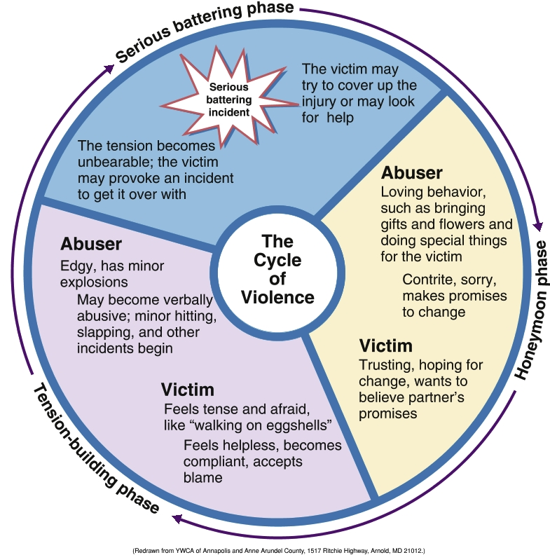
Cycle of Violence
Tension-building stage
Acute battering stage
Honeymoon stage
Repeat
Periods of calm and safety diminish over time and repetition

Slide 19
The Battered Partner
The battered partner:
Does not ask to be beaten and does not enjoy it.
Lives in terror.
Does not usually initiate the violence, but when aggressive toward a violent mate, it is usually in self-defense.
Has feelings of powerlessness and low self-esteem.
Loses her or his sense of self.
Violence and pain remain secret.

Slide 20
The Battered Partner—(cont.)
Is often the subject of extreme and irrational jealousy.
Is isolated and verbally and physically abused.
Lives in fear for her or his life and for the children’s lives because of the physical and sexual abuse and threats.
Families are usually isolated and have few, if any, friends or outside influences.
Is at high risk for secret drug and alcohol abuse.

Slide 21
The Battered Partner— (cont.)
Is psychologically destroyed and believes what the abuser says is true.
Believes if they say or do the right thing or not do anything “wrong” then the abuse will not happen.
May contemplate or complete suicide.
May contemplate or commit homicide.
May lose job as a result of the partner stalking and harassing.

Slide 22
Older Adult Abuse
Mistreatment
Failure to provide basic needs
Failure to protect
Physical or sexual abuse
Financial abuse
Epidemiology
Family
Custodial/care personnel

Slide 23
Risk Factors
Poor mental or physical health
Disruptive due to a disorder (Alzheimer’s)
Dependent on perpetrator
Female, older than 75 years, white, living with a relative while impaired
Elderly parents cared for by children or spouses they abused earlier in life

Slide 24
Audience Response Question
Which might the nurse cite as the most likely indication that the father is possibly a perpetrator?
His description of his family’s needs
His insistence on being the one to provide financial information
His disdain for skateboards
His description of his son’s learning disability

Slide 25
Case Study
Alone with Adam, the nurse says, “You know, my little brother falls off his skateboard a lot. What kind of board do you have?”
Adam looks panicky at the question for a moment, then shrugs and says, “I don’t know.”
The nurse tries again, “Jason has one of those ones with a ninja painted on it. Do you have that kind?”
“I don’t know,” Adam says. “Maybe.”

Slide 26
Application of the Nursing Process
Assessment
General assessment
History of sexual abuse, family violence, and drug use or abuse
Interview process and setting
Avoid assumptions about a person’s sexual orientation
Self assessment

Slide 27
Assessment: Interview Guidelines
Verbal approaches
Tell me about what happened to you.
Who takes care of you? (for children and dependent elders)
What happens if you do something wrong?
How do you and your partner resolve disagreements?
What do you do for fun?
Who helps you with your children/parent?
What time do you have for yourself?
What do you do after school?
Who are your friends?

Slide 28
Assessment: Interview Guidelines (Cont.)
Open-ended questions for parents
What arrangements do you make when you have to leave your child alone?
How do you discipline your child?
When your infant cries for a long time, how do you get him/her to stop?
What about your child’s behavior bothers you the most?

Slide 29
Assessment: Interview Guidelines (Cont.)
“Don'ts” of assessment
Do not judge or accuse
Do not use the words “abuse” or “violence”
Do not display horror, anger, shock, or disapproval
Do not force a child or anyone else to remove clothing
Allow a child to feel “in trouble” or “at fault”
Suggest answers to a question
Probe or press for answers

Slide 30
Audience Response Question
Alone for a moment with Adam’s parents, which secondary question is least appropriate to ask at this time?
How do you discipline Adam?
Who helps you take care of his special needs?
What about Adam’s behavior bothers you the most?
What did you do to this child?

Slide 31
Assessment
Should include
Violence indicators
Level of anxiety and coping responses
Family coping patterns
Support systems
Suicide and/or homicide potential
Drug and alcohol use

Slide 32
Assessment (Cont.)
Signs of Sexual Abuse in Children
Sexualized behavior
Precocious sexual knowledge/ explicit talk or images/demonstration of sexual aggression
Acting out sexual interactions
Masturbation
Sexual promiscuity in older children
PTSD symptoms
Somatic complaints
Feelings of guilt

Slide 33
Assessment (Cont.)
Emotional abuse
Low self-esteem, reported feelings of inadequacy, anxiety and withdrawal, learning difficulties, and poor impulse control
Neglect
Appear undernourished, dirty, and poorly clothed; inadequate medical care such as lack of immunizations and untreated medical or dental conditions
Economic Abuse
Failure to provide needs

Slide 34
Assessment (Cont.)
Assessment Documentation
Verbatim statement of who and when
Body map to indicate size, color, shape, areas, and types of injuries with explanations
Physical evidence of sexual abuse, when possible
Self-Assessment
Intense and overwhelming feelings
Strong negative feelings may cloud judgment and interfere with objective assessment and intervention
Common responses of healthcare professionals to violence

Slide 35
Discussion Questions
What are some questions you should ask Adam?

Slide 36
Application of the Nursing Process (Cont.)
Nursing Diagnosis (Table 28.4)
Directed toward protecting vulnerable family members
Can also include perpetrator in plans of care
Outcomes identification
Reduce or reverse the problem addressed

Slide 37
Planning
Joint Commission Guidelines Require—
Staff education in family violence and abuse
Development of standards of care to guide clinical practice
Protocol for Planning
Patient’s safety first
Discuss with patient if possible; child removed to safe place
Consider needs of abusers as well if they are motivated

Slide 38
Implementation
Reporting abuse
Considering family’s culture
Counseling—safety plan (for rapid escape)
Case management
Promotion of community support
Health teaching and health promotion

Slide 39
Developing a Safety Plan
A plan for a fast escape when violence occurs
Identified sign of escalation of violence and designate this as the time to leave
Include in plan a destination and a way to get there
Have the hotline referral telephone number of a shelter or safe house and a contact person
National Domestic Violence Hotline
Call 800-799-SAFE (7233)
SMS: Text START to 88788

Slide 40
Case Study Discussion
In the end, the nurse does suspect child abuse in Adam’s case. What important documentation is needed?

Slide 41
Prevention of Abuse
Primary prevention
Measures taken to prevent the occurrence of abuse
Secondary prevention
Early intervention in abusive situations to minimize their disabling or long-term effects
Tertiary prevention
Facilitating the healing and rehabilitative process
Providing support
Assisting survivors of violence to achieve their optimal level of safety, health, and well-being

Slide 42
Treatment Modalities— Psychological Therapies
Individual therapy
Family therapy
Group therapy

Slide 43
Audience Response Question
Adam admits, “I don’t have a skateboard. I didn’t fall off anything else either.” He agrees to tell you what happened, “as long as you keep it a secret.” What should the nurse do?
Agree to keep the child’s secret to build trust.
Ask the child’s parents to explain what happened.
Explain that a nurse cannot always keep that promise.
Have the child talk to another victim of child abuse.

Slide 44
Audience Response Questions
Child abuse perpetrators are most often
extended family members.
child care workers.
the child’s parents.
strangers.

Slide 45
Case study
You are the ED triage nurse. Chloe, a 25-year-old woman with torn clothing, has bruising around her face and neck. She states that she fell from a ladder while hanging a picture on her wall. Chad, her husband, is agitated and pacing outside the triage area. Based on the following statement, what are your best actions?

Slide 46
Audience Response Question (SATA)
Chloe is now being seen by the ED physician. Her husband, Chad, is quietly demanding to see his wife. As the triage nurse, what are your best actions? Select all that apply.
A. Tell Chad that Chloe “is fine” but no room for visitors is provided.
B. Have staff members (e.g., physician, nurse, technician, assistant) make regular contact with Chad in the waiting room.
C. Immediately call hospital security.
D. Move Chloe to secluded area in the ED so that you can interview her in private.
E. Insist that Chloe admit she is being abused by Chad.
F. Immediately report the abuse to the police department.
G. Advise Chloe of SAFE SHELTERS, and offer brochures.

Slide 47
Communication with Chloe
Chloe leaves the ED after treatment but does not want to press charges. You watch her drive away with Chad and their two children.
Were you able to communicate the following to Chloe?
Hide the brochures of SAFE SHELTERS from your abuser.
Remember the verbal information regarding support services.
No one deserves to be beaten.
You cannot make anyone hurt you. It is not your fault.
You have the right to protect yourself and your kids.
National Domestic Violence Hotline can be reached at (800) 799-7233.
National Coalition Against Domestic Violence
Empowering victims and survivors
http://www.ncadv.org/

