Slide 1
Cultural Implications
Chapter 5

Slide 2
Minorities and Minority Status
Minorities
racially, ethnically, or culturally distinct groups that coexist, but are subordinate in some way to a dominant group
Minority status
not always fewer in numbers, but lacking political and social power; may be treated differently and discriminated against

Slide 3
Race, Ethnicity, and Culture
Race
Can be defined biologically, anthropologically, or genetically; can be distinguished visually from one another based physical characteristics
Ethnicity
Common heritage and history
Share worldview for thinking
Culture
Shared beliefs, values, and practices

Slide 4
Measuring Race and Ethnicity in the United States
U.S. Census Bureau
Combined race-ethnicity categorization system
Purpose
Racial-ethnic descriptions help the government understand the needs of its citizens
The census helps to identify disparities in health care along racial-ethnic lines.

Slide 5
Demographic Shifts in the United States
In 2045, the U.S. population is projected for the first time to become a majority–minority nation.
No one group will make up the majority or make-up 51% of the population.
However, non-Hispanic whites will continue to remain the largest single group.

Slide 6
Los Angeles County 2020 census

Slide 7
Basic Worldviews

Slide 8
Western Tradition
Identity found in individuality
Values
Autonomy
Independence
Self-reliance
Mind and body = separate entities
Disease has a measurable cause, and treatment is aimed at the cause
Time is linear
Success is obtained in preparing for the future

Slide 9
Eastern Tradition
Family basis for identity
Body-mind-spirit one entity
Time is circular and recurring
Born into a fate; duty to comply
Disease caused by fluctuations in opposing forces

Slide 10
Hispanic Tradition
Family basis for identity
Collectivist culture
Values
Collectivismo
Familismo
Respeto
Health beliefs
Espiritu
Traditional healers
Curanderas
Espiritistas
Time orientation - present

Slide 11
Indigenous Culture
Places significance on place of humans in natural world
Basis of identity is the tribe
Person is an entity only in relation to others
Disease—lack of harmony between individual and environment

Slide 12
Case Study: Discussion
Mr. H lives with his daughter, who has become concerned about his memory. “Sometimes he says he’s going out to garden, but then he just disappears.
“Yesterday I was frantic. Then a neighbor brought him home from the shops nearly half a mile away. When I said, ‘Dad, where were you trying to go?’ he said, ‘I don’t know. Did I get there?’ Sometimes I think he believes he is back in Mumbai.”

Slide 13
Audience Response Questions
Although his daughter has been here almost 15 years, Mr. H is a fairly new immigrant. He speaks some English and is highly educated. His daughter has mentioned he is from Mumbai, India. Which attitude would you expect him to share?
“Disease is caused by fluctuations in opposing forces.”
“Disease is part of one’s fate and we have a duty to comply.”
“Disease has a cause, and treatment is aimed at the cause.”
“Disease is caused by a disruption in spiritual balance.”

Slide 14
Impact of Culture
Nonverbal communication & etiquette
Beliefs & values: Enculturation
Deviance from cultural expectations can be defined as illness by other members of the group
Ethnocentrism
Cultural imposition

Slide 15
Cultural Barriers to Mental Health Services
Communication barriers
Stigma of mental illness
Misdiagnosis
Cultural concepts of distress
Cultural, or culture-bound, syndromes
Cultural idioms of distress
Cultural explanations or perceived cause
Cultural syndromes
Genetic variations in pharmacodynamics
How genes influence responses to drugs
Genetic variations in the P450 enzyme system alter the way many drugs are metabolized including antidepressants and antipsychotics

Slide 16
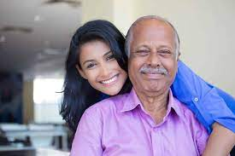
Special At-Risk Populations
Immigrants
Refugees
Cultural “minorities”
Mr. H is most definitely an immigrant, brought here by his daughter just 2 years ago expressly so she and her partner could take care of him.

Slide 17
Culturally Congruent Care and Associated Competencies
Five constructs of culturally effective care
Cultural awareness
Cultural knowledge
Cultural encounters
Cultural skill
Cultural desire

Slide 18
Culturally Congruent Care and Associated Competencies (Cont.)
1. Cultural awareness
Examine beliefs, values, and practices of own culture
Recognize that during a cultural encounter, three cultures are intersecting
Culture of the patient, nurse, and setting

Slide 19
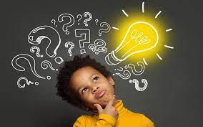
Culturally Congruent Care and Associated Competencies (Cont.)
2. Cultural knowledge
Learn by attending cultural events and programs
Forge friendships with diverse cultural groups
Learn by studying
Learning cultural differences helps nurse
Establish rapport
Ask culturally relevant questions
Identify cultural variables to be considered

Slide 20
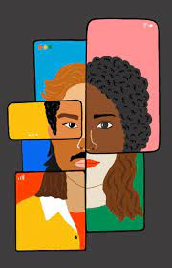
Culturally Congruent Care and Associated Competencies (Cont.)
3. Cultural encounters
Deter nurses from stereotyping
Help nurses gain confidence in cross-cultural interactions
Help nurses avoid or reduce cultural pain

Slide 21
Culturally Congruent Care and Associated Competencies (Cont.)
4. Cultural skill
Ability to perform a cultural assessment in a sensitive way
Use professional medical interpreter to ensure meaningful communication
Use culturally sensitive assessment tools
Goal
A mutually agreeable therapeutic plan
Culturally acceptable
Capable of producing positive outcomes

Slide 22
Case Study: Discussion
Mr. H is admitted to your unit. In your assessment you identify some cultural patterns that may support or interfere with his health and recovery process.
What can you do?

Slide 23
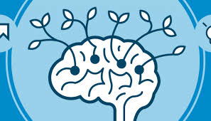
Culturally Congruent Care and Associated Competencies (Cont.)
5. Cultural desire
Genuine concern for patient’s welfare
Willingness to listen until patient’s viewpoint is understood
Patience, consideration, and empathy

Slide 24
Audience Response Questions
Which worldview would the nurse anticipate from a client who says, “It is important to save enough money to take care of yourself in your old age. We should not rely on anyone else to take care of us.”
Eastern (balance)
Western (science)
Indigenous (harmony)
Pluralism (acceptance)

Slide 25
Audience Response Questions
Which term refers to individuals’ belief that their cultural values and practices are correct and superior to those of others?
Assimilation
Enculturation
Ethnocentrism
Acculturation

