Slide 1
Therapeutic Communication
Chapter 9

Slide 2
Introduction
Therapeutic Communication
Patient-centered
Goal-directed
Scientifically based
Saying the Wrong Thing
Making mistakes helps us to find more useful and effective ways of helping individuals reach their goals.

Slide 3
Therapeutic Communication
Benefits to The Patient
Feeling safer and protected
More satisfied with the care
Increased recovery rates
Improved adherence to treatment

Slide 4
Therapeutic Communication (continued)
It is often during the psychiatric rotation that students discover the utility of therapeutic communication and begin to rely on techniques they once considered artificial. With continued practice, students will develop their own style and rhythm, and eventually these techniques will become a part of the way they communicate with others.

Slide 5
Theoretical Models of Communication

Slide 6
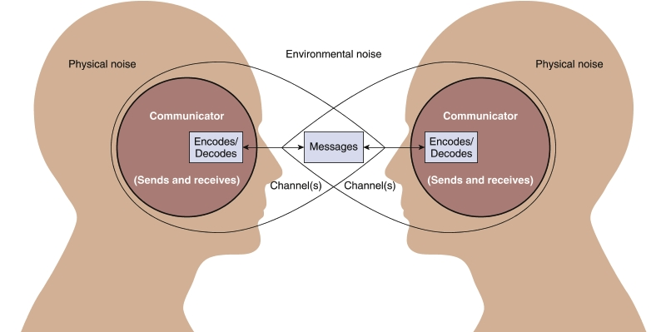
The Transactional Model
←Feedback→

Slide 7
Case Study
You are a new nurse in a psychiatric ward for adolescents. Noah is your first patient. He is depressed and has fresh cuts on his wrist, which is why his mother has had him admitted. While taking his pulse, you see that Noah also has a number of older scars on his arm. When he sees you looking at them, he shakes his head and whispers, “Yeah, well. It’s just gonna keep on happening.”

Slide 8
Audience Response Question
Noah’s whispered statement of “Yeah, well. It’s just gonna keep on happening” does not involve which of the following?
Channel
Stimulus
Message
Feedback

Slide 9
Audience Response Question
What is an appropriate response to Noah’s whispered statement of “Yeah, well. It’s just gonna keep on happening”?
Report this statement to his parents.
Report this statement to your supervisor.
Tell Noah you are willing to listen if he wants to talk about this.
Ignore this statement: the patient is in a vulnerable state and it’s risky to say the wrong thing.

Slide 10
Peplau’s Interpersonal Theory
Guiding Principles in Communication
Clarity: Ensures that the meaning of the message is accurately understood by both parties
Continuity: Promotes connections among ideas, feelings, events, and themes
Nondirective listening: Nonjudgmental feedback

Slide 11
Factors That Affect Communication
Personal factors
Depression
Cognition
Language/cultural barriers
Environmental factors
The setting
Relationship factors
Level of equality within the relationship

Slide 12
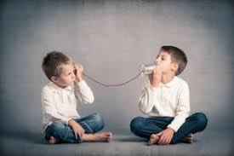
Verbal Communication
All words a person speaks
Communicates
Beliefs and values
Perceptions and meaning
Can convey
Interest and understanding
Insult and judgment
Clear or conflicting messages
Honest or distorted feelings

Slide 13
Nonverbal Communication
Tone of voice
Emphasis on certain words
Physical appearance
Facial expressions
Body posture
Amount of eye contact
Hand gestures

Slide 14
Interaction of Verbal and Nonverbal Communication
Messages can appear to be one thing when in fact they are another.
People are often less aware of their nonverbal messages and behaviors.
Verbal message can be called the content, while the nonverbal behavior is the process.
Double-bind messages: Mutually contradictory messages, usually given by a person in power.

Slide 15
Case Study
As you prepare for the initial interview with 15-year-old Noah, you learn that he has a history of cutting himself. His parents have separated and are getting a divorce; his father has left and Noah is living with his mother. Noah has been smoking for about a year and a half and his mother suspects that he has come home smelling of marijuana twice now. All three behaviors were ongoing before the father left.

Slide 16
Audience Response Question
Which behavior from Noah would be considered a double-bind message?
He winks at you and says, “Do any of these nurses date 15-year-old guys?”
He puts his head in his hands, shakes it, and snaps, “I don’t want to do this. Just get me out of here!”
He sneers at you and almost purrs as he says, “Oh yes. I will tell you anything you want to know. Of course. Of course, I will.”
He cries and shakes, jiggling one leg, as he says softly, “Please. Let’s just not talk about Dad, okay? God, please?”

Slide 17
Preparing for the Clinical Patient Interview
Pace
Setting
Seating
Introductions
Initiating the interview

Slide 18
Active Listening: SOLER
Sit facing the patient at eye level
Observe an open posture
Lean toward the patient
Establish and maintain intermittent eye contact
Relax

Slide 19
Therapeutic Communication Techniques
Questions
Open-ended
Closed-ended
Projective
The miracle question

Slide 20
Therapeutic Communication Techniques
Accepting
Giving recognition
Offering self
Offering general leads
Giving broad openings
Placing the events in time and sequence
Making observations
Encouraging description of perception
Encouraging comparison
Restating
Reflecting
Confrontation
(Continued.)

Slide 21
Therapeutic Communication Techniques (cont.)
Exploring
Giving information
Seeking clarification
Presenting reality
Voicing doubt
Seeking consensual validation
Verbalizing the implied
Encouraging evaluation
Attempting to translate into feelings
Suggesting collaboration
Summarizing
Encouraging formulation of plan
Focusing

Slide 22
Blocks to Therapeutic Communication
Giving advice
Minimizing feelings
False reassurance
Making value judgments
Asking “why” questions
Asking excessive questions
Using clichés
Giving approval—agreeing/cheerleading
Disapproving—disagreeing
Changing the subject

Slide 23
Tactics to Avoid
Arguing or challenging the patient
Interpreting or speculating
Probing into sensitive areas the patient doesn’t want to discuss
Trying to “sell” the patient on accepting treatment
Joining in attacks patients launch on others
Participation in criticizing other staff members

Slide 24
Case Study/ Audience Response Question
Noah has made it clear he doesn’t want to talk about his dad. But the truth is, as the interview proceeds, he becomes anxious and tries to evade all questions about why he is here. Which type of communication might be most appropriate right now?
Stop questioning so much and just give him some good advice so he’ll trust you.
Express honest disapproval of his resistance to help.
Ask him pointblank why he is evading you.
Ask a miracle question.

Slide 25
Cultural Considerations
Communication style
Use of eye contact
Perception of touch
Cultural filters—form of bias or prejudice

Slide 26
Clinical Supervision & Debriefing
Communication and interviewing are acquired skills
Fosters professional growth and helps minimize the development of nontherapeutic nurse–patient relationships.

Slide 27
Process Recording
Written record of a segment of the nurse–patient session that reflects as closely as possible the verbal and nonverbal behaviors of both patient and nurse
Useful tool for identifying communication patterns

Slide 28
Information Communication Technologies
Mobile Applications
Telehealth-monitor, diagnose, treat, and communicate with patients
Many quickly adoptable apps available
More research is needed
SAMHSA free apps for suicide prevention, bullying prevention, and underage drinking prevention
NAMI Air – free support for consumers and care partners
Moodkit, Talkspace, Headspace – paid/subscription based
Better Stop Suicide, MY3 – free apps
Many more….

Slide 29
Information Communication Technologies (Cont.)
Some Concerns
Privacy and confidentiality issues
Lack of data for efficacy and safety
Liability issues
Research is needed to evaluate risks versus benefits
Professional and ethical guidelines needed

Slide 30
Audience Response Question
As a nurse assesses a new client, the nurse makes sure the door remains open. Which type of communication factor is this action?
Environmental
Relationship
Personal
Kinesic

