Slide 1
Schizophrenia Spectrum Disorders
Chapter 12

Slide 2
Schizophrenia Spectrum Disorders
Share features with schizophrenia
Characterized by psychosis
Altered cognition
Altered perception, and/or
Impaired ability to determine what is or is not real

Slide 3
Schizophrenia Spectrum Disorders
Delusional Disorder
Brief Psychotic Disorder
Schizophreniform Disorder
Schizoaffective Disorder
Substance-Induced Psychotic Disorder
Psychotic Disorder due to a medical condition

Slide 4
DSM-V Criteria: Highlights
Two or more of the following for a significant portion of time in 1 month:
Delusions
Hallucinations
Disorganized speech
Gross disorganization or catatonia
Negative symptoms (diminished emotional expression or avolition)
Functional impairment of some kind
Continuous disturbance for at least 6 months
Ruled out: substances or other disorders

Slide 5
Schizophrenia
Schizophrenia affects 1% of population
No difference related to
Race
Culture
75%: Develop gradually, presenting at 15 to 25 years of age
Early Onset
Later onset
Child-onset and late-onset are more rare
Before 15 or after 40

Slide 6
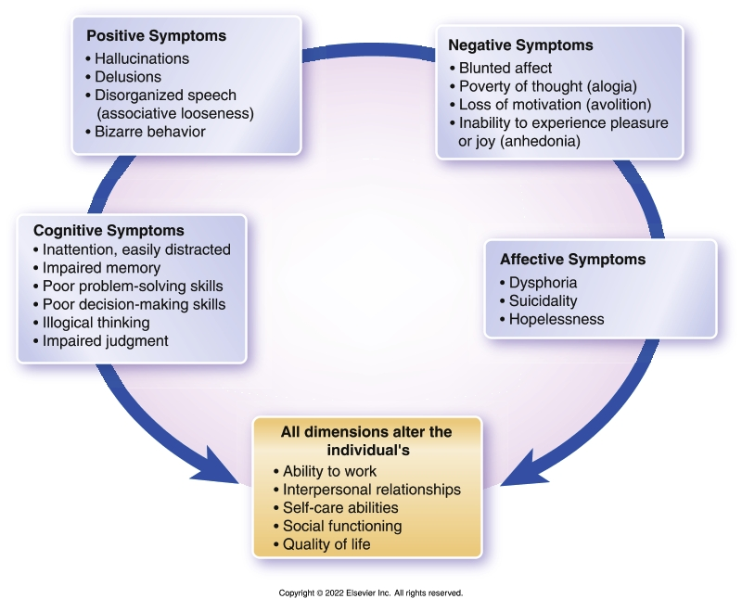
Four Main Symptom Groups of Schizophrenia
Positive
Negative
Cognitive
Affective

Slide 7
Case Study
Eric M, 18, has always been a good student. However, in his second semester of college, he begins, for the first time in his life, to have trouble concentrating. When his family doesn’t hear from Eric, they contact the school, only to discover that his roommate says Eric is “talking weird.”
Asked what he means, the roommate says, “Well, you know, he says stuff that doesn’t connect, doesn’t make any sense. I asked him if he was high or something, but he said no, and I believed him.”
On further investigation, Eric’s professors say he’s been missing class, after starting out so well.

Slide 8
Case Study/ Audience Response Question
Eric’s roommate says his speech “… doesn’t connect; it doesn’t make any sense. He sort of gets derailed.” Which of the following symptoms is Eric displaying?
Avolitional speech
Delusional speech
Disorganized speech
Diminished emotional expression

Slide 9
Comorbidity
Substance abuse disorders
Nicotine dependence and associated health consequences
Alcohol and marijuana
Anxiety, depression, and suicide
Physical illness
CV disease
Diabetes
Psychosis- Induced Polydipsia

Slide 10
Risk Factors
Biological factors
Genetics
Brain structure abnormalities
Neurobiological
Glutamate, dopamine, and serotonin
Acetylcholine

Slide 11
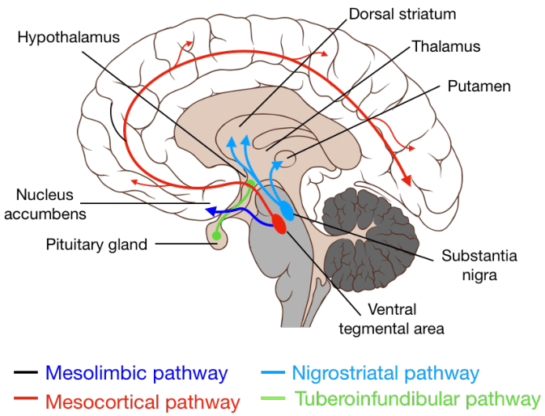

Slide 12
Risk factors (Cont.)
Psychological and environmental factors
Prenatal stressors
Psychological stressors
Environmental stressors
Prognostic considerations

Slide 13
The Association Between Cannabis Use and Schizophrenia: Causative or Curative? A Systematic Review Patel, et. Al (2020)
Cannabis and schizophrenia/psychosis have a close relationship.
Cannabis use, primarily THC in cannabis, in genetically predisposed or at-risk populations, leads to earlier diagnosis of psychosis/schizophrenia.
THC in cannabis has a small causative effect on schizophrenia.
THC in cannabis also makes schizophrenia and psychosis symptoms worse and causes more relapses and hospitalizations.
Neuroimaging studies show the detrimental effect of cannabis on brain morphology, especially adolescent brains.
Recent trials in therapeutic CBD use are showing its alleviating effect on positive symptoms of schizophrenia and its opposing effect on THC, which warrants further research.
Although CBD shows therapeutic potential, there is still more harm from cannabis than benefits, and adolescent cannabis usage should be discouraged at all costs.
We still need more extensive studies for more detailed data about cannabis and its effects.

Slide 14
Phases of Schizophrenia
Prodromal
Acute
Stabilization
Maintenance or Residual

Slide 15
Case Study
Eric’s parents arrive on campus, and he agrees to meet with them and a campus counselor. He appears anxious. He expresses sorrow that his grades are suffering, acknowledging that his concentration “just isn’t there.” He says that he feels “something weird is happening to me” and describes frequent distressing thoughts. He admits to feeling suspicious of everyone he passes.
Eric’s parents and the counselor both notice what the roommate had described about Eric’s speech.

Slide 16
Case Study
Eric agrees to see a psychiatrist and an initial assessment and history indicate that he has only been experiencing some mild changes in his thinking and mood for about a month—ever since returning from the winter holiday. The examiner confirms that his speech is sometimes disorganized and his ability to concentrate and study is diminished from his previous longstanding as a strong student.

Slide 17
Case Study/ Audience Response Question
Given the evidence we have so far, if Eric has schizophrenia, which is suspected, which phase is he most likely experiencing?
Acute
Residual
Prodromal
Stabilization

Slide 18
Assessment – Student Recall
During the prodromal phase
General assessment
Positive symptoms
Negative symptoms
Cognitive symptoms
Affective symptoms

Slide 19
Positive Symptoms
Delusions—false, fixed beliefs
Ideas of reference (referential delusion)
Persecution (paranoia)
Grandiosity
Nihilistic
Somatic Sensations
Jealousy
Erotomanic
Control

Slide 20
Alterations in Speech
Associative looseness
Flight of ideas
Neologisms
Echolalia
Circumstantiality
Tangentiality
Symbolic speech
Clang associations
Word salad

Slide 21
Word Salad - Facebook

Slide 22
Disorders or Distortions of Thought
Thought blocking
Thought insertion
Thought deletion
Magical thinking

Slide 23
“As I walked along, I began to notice that the colors and shapes of everything around me were becoming very intense. And at some point, I began to realize that the houses I was passing were sending messages to me: Look closely. You are special. You are especially bad. Look closely and ye shall find. There are many things you must see. See. See.
I didn’t hear these words as literal sounds, as though the houses were talking and I were hearing them; instead, the words just came into my head-they were ideas I was having. Yet I instinctively knew they were not my ideas. They belonged to the houses, and the houses put them in my head.”
Elyn Saks – The Center Cannot Hold

Slide 24
Case Study/ Audience Response Question
During assessment, Eric has trouble staying on topic, zipping rapidly from one thought to the next, making it hard to follow what he’s trying to say. Which speech disturbance is he exhibiting?
Pressured speech
Circumstantiality
Flight of ideas
Tangentiality

Slide 25
Alterations in Perception
Hallucinations
Auditory
Visual
Olfactory
Gustatory
Tactile
Command vs. benign
Illusions
Depersonalization
Derealization

Slide 26
Alterations in Behavior
Catatonia
Motor retardation
Motor agitation
Stereotyped behaviors
Waxy flexibility
Echopraxia
Negativism
Impaired impulse control
Gesturing or posturing
Boundary impairment

Slide 27
Negative Symptoms
The absence of essential human qualities
Anhedonia
Avolition
Asociality
Affective blunting
Apathy
Alogia

Slide 28
Negative Symptoms (Cont.)
Affect: Outward expression of a person’s internal emotional state
Flat
Blunted
Constricted
Inappropriate
Bizarre

Slide 29
Cognitive Symptoms
Concrete thinking
Impaired memory
Impaired information processing
Impaired executive functioning
Anosognosia

Slide 30
Affective Symptoms
Assessment for depression is crucial
May herald impending relapse
Increases substance abuse
Increases suicide risk
Further impairs functioning

Slide 31
Self-Assessment
Anosognosia
Inability to realize they are ill
Caused by the illness itself
May result in resistance to or cessation of treatment
Often combined with paranoia so that accepting help is impossible
Nurse’s self-assessment
Anxiety or fear
Frustration
Expectations

Slide 32
Case Study/ Audience Response Question
Eric becomes anxious and says, “There are worms under my skin eating the hair follicles.” How would you classify this assessment finding?
Positive symptom
Negative symptom
Cognitive symptom
Depressive symptom

Slide 33
Case Study/ Audience Response Question
Eric has problems remembering when to take prescribed medication and consistently misses scheduled appointments. What category of symptoms would this fall under?
Positive symptom
Negative symptom
Cognitive symptom
Affective symptom

Slide 34
Case Study Discussion Guide
The psychiatric nurse conducting Eric’s assessment believes that he is also suffering from command hallucinations. Discuss what kinds of questions could help affirm this.

Slide 35
Potential Nursing Diagnoses
Positive symptoms
Disturbed sensory perception
Formerly Disturbed Thought Process
Risk for self-directed or other-directed violence
Impaired verbal communication
Negative symptoms
Social isolation
Chronic low self-esteem
Powerlessness
Impaired Health Maintenance

Slide 36
Outcomes Identification
Phase I—acute
Patient safety and medical stabilization
Phase II—stabilization
Help patient understand illness and treatment
Stabilize medications
Control or cope with symptoms
Phase III—maintenance
Maintain achievement
Prevent relapse
Achieve independence, satisfactory quality of life

Slide 37
Case Study Discussion
After an acute admission, discharge is being planned for Eric. What are some things that need to be considered?

Slide 38
Implementation: Acute phase
Psychiatric, medical, and neurological evaluation
Psychopharmacological treatment
Support, psychoeducation, and guidance
Supervision and limit setting in the milieu
Monitor fluid intake
Activities and groups
Working with aggression
Regularly assess for risk and take safety measures

Slide 39
Implementation Stabilization and maintenance phase
Medication administration/adherence
Relationships with trusted care providers
Community-based therapeutic services
Teamwork and safety

Slide 40
Communication Guidelines
Therapeutic strategies for communicating with patients with schizophrenia focus on:
Lowering the patient’s anxiety
Decreasing defensive patterns
Encouraging participation in therapeutic and social events
Raising feelings of self-worth
Increasing medication compliance

Slide 41
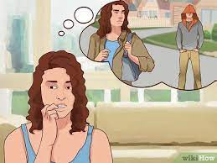
Counseling: Communication Guidelines
Delusions
Be open, honest, matter-of-fact, and calm
Have patient describe delusion
Avoid arguing about content
Interject doubt when appropriate
Validate part of delusion that is real
Focus on feelings the delusions generate
Once delusion is described, do not dwell on it
Observe events that trigger delusions

Slide 42
Counseling: Communication Guidelines
Hallucinations
Hearing voices (auditory hallucinations) most common
Approach patient in nonthreatening and nonjudgmental manner
Assess if messages are suicidal or homicidal
Ask directly what the voices are saying
Do not argue or negate patient perception
Offer your own perceptions (present reality)
Focus on reality-based diversions
Patient anxious, fearful, lonely, brain not processing stimuli accurately
Initiate safety measures if needed

Slide 43
Counseling: Communication Guidelines
Associative looseness
Do not pretend that you understand
Place difficulty of understanding on yourself
Look for reoccurring topics and themes
Emphasize what is going on in the patient's environment
Involve patient in simple, reality-based activities
Reinforce clear communication of needs, feelings, and thoughts

Slide 44
Reality Based Interventions
Distraction
Talk with friends
Listen to music
Watch TV
Physical activity
Exercise
Sing, dance, etc.
Fighting back
Positive self –talk
Yelling at voices
Tell voices to go away
Help-seeking
Call therapist/mental health worker
Go to clinic/NP/MD
Seek family/significant other support
Relaxation activities
Shower, bath
Breathing exercises
Relaxation techniques
Take PRN med

Slide 45
Patient and Family Teaching for Schizophrenia
Learn
Learn all you can about the illness
Develop
Develop a relapse prevention plan
Participate in
Participate in family, group and individual therapy
Avoid
Avoid alcohol and drugs
Learn
Learn ways to address fears and losses
Learn
Learn new ways of coping; have a plan on paper of what to do in times of increased stress
Adhere
Adhere to treatment
Maintain
Maintain communication with supportive people
Stay
Balance: stay healthy by managing stress, sleep, and diet

Slide 46
Evaluation
Reevaluate progress regularly and adjust treatment when needed
Even after symptoms improve outwardly, inside the patient is still recovering.
Set small goals; recovery can take months.
Active, ongoing communication and caring is essential.

Slide 47
Treatment Modalities

Slide 48
Biological: Pharmacotherapy
Antipsychotic medications
First-generation
Second-generation
Third-generation
Injectable antipsychotics
Short-acting
Long-acting
First-generation: haloperidol, fluphenazine decanoate
Second-generation: olanzapine pamoate, paliperidone palmitate

Slide 49
First-Generation Antipsychotics (Typicals)
Dopamine antagonists (D₂ receptor antagonists)
Target positive symptoms of schizophrenia
Advantage
Less expensive than second generation
Disadvantages
Extrapyramidal side effects (EPS)
Anticholinergic (ACh) side effects
Tardive dyskinesia
Metabolic effects – weight gain, diabetes, dyslipidemia
Sexual dysfunction

Slide 50
Second-Generation Antipsychotics (Atypicals or SGA’s)
Serotonin (5-HT_{2A} receptor) and dopamine (D₂ receptor) antagonists
Treat both positive and negative symptoms
Advantages – lower side effects
Minimal to no EPS
Disadvantage—tendency to cause significant weight gain; risk of metabolic syndrome
Clozaril (clozapine) -not used first line due to high rates of agranulocytosis; often works for suicidality and treatment resistant patients

Slide 51
Third-Generation Antipsychotics
A subset of the SGAs
Aripiprazole (Abilify), brexpiprazole (Rexulti), and cariprazine (Vraylar)
Dopamine system stabilizers
May improve positive and negative symptoms and cognitive function
Little risk of EPS

Slide 52
FDA Approves Janssen’s Treatment for Adults with Schizophrenia (September 2021)
Johnson & Johnson’s Janssen subsidiary has won FDA approval for Invega Hafyera (6-month paliperidone palmitate) as a twice-a-year injectable treatment for adults with schizophrenia.
Before receiving the treatment, patients must first be treated with Invega Sustenna, a once-a-month injection, for at least four months, or with Invega Trinza, a 3-month injection, for at least one cycle.
The approval was supported by results from a late-stage study in 702-participants in which 92.5 percent of patients treated with Invega Hafyera were relapse-free after a year

Slide 53
Side Effects
Class side effects
Seizure
Impotence
Hyperprolactinemia
Other side effects
Extrapyramidal Symptoms (EPS)
Sedation
Orthostatic hypotension
Weight gain
Metabolic syndrome/diabetes
Anticholinergic side effects

Slide 54
Extrapyramidal Side Effects

Slide 55
Summary - EPS Symptom Treatment
Side effect | Treatment options
Acute dystonia | Anticholinergic (benztropine) Antihistamine (diphenhydramine)
Parkinsonism | Lower antipsychotic dosage Switch to another antipsychotic Anticholinergic medication benztropine – Cogentin Trihexyphenidyl –Artane Dopamine agonist Amantadine - Symmetrel
Akathisia (can be confused with psychotic agitation) | Lower antipsychotic dosage Switch to another antipsychotic Add benzodiazepine Add β-adrenergic blocker
Moderate to severe tardive dyskinesia | Reversible inhibitor of the vesicular monoamine-transporter-2 (VMAT2)

Slide 56
Rare and Toxic Side Effects
ACh toxicity
Neuroleptic malignant syndrome (NMS)
Agranulocytosis
Hepatotoxicity
Prolongation of the QT interval

Slide 57
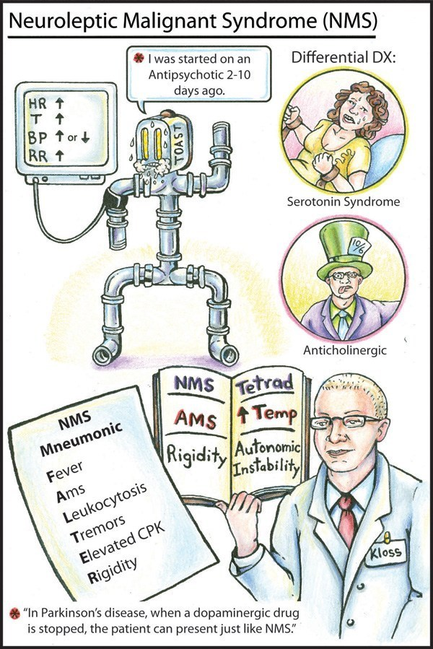

Slide 58
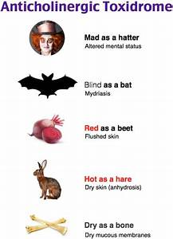

Slide 59
Psychological Therapies
Individual and group therapy
Psychoeducation
Medication prescription and monitoring
Basic health assessment
Cognitive remediation or enhancement
Family therapy
Support groups
NAMI
Schizophrenia and Related Disorders Alliance of America

Slide 60
Audience Response Question
Loose associations in a person with schizophrenia indicate
paranoia.
mood instability.
depersonalization.
poorly organized thinking.

Slide 61
Audience Response Question
Which assessment finding represents a negative symptom of schizophrenia?
Apathy
Delusion
Motor tic
Hallucination

