Slide 1
Eating Disorders
Chapter 18

Slide 2
Clinical Picture
Anorexia nervosa
Bulimia nervosa
Binge eating disorder

Slide 3
Anorexia Nervosa
This Photo by Unknown Author is licensed under CC BY-SA-NC

Slide 4
Case Study
Addie, age 15, is brought to the school nurse after fainting during gym class. She is grossly underweight, wears baggy clothes, and has dry skin. She complains of feeling cold despite wearing two sweaters. As the nurse examines her perfunctorily, she notices that Addie’s skin seems slightly yellow, and a gentle scrape of her skin shows signs of dehydration.

Slide 5
Audience Response Question
Predict: What do we mean by the term purging when we talk about anorexia nervosa?
Vomiting
Excessive exercise
Using stimulants or thyroid medications
All of the above

Slide 6
Anorexia Nervosa
DSM-5 Criteria includes:
Restricting energy intake to below requirements
Significant loss of weight and malnourishment
Intense fear of weight gain or persistent interference with weight gain
Disturbance of body image
Self-evaluation linked to body weight or shape
Restricting type
During the last 3 months, the individual has not engaged in recurrent episodes of binge-eating or purging behavior
Binge-eating/purging type
During the last 3 months, the individual has engaged in recurrent episodes of binge-eating or purging behavior

Slide 7
Epidemiology
Lifetime prevalence of 0.5% - does not represent the actual prevalence
Fewer than half seek help
Individuals tend to conceal symptoms
Commonly begins during adolescence or in young adults

Slide 8
Comorbidity
Bipolar disorder
Anxiety disorders
Depressive disorders
Obsessive-compulsive disorder
Posttraumatic stress disorder (PTSD) and other trauma-related disorders
Alcohol or substance use disorder

Slide 9
Risk Factors
Biological factors
Genetics
Neurobiological
Cognitive factors
Environmental factors

Slide 10
Thin Commandments
If you aren't thin, you aren't attractive.
Being thin is more important than being healthy.
You must buy clothes, style your hair, take laxatives, starve yourself, do anything to make yourself look thinner.
Thou shall not eat without feeling guilty.
Thou shall not eat fattening food without punishing oneself afterwards.
Thou shall count calories and restrict intake accordingly.
What the scale says is the most important thing.
Losing weight is good/gaining weight is bad.
You can never be too thin.
Being thin and not eating are signs of true willpower and success

Slide 11
Assessment (Cont.)
Assessment Guidelines
Patient’s perception of the problem
Vital signs, review of systems, appearance
Screen for suicide or self-harm behaviors
Nutritional and fluid intake
Daily activities
Laboratory testing review

Slide 12
Anorexia Nervosa Phenomena
Terror of gaining weight
Food preoccupation
View self as fat
Peculiar food handling habits
Possible rigorous exercise regimen
Possible purging, laxative, diuretics
Self-worth judged by weight

Slide 13
Anorexia Nervosa: Clinical Presentation
Low weight
Amenorrhea
Yellow skin
Lanugo
Cold extremities (acrocyanosis)
Peripheral edema
Muscle weakness
Impaired renal function
Hematuria
Proteinuria
Constipation
Low T3/T4
Hypotension
Bradycardia
Heart failure
Hypokalemia/electrolyte imbalances
Prolonged QT interval
Sudden cardiac arrest
Pancytopenia
Decreased bone density

Slide 14
Case Study
During assessment, Addie says, “This all started because my mom found out I fainted during gym class. It’s ridiculous.” She seems genuinely unaware that her low weight and other symptoms might be a source of alarm. Addie’s skin is slightly yellow and her skin showed signs of dehydration.

Slide 15
Audience Response Question
With that fainting spell in mind, to further assess for anorexia nervosa, the school nurse should ask:
“Do you often wear heavy clothing in warm weather?”
“When was your last menstrual period?”
“Do you use any drugs or alcohol?”
“Do you ever lose lapses of time?”

Slide 16
Audience Response Question
What is yellow skin in anorexia nervosa linked to?
Lanugo
Amenorrhea
Use of street drugs
Hypercarotenemia

Slide 17
Anorexia Nervosa (Cont.)
Nursing diagnoses
Impaired nutritional status
Impaired cardiac output
Electrolyte/fluid imbalance
Disturbed body image
Ineffective Coping
Chronic low self-esteem
Powerlessness
Risk for suicide

Slide 18
Eating Disorders: Admission Criteria
Weight loss over 30% over 6 months
Temperature <36ºC or 96.8ºF
Heart rate < 40
SBP < 70 mmHg
Hypokalemia (<3mEq/L)
Impaired renal function
EKG changes
Rapid loss or inability to gain weight outpatient
Suicidal, out-of-control or self-mutilating behaviors
Family crisis, severe depression, psychosis
Failure to comply with treatment

Slide 19
Anorexia Nervosa (Cont.)
Outcomes identification
Improved nutritional intake, cardiac output, electrolyte balance, and fluid balance
Positive body image: Congruence between body reality
Effective coping & positive self-esteem
Planning
Refeeding syndrome

Slide 20
Case Study/ Audience Response Question
Addie condition worsens and she collapses at home. She is admitted to your unit with anorexia nervosa. You have completed your physical and biopsychosocial assessment of her. Which common personality trait is likely to present a particular challenge?
Lack of hygiene and cleanliness
Lack of interest in self and others
Irresistible desire to purge
Perfectionism

Slide 21
Anorexia Nervosa: Interventions
Acute phase/basic level intervention
Milieu therapy
Precise mealtimes and menus
Observation during and after meals
Regularly scheduled weighing
Monitored bathroom visits
Privileges linked to compliance/weight gain
Therapeutic communication/counseling
Cognitive distortions

Slide 22
Therapeutic Relationship: Building Trust and Having Empathy In Anorexia Nervosa
Perfectionism
Obsessive thoughts and actions relating to food
Need to control

Slide 23
Anorexia Nervosa: Interventions
Acute care
Pharmacological interventions
Fluoxetine (Prozac)
Chlorpromazine (Thorazine)
Olanzapine (Zyprexa)
Health teaching
Self-care

Slide 24
Treatment Modalities
Integrative Medicine
Yoga, massage, acupuncture, bright light therapy
Psychological Therapies
Insight-oriented individual therapy
Adolescent-focused therapy (AFT)
Family therapy (F-BT)
Cognitive-behavioral therapy (CBT)

Slide 25
Anorexia Nervosa: Evaluation
Nutritional status
Weight gain behaviors
Anxiety self control
Self-esteem
If weight falls below the goal, treatment is changed

Slide 26
Anorexia: Self-Assessment
Feelings of exhaustion/defeat
Resentment toward patient due to manipulation/staff splitting
Sense of over protection of patient
Avoidance/anger toward patient
Failure to monitor patients appropriately
Feeling repelled/disgusted by patient appearance
Believing patient is deliberately manipulating staff/family

Slide 27
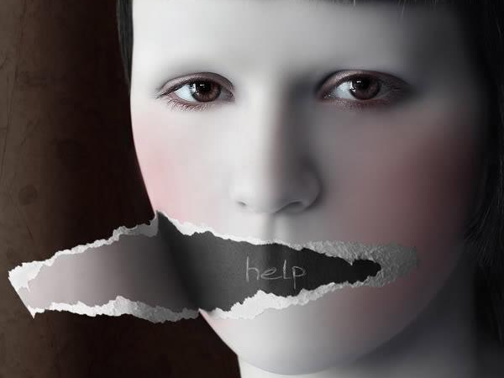
Bulimia Nervosa
This Photo by Unknown Author is licensed under CC BY-NC-ND

Slide 28
Bulimia Nervosa
DSM-5 Criteria
Recurrent episodes of binge eating
Recurrent inappropriate compensatory behavior
Both occur, on average, at least once a week for 3 months
Self-evaluation is unduly influenced by body shape and weight

Slide 29
Bulimia Nervosa (Cont.)
Epidemiology
Comorbidity
Depressive disorders
Anxiety disorders
Bipolar disorder
Alcohol and substance use disorders
PTSD and other trauma-based disorders
Borderline personality disorder

Slide 30
Bulimia Nervosa (Cont.)
Risk Factors
Genetic
Neurobiological
Cognitive Factors
Attachment challenges
Self-evaluation based on weight and shape
Environmental Factors
Internalization of a thin body ideal
Bullying

Slide 31
Bulimia Nervosa Phenomena
Binge eating behavior
Laxative, diuretic use
History of anorexia in 1/4 to 1/3 of patients
Increased levels of anxiety
Depressive symptoms
Problems with:
Interpersonal relationships
Self-concept
Impulsive behaviors (shoplifting)
Compulsive behaviors

Slide 32
Bulimia Nervosa: Clinical Presentation
Around normal weight
May be slightly under or overweight
Dental caries, tooth erosion
Parotid swelling
Russell’s sign
Peripheral edema
Muscle weakness
Gastric dilatation/rupture
Hypokalemia, hyponatremia
EKG changes/Cardiac dysrhythmias
Cardiomyopathy (Ipecac toxicity/chronic use)
Dehydration

Slide 33
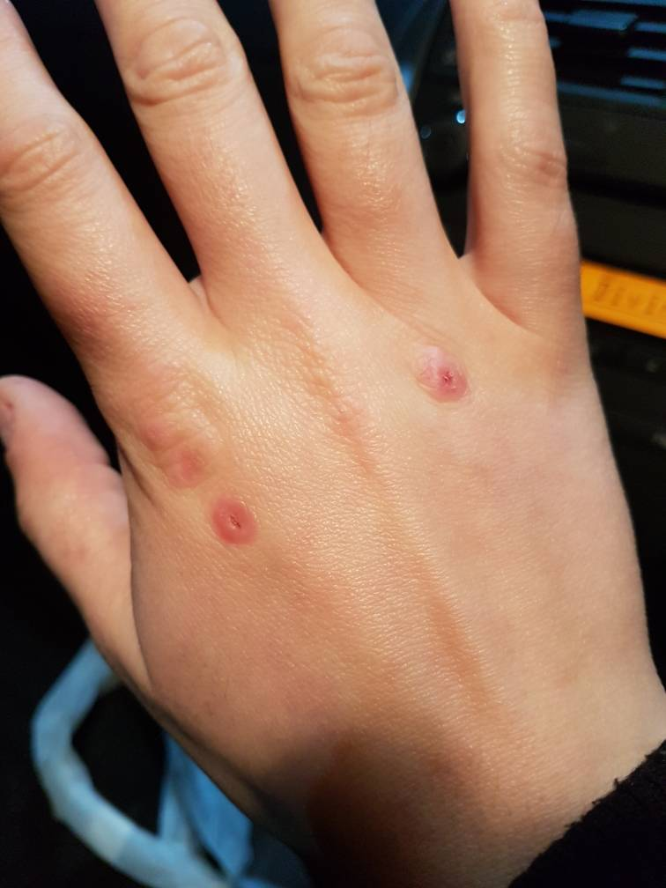
Russell’s sign

Slide 34
Parotid Enlargement: before and after

Slide 35
Dental Erosion

Slide 36
Nursing Diagnoses: Bulimia Nervosa
Impaired cardiac output
Electrolyte imbalance
Disturbed body image
Powerlessness
Low self-esteem
Anxiety
Ineffective coping (e.g., substance abuse, impulsive responses to problems)

Slide 37
Outcomes Identification Bulimia Nervosa
Electrolytes in balance
Improved cardiac output
Refrain from binge-purge behaviors
Demonstrate two new skills for managing anxiety
Be free of self-directed harm
Express feelings in a nonfood-related way
Name two personal strengths

Slide 38
Bulimia Nervosa: Interventions
Acute phase/basic level intervention
Milieu therapy
Interrupt binge-purge cycle
Normalize eating habits
Therapeutic communication
Health teaching
Long-term treatment/advanced practice interventions
Psychotherapy
Psychopharmacology
SSRI’s and other antidepressants

Slide 39
Therapeutic Relationship in Bulimia Nervosa: Building Trust and Having Empathy
Sensitive to perceptions of others
May feel
Shame
Out of control
Low self-esteem
Unworthiness
Dysphoria

Slide 40
Treatment Modalities
Biological Treatment: Pharmacotherapy
Antidepressants: Fluoxetine (Prozac)
Other antidepressants
Advanced Practice Interventions
Cognitive-behavioral therapy (CBT)
Mixed-method approach for refractory cases
Others: dialectical behavioral therapy (DBT), interpersonal therapy (IPT), and acceptance and commitment therapy (ACT)

Slide 41
Bulimia Nervosa: Evaluation
Physiologic safety
Impulse self-control
Weight maintenance behavior
Hope

Slide 42
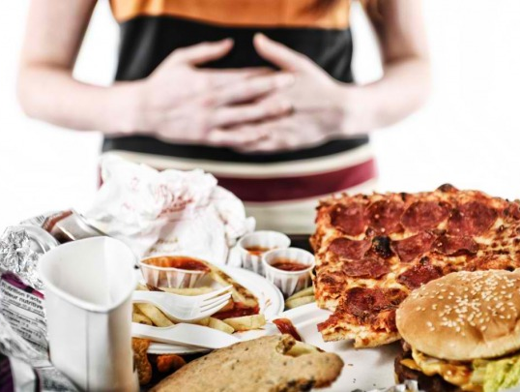
Binge Eating disorder
This Photo by Unknown Author is licensed under CC BY-NC-ND

Slide 43
Binge Eating
DSM-5 Criteria
Recurrent episodes of binge eating
Eating, in a discrete period of time (e.g., within any 2-hour period), an amount of food that is definitely larger than what most people would eat in a similar period of time under similar circumstances.
A sense of lack of control overeating during the episode (e.g., a feeling that one cannot stop eating or control what or how much one is eating).
Marked distress over binge eating
Occurs at least 1X/week for 3 months & is not associated with other disorders

Slide 44
Binge Eating— DSM-5 Criteria (Cont.)
Episodes are associated with three (or more) of the following:
Eating much more rapidly than normal.
Eating until feeling uncomfortably full.
Eating large amounts of food when not feeling physically hungry.
Eating alone because of feeling embarrassed by how much one is eating.
Feeling disgusted with oneself, depressed, or very guilty afterward.

Slide 45
Binge Eating (Cont.)
Epidemiology
Comorbidity
Specific phobia (37%)
Social phobia (32%)
Post-traumatic stress disorder (26%)
Alcohol abuse or dependence (21%)

Slide 46
Risk Factors
Biological factors
Genetics
Neurobiological
Cognitive factors
Environmental factors

Slide 47
Binge Eating Nursing Process
Assessment
General assessment
Self assessment
Nursing diagnosis
Outcomes identification

Slide 48
Planning & Implementation
Planning: Balanced intake & healthy movement
Implementation
Avoid judgmental language: binge eating is not about food, but about coping with emotion
Help patient track what events triggered an episode
Help patient explore community activities or groups
Use incremental approach in goal setting
Health teaching and health promotion
Evaluation

Slide 49
Treatment Modalities
Biological: Pharmacotherapy
SSRIs
Weight tends to return after treatment
SNRIs
Lisdexamfetamine (Vyvanse)
Lowered relapse risk

Slide 50
Treatment Modalities (Cont.)
Surgical Interventions
Bariatric surgery
Psychological Therapies
Cognitive-behavioral therapy
Dialectical behavior therapy
Interpersonal therapy

Slide 51
Teamwork and Collaboration are needed to treat EDs effectively
Patient
Nurse
Psychiatrist
Registered dietician
Internist and pediatrician
Psychologist
Social services
Mental Health Technician
Family
Social network
Support groups

Slide 52
Audience Response Questions
Which medication is likely to be used in the treatment of patients with EDs?
SSRI, such as fluoxetine
Antipsychotic medication, such as risperidone
Anxiolytic medication, such as alprazolam
Anticonvulsant agent, such as carbamazepine

Slide 53
Audience Response Questions
Typical goals of inpatient hospitalization for a patient with anorexia do not include which of the following?
Stabilization of the patient’s immediate condition
Limited weight restoration
Determination of the causes for the ED
Restoration of normal electrolyte balance

Slide 54
Audience Response Question
Hypoalbuminemia in a patient with an eating disorder would produce which assessment finding?
Lanugo
Jaundice
Amenorrhea
Peripheral edema

