Slide 1

Crisis and Disaster
Chapter 26

Slide 2

Crisis
“The Chinese word for crisis is written by joining two ideograms together. These two ideograms make up the Chinese word for crisis. When these ideograms are presented separately, they stand for two different ideas or concepts. The first ideograms stands for danger and the second idea grandstands for opportunity.”
(Russell, 1979)

Slide 3
Crisis Characteristics
Disturbance caused by a stressful event or a threat
Disrupts an individual’s homeostasis or equilibrium
Normal coping mechanisms fail
Results in inability to function as usual
Equilibrium is displaced with disequilibrium

Slide 4
Crisis Intervention Foundations
Crisis is self-limiting (4-6 weeks)
Goal of crisis intervention: return to pre-crisis level of functioning
During a crisis, people are more open to new problem solving and coping techniques
Focus on the immediate crisis only
Nurse will be active, even directive
Early intervention increases chance for good outcomes
Goals should be realistic and mutual

Slide 5

Successful Crisis Outcome
Factors
  Realistic perception of the event
  Adequate situational supports
  Adequate coping mechanisms

Slide 6
Case Study
Mr. and Mrs. Alessandro are devastated when a faulty ceiling fan causes an electrical fire in their home. Last Wednesday they came home from dinner with friends to find that not only was their home destroyed, but their cat, Alfie, is missing. He hasn’t been seen since.
Insurance is paying for their temporary stay in a tiny apartment for now, but Mr. Alessandro tells you that “the place just adds to my wife’s depression. I can’t get her to do anything with me. Not even take a walk, which she usually makes me do.”
“We do go to the old neighborhood every day, looking for Alfie, but we’re starting to lose hope for him.”

Slide 7



Clinical Picture: Types of Crisis
Three basic types of crises:
(1) Maturational
(2) Situational
(3) Adventitious (disasters)
Divorce

Slide 8

Types of Crisis
Maturational
  New developmental stage is reached
  Old coping skills no longer effective
  Leads to increased tension and anxiety

Slide 9

Types of Crisis (Cont.)
Situational
  Arise from events that are
    Extraordinary
    External
    Often unanticipated

Slide 10
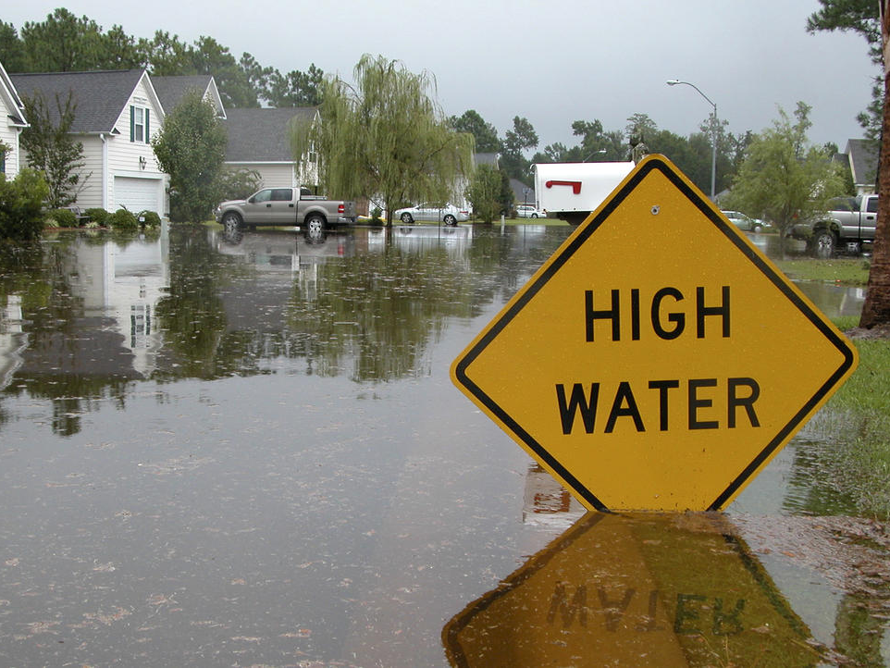
Types of Crisis (Cont.)
Adventitious
  Natural
    E.g., epidemics, floods, fires, and earthquakes
  Human
    E.g., one-on-one violence (rape, assault, abuse, homicide), acts of terrorism, wars, riots, mass shootings, and bombings
  Accidental
    E.g., airline crashes, structural collapses, nuclear power plant failures

Slide 11
Audience Response Question
Ms. T., a single mother of four, comes to the crisis center
24 hours after an apartment fire in which all the family’s household goods and clothing were lost. Ms. T. has no family in the area. Her efforts to mobilize assistance have been disorganized, and she is still without shelter. She is distraught and confused. The nurse assesses the situation as which of the following types of crisis?
Maturational crisis
Situational crisis
Adventitious crisis
Environmental crisis

Slide 12

Phases of Crisis

Slide 13
Phase 1
Conflict or problem
Self-concept threatened
Increased anxiety
Use of usual problem-solving techniques and defense mechanisms
Resolve conflict or problem
Reduce anxiety

Slide 14
Phase 2
Problem-solving techniques and defense mechanisms fail
Threat persists
Anxiety increases
Feelings of extreme discomfort produced
Functioning disorganized
Trial-and-error attempt to solve problem
and restore normal balance

Slide 15
Phase 3
Trial-and-error attempts fail
Anxiety can escalate to severe
and panic levels
Automatic relief behaviors
(i.e., withdrawal and flight)
Some form of resolution may be made
(i.e., compromising needs or redefining situation)

Slide 16
Phase 4
Problem not solved
and coping skills ineffective
Overwhelming anxiety
Possible serious personality disorganization
Depression, confusion, violence against others, or suicidal behavior

Slide 17
Case Study
Mr. Alessandro returns to the clinic 10 days later, bringing his wife with him, though she is resentful.
“I don’t want this,” she says. “Why can’t people just leave me alone.”
Mr. Alessandro does most of the talking as his wife is clearly withdrawn. He talks about things he has done to try to cheer both of them up, but “everything’s failed. Ellie’s withdrawing from everyone, she’s so depressed, and me, I’m a basket case because I’m afraid we’re never going to recover from this. Last week I was driving to the grocery when I had to pull over because I couldn’t breathe. I think it was my first-ever panic attack.”

Slide 18
Case Study (Cont.)
During therapy, the nurse and Mr. Alessandro propose a move to a nicer, larger apartment while they wait for insurance to begin the process of helping them build a new home.
“There’s that new complex near the park where we used to walk,” Mr. Alessandro says. “We could walk the trails there like we used to without having to drive so far. There’s a fitness center and even yoga, and when you’re ready, we can think about adopting a cat.”
“I’m not ready to replace Alfie!” his wife says. But after a moment, she softens and says, “I’m sorry, Robert. Those new apartments by the park, though. I’d like to see those.”

Slide 19
Audience Response Question
Which phase best describes how the Alessandro's are doing right now?
  Phase 1
  Phase 2
  Phase 3
  Phase 4

Slide 20
Application of the Nursing Process
Assessment
  General assessment
  Perception of precipitating event
  Situational supports
  Coping skills
  Self-assessment

Slide 21
Nursing Process (Cont.)
Nursing Diagnosis
Risk for impaired coping
Impaired coping
Risk for (or actual) impaired family coping
Risk for (or actual) impaired community coping
Anxiety
Outcomes identification
Basic level
Patient safety
Anxiety reduction

Slide 22
Levels of Prevention
Primary Prevention
Promotes mental health and reduces mental illness to decrease the incidence of crisis
Secondary Prevention
Intervention during an acute crisis to prevent prolonged anxiety
Tertiary Prevention
Provides long-term support for those who have experienced a crisis

Slide 23
Evaluation: Crisis
An evaluation for a person in crisis is usually performed 4 to 8 weeks after the initial interview.
Appropriate questions to ask are as follows:
Is the patient safe?
Has the patient developed more adaptive ways to cope with stress and anxiety?
Does the patient have a stronger existing support system?
Has the patient maintained an optimal level of functioning?
Has the patient returned to the pre-crisis level of functioning?

Slide 24
Treatment Modalities
Emergency rooms (not ideal)
Behavioral Crisis Care Services
Crisis call lines
Warm lines
Crisis intervention teams
Crisis stabilization facilities

Slide 25
Audience Response Question
A single parent has just lost her job and calls a warm line in her community. This is an example of:
  Tertiary prevention
  Primary prevention
  Secondary prevention
  Critical incident stress debriefing

Slide 26
Disaster Response

Slide 27
Global Disasters
Large-scale crisis
  Examples: tsunamis, hurricanes, wildfires, large-scale depletion of natural resources; international stock exchange collapses; pandemics
Disaster preparedness
  Develop resilient communities
  Assess disaster risks on a local level
  Extend to networking communities
  Extend to larger societal and national programs

Slide 28
Disaster Management Context
Department of Homeland Security (DHS)
  Coordinate United States responses to US disasters
  Ultimate responsibility for US safety
  Assure immediate availability of preparedness, response, and recovery protocols
  Uses civilian first response professionals
  Created National Incident Management System (NIMS) to coordinate efforts between responder agencies

Slide 29
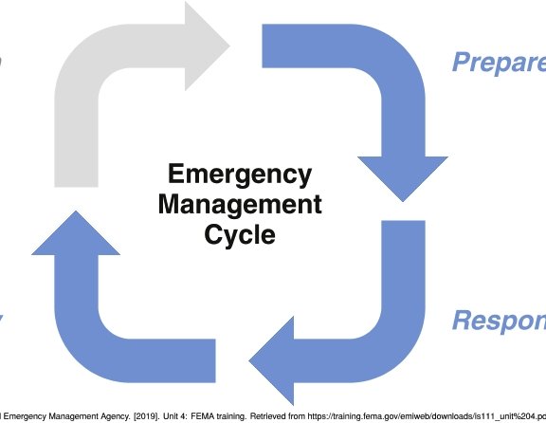
Disaster Response
FEMA’s Four-Phase Disaster Management Continuum
  Preparedness
  Mitigation
  Response
  Recovery

Slide 30
Critical Incident Stress Debriefing
A Tertiary Prevention Tool
Seven-phase group meeting
Examples
debrief staff on an inpatient unit following a patient suicide
debrief schoolchildren and school personnel after a school shooting
debrief rescue and health care workers who have responded to a natural disaster

Slide 31
Audience Response Question
A category 5 hurricane destroys homes and businesses in a community. How would this crisis be classified?
  Accidental crisis
  Situational crisis
  Adventitious crisis
  Maturational crisis

