Slide 1
Family Interventions
Chapter 35

Slide 2
Objectives
Discuss
Discuss the characteristics of a healthy family.
Identify
Identify the evolving nature of traditional family structures.
Differentiate
Differentiate family patterns of behavior as they relate to five family functions: management, boundaries, communication, emotional support, and socialization.

Slide 3
Family Structure
Nuclear family
Single-parent family
Unmarried biological or adoptive family
Blended/step-family
Cohabitating family
Extended family
Grandparent family
Childless family
“Other” family
Notes:
Blended family is one biologic/adoptive parent married to a step-parent
Cohabitating family is one biologic/adoptive parent not married but living with a partner
Other – Children living with related or unrelated adults who are not biological or adoptive parents. children living with grandparents or foster parents

Slide 4
Family Functions
Management
Boundaries
Clear
Diffuse
Rigid
Notes:
Management
Who has the power, how are the resources allocated, what are the rules, etc.
Usually, the parents are a family managers
In an unhealthy family, a teenager may be responsible for things like paying bills, buying the groceries
Single parents may become overwhelmed with these tasks
Boundaries – flexible and appropriate boundaries are essential to healthy family function
Clear – adaptive and healthy, members have a sense of “I”-ness and “we”-ness
allow functioning without inappropriate influence from other members
reflect both structure and flexibility
Diffuse and enmeshed – when boundaries are diffuse, it’s usually because of over involvement and members become enmeshed
it’s unclear who is in charge, who is responsible for decisions
Ex: a child works to support the family
Members are not encouraged to have their own way of beings or evolve as they mature
to the outside the family may seem “extremely close” and family feels they are of one mine
what comes up if the family is treated is anger and frustration
expression of separateness or independence is seen as being disloyal to the family
Rigid or disengaged boundaries
consistent adherence to rules and roles no matter what
family members may avoid each other, communication is minimal, thoughts and feelings are rarely shared
isolation is common – members lead highly separate and distinct lives and are not involved with anyone else
children may have trouble bonding with others
Children living within households with inappropriate boundary structures tend to engage in manipulative and perhaps age-inappropriate behavior, and feel insecure and helpless as they mature

Slide 5
Family Functions (Cont.)
Communication
Emotional-supportive
Socialization
Notes:
Communication is one of the hardest skill sets to develop
Cardinal rule – be clear and direct in saying what you need and want
This is hard because to feel comfortable to do so members must feel respected and loved
Emotional-supportive
healthy families are concerned with each other emotional needs
a family dominated by conflict and anger leaves members feeling isolated, fearful and impaired emotionally
Socialization
within the family, younger members learn social skills to use in the outside world
as the family grows through each developmental stage, new roles are taken on to prepare for the future

Slide 6
Case Study
The Merchant family consists of parents Trent and Marnie and their two daughters Morgan, age 13, and Heather, age 9. Mr. and Mrs. Merchant are seeking family therapy because they are having trouble helping Morgan, who has attention deficit hyperactivity disorder (ADHD), cope with stress and social situations. Her anxiety and frustration sometimes manifest as panic attacks that can look like aggression. These attacks set off panic in the parents as well, who compound the problem, Marnie says, “because we just can’t find a consistent, right way to handle it. So, we just wing it every time.”

Slide 7
Case Study (Cont.)
A second response to the stress in the Merchants’ household is a certain “overprotectiveness” that they describe seeing in their younger daughter, Heather.
In general, they’ve noticed that Heather tries to compensate by being very well behaved: “…like, almost abnormally so,” says Trent. “We think she’s trying to protect us from more stress.”
Marnie nods. “Sometimes, on rough evenings, she even takes control of dinnertime, ordering pizza or making hot dogs for dinner when we’re focused on Morgan. And she’s only 9 years old! It’s cool that she’s so sweet, but we also feel bad that she even thinks to do that.”

Slide 8
Audience Response Question
The family has come to rely on 9-year-old Heather to initiate dinner preparations when her sister is having an episode. Although this can be a positive, it does mean that they run the risk of violating ordinary family:
Boundaries
Socialization
Communication
Management
Notes:
ANS: D—though A is acceptable.
Although children learn decision-making skills as they mature and increasingly make decisions and choices about their own lives, they should not be expected or forced to take on this responsibility for the family. A 9-year-old child like Heather should not be the one to manage meal planning and initiate dinner preparations, unless this is an occasional learning task that parent and child enjoy together. It can also run the risk of violating boundaries if the child begins to feel an adult’s burden to provide meals for her family.

Slide 9
Overview of Family Therapy

Slide 10
Objectives
Compare and contrast
Compare and contrast models of modern family therapy.
Discuss
Discuss the central concepts of the identified patient and triangulation.
Review
Review a genogram using a three-generation approach.

Slide 11
Major Goals of Family Therapy
Improve the skills of the individual members
Strengthen the functioning of the family as a whole, in—
Cohesiveness
Communication
Appreciation
Commitment
Coping
Collective beliefs and values

Slide 12
Examples of Dysfunctional Communication
Manipulating
Distracting
Generalizing
Blaming
Placating

Slide 13
Models of Contemporary Family Therapy
Contextual therapy
Gain insight into problematic relationships
Family of origin therapy
Foster differentiation and decrease emotional reactivity
Experiential-existential therapy
Guide the family to identify and develop their own solutions to dysfunctional behavior

Slide 14
Models of Contemporary Family Therapy (CONT.)
Structural therapy
Improve family relationships through restructuring the family hierarchy and boundaries
Strategic therapy
Realign family hierarchy through use of rituals which change repetitive and maladaptive patterns
Cognitive-behavioral therapy
Improve patterns of negative behaviors through changing thought patterns

Slide 15
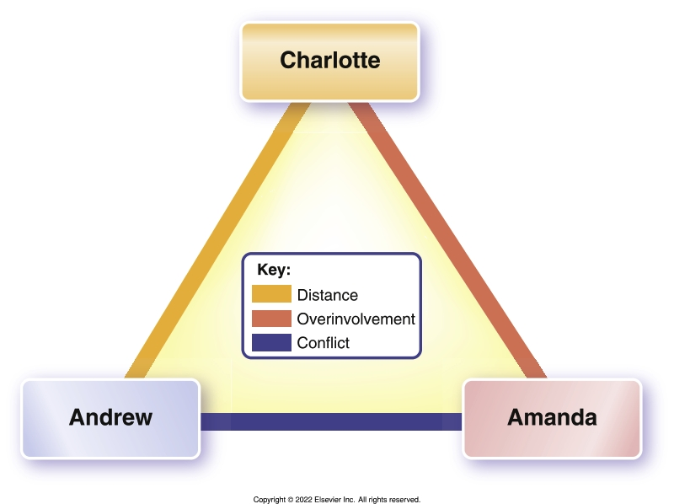
Concepts Central to Family Therapy
“Identified patient”
Family triangles
Scapegoating
Double bind messages

Slide 16
Case Study/ Audience Response Question
Who is the identified patient in the Merchant family?
Trent (dad)
Marnie (mom)
Morgan (age 13)
Heather (age 9)

Slide 17
Audience Response Question
The goal most associated with experiential-existential therapy is to:
Guide families to recognize and develop solutions to their own dysfunctional behaviors.
Improve inflexible structure and hierarchy.
Gain insight into past problematic relationships to promote a “balanced ledger”.
Realign family hierarchy through use of rituals.

Slide 18
Application of the Nursing Process

Slide 19
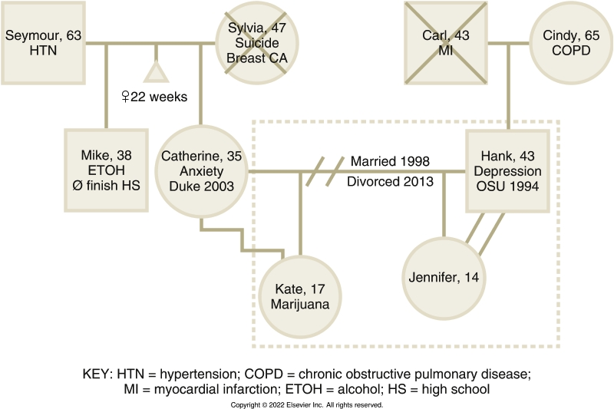
Assessment – Genogram (Three Generations)

Slide 20
Nursing Process (Cont.)
Nursing diagnosis (Box 35.3)
Impaired parenting
Dysfunctional family processes
Caregiver role strain
Ineffective denial
Defensive coping

Slide 21
Outcomes Identification
Reduce
Reduce dysfunctional behavior of individual family members and resolve or reduce conflicts
Mobilize
Mobilize family resources, encourage adaptive family problem-solving behaviors, improve family’s communication skills, heighten awareness and sensitivity to other family members’ emotional needs
Strengthen
Strengthen family’s ability to cope with major life stressors and traumatic events, including chronic physical or psychiatric illness

Slide 22
Implementation
Counseling and communication techniques
Use listening skills and nonjudgmental manner
Elicit perspective of each family member
Identify and address indicators of stress
Promoting the family’s mental health
Family Psychoeducation

Slide 23
Evaluation
Basic Level
Knowledge of therapeutic regimen
Accessing outside support
Improved family coping.
Advanced Level
Level of members’ individual and group functioning
Reduced or resolved conflicts
Stronger coping methods
Better integration of family members into the broader societal system

Slide 24
Treatment Modalities
Psychological Therapies
Psychiatric-mental health advanced practice registered nurses
Conduct family therapy
Apply family therapy to specific disorders
Help with substance use disorders, child behavioral problems, marital relationship distress, and as an element of the treatment plan for schizophrenia

Slide 25
Goals of the Psychiatric Advanced Practice Nurse
Reduce individual dysfunctional behavior
Resolve/reduce intrafamily conflicts
Mobilize family resources
Encourage adaptive family problem-solving
Improve family communication skills

Slide 26
Goals of the Psychiatric APN (Cont.)
Increase sensitivity to other members’ needs
Help family members meet their needs
Strengthen family’s coping mechanisms
Improve integration of the family system into the societal system
Promote appropriate individual psychosocial development of each family member

Slide 27
Case Study/ Audience Response Question
Often a combination of therapies is most useful. Morgan’s parents alternate between making up rules as they go along to withdrawing or disengaging when a panic attack begins. “Morgan kind of takes control,” they confess. Which type of therapy will be most helpful with this particular problem?
Structural
Contextual
Family of origin
Experiential-existential

Slide 28
Case Study/ Audience Response Question
Which goal is most appropriate as a first step in helping Morgan and her parents with behavioral problems related to her ADHD?
Morgan will develop stress-reduction techniques.
Morgan’s parents will provide structure and limit setting.
Morgan will adhere to the medication regimen.
Morgan will be free of aggressive behavior.

Slide 29
Audience Response Question
A genogram should include a minimum of how many generations?
2
3
4
5

