Slide 1
Psychiatric Symposium
Schizophrenia
Addiction
Major Depressive Disorder
Bipolar Disorder

Slide 2
Schizophrenia

Slide 3
Schizophrenia: A Psychotic Disorder
Delusions
Hallucinations
Disorganized speech
Disorganized behavior
Psychotic symptoms more pronounced and disruptive than in other psychotic disorders

Slide 4
Four Main Symptom Groups of
Schizophrenia
Positive
Negative
Cognitive
Affective

Slide 5
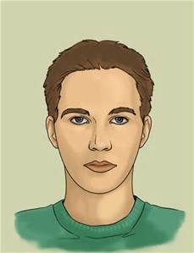
Positive Symptoms
Hallucinations
Delusions
Disorganized speech (associative looseness)
Bizarre Behavior
Negative Symptoms
Blunted affect
Poverty of thought (alogia)
Loss of motivation (avolition)
Inability to experience pleasure or joy (anhedonia)
Cognitive Symptoms
Inattention, easily distracted
Impaired memory
Poor problem-solving skills
Poor decision-making skills
Illogical thinking
Impaired judgment
Affective Symptoms
Dysphoria
Suicidality
Hopelessness
All Dimensions Alter
the Individual’s
Ability to work
Interpersonal relationships
Self-care abilities
Social functioning
Quality of life

Slide 6
Etiology
Biological factors
  Genetics
Neurobiological
  Dopamine theory
  Other neurochemical hypotheses
    Serotonin
    Glutamate
    ACh plus more…..

Slide 7
Etiology
Psychological and environmental factors
  Prenatal stressors
  Psychological stressors
  Environmental stressors

Slide 8
Dopamine Hypothesis
Thorazine (chlorpromazine)
Excess of DA in the mesolimbic system
Reduction of DA activity in the frontal cortex
Correction does not eliminate all symptoms
More complex interaction of multiple NT involved

Slide 9
Serotonin
Second generation antipsychotics
  DA antagonist
  5HT_{2a} antagonist

Slide 10
Glutamate Hypothesis
Glutamate hypofunction is associated with schizophrenic symptoms
Phencyclidine (PCP) can produce a full array of schizophrenic symptoms
  PCP blunts NMDA glutamate receptor function
NMDA receptors
  Regulate cognitive functions such as memory
  Have direct influence on dopaminergic pathways
NMDA receptor does not function properly in schizophrenia
Nearly all of the genes implicated in schizophrenia play roles in glutamate function

Slide 11
Pathophysiology
NT alterations as discussed previously
Brain structural abnormalities

Slide 12
Counseling: Communication Guidelines
Associative looseness
  Do not pretend that you understand
  Place difficulty of understanding on yourself
  Look for reoccurring topics and themes
  Emphasize what is going on in the patient's environment
  Involve patient in simple, reality-based activities
  Reinforce clear communication of needs, feelings, and thoughts

Slide 13
Counseling: Communication Guidelines
Hallucinations
  Hearing voices (auditory hallucinations) most common
  Approach patient in nonthreatening and nonjudgmental manner
  Assess if messages are suicidal or homicidal
  Ask directly what the voices are saying
  Do not argue or negate patient perception
  Offer your own perceptions (present reality)
  Focus on reality based diversions
  Patient anxious, fearful, lonely, brain not processing stimuli accurately
  Initiate safety measures if needed

Slide 14
Counseling: Communication Guidelines
Delusions
  Be open, honest, matter-of-fact, and calm
  Have patient describe delusion
  Avoid arguing about content
  Interject doubt when appropriate
  Validate part of delusion that is real
  Focus on feelings the delusions generate
  Once delusion is described, do not dwell on it
  Observe events that trigger delusions

Slide 15
Case Study
Sara, a 23 year-old single female, has just been admitted to the psychiatric unit by her parents. They explain that over the past few months she has become more and more withdrawn. She stays in her room alone, but lately has been heard talking and laughing to herself.
Sara left home for the first time at age 18 to attend college. She performed will during her first semester, but when she returned after winter break, she began to accuse her roommate of stealing her possessions. She started writing to her parents that her roommate wanted to kill her and that her roommate was turning everyone against her. She said she feared for her life. She started missing most of her classes and stayed in bed most of the time. Sometimes she locked herself in the closet. Her parents took her home, and she was hospitalized and diagnosed with Schizophrenia.

Slide 16
Case Study continued
She has since been maintained on antipsychotic medication while taking a few classes at the local community college.
Sara tells the admitting nurse that she quit taking her medication 4 weeks ago because the pharmacist is plotting to have her killed. She believes he is trying to poison her. She says she got this information from a television message. As Sara speaks, that nurse notices that she sometimes stops midsentence and listens; sometimes she cocks her head to the side and moves her lips as though she is talking.

Slide 17
Patient and Family Teaching for Schizophrenia
Learn all you can about the illness
Develop a relapse prevention plan
Participate in family, group and individual therapy
Avoid alcohol and drugs
Learn ways to address fears and losses
Learn new ways of coping
Have a plan on paper of what to do in times of increased stress
Adhere to treatment
Maintain communication with supportive people
Stay healthy by managing illness, sleep, and diet
  Balance

Slide 18
Pharmacologic Therapy
Antipsychotic Medications
Alleviate symptoms of schizophrenia but cannot cure underlying psychotic processes.
      Psychotic symptoms return with medication noncompliance.
Antipsychotic drugs are effective in:
      Acute exacerbations of schizophrenia
      Preventing or mitigating a relapse

Slide 19
Pharmacological Interventions
Antipsychotic medications
  First Generation (Typicals)
    Includes phenothiazines, thioxanthenes, butyrophenones
  Second Generation (Atypicals)
  Third Generation

Slide 20
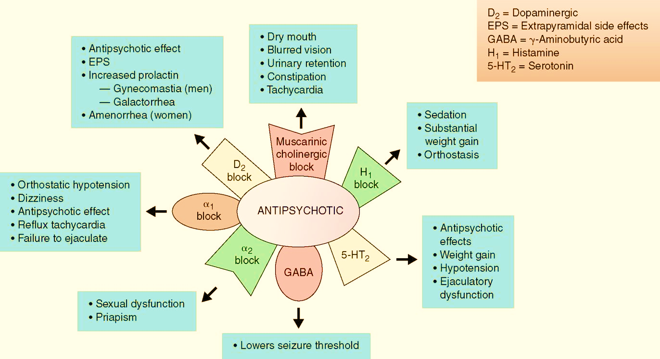
Adverse effects of receptor blockage of antipsychotic agents

Slide 21
Class Side Effects
Seizure
Impotence
Hyperprolactinemia
Refer to the antipsychotic side effect tables in the clinic syllabus for the specific “side effect profile” for the drug you will describe in your patho

Slide 22
Extrapyramidal Side Effects (imbalance of dopamine/acetylcholine)
Acute dystonic reactions
Pseudoparkinsonism
Akathisia
Tardive dyskinesia
  Abnormal Involuntary Movement Scale(AIMS test)

Slide 23
Rare and Toxic Side Effects
Agranulocytosis
Cholestatic jaundice
Anticholinergic toxicity (next slide)
Neuroleptic malignant syndrome (NMS)

Slide 24
Addiction

Slide 25
What Is Addiction?
National Institute on Drug Abuse (NIDA)
  Not a disorder of choice
  Chronic relapsing brain disease
  Similar to diabetes, asthma, heart disease, it can be managed successfully
  Relapse is not a failure- treatment needs to be reinstated, adjusted, or altered
Characterized by
  Compulsive substance seeking and use
  Substance use despite harmful consequences
  Tendency to relapse

Slide 26
Substance Use Disorder
A problematic pattern of use leading to clinically significant impairment or distress, as manifested by at least two of the following, occurring within a 12-month period:
Using larger amounts or over longer periods than intended
There is a persistent desire or unsuccessful efforts to cut down or control use
A great deal of time is spent on activities necessary to obtain the substance, use the substance, or recover from it’s effects

Slide 27
Substance Use Disorder continued
Craving, or a strong desire or urge to use the substance
Recurrent use resulting in failure to fulfill major role obligations at work, school, or home
Continued use despite persistent or recurrent social or interpersonal problems caused or exacerbated by the effects of use
Important social, occupational, or recreational activities are given up or reduced because of use
Recurrent use in situations in which it is physically hazardous

Slide 28
Substance Use Disorder continued
Use is continued despite knowledge of having a persistent or recurrent physical or psychological problem that is likely to have been caused or exacerbated by the substance
Tolerance
Withdrawal
Mild: presence of 2-3 symptoms
Moderate: presence of 4-5 symptoms
Severe: Presence of 6 or more symptoms

Slide 29
Etiology
Biological
  Specific effects on selected neurotransmitters
  Genetic predisposition
Psychodynamic Theories
  Defense against anxious impulses
  Oral regression (dependency)
  Self-medication for depression
Behavioral
  Positive reinforcement effects of drug-seeking behavior

Slide 30
Etiology
Continued
Sociocultural
  Social and cultural norms
  Socioeconomic stress

Slide 31
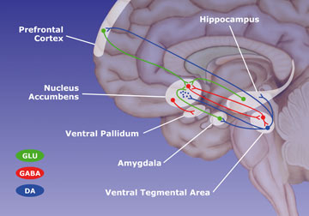
The Brain Reward Pathway

Slide 32
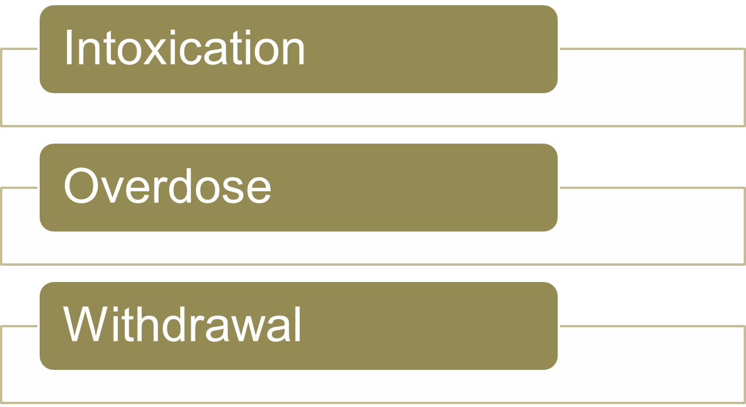
Three Potential States

Slide 33
Alcohol Intoxication
BAL (mg %) Effect in Nontolerant Drinker
.01-.06 Change in mood, behavior, and impaired judgment
.06-.10 Loss of inhibition, extroversion, depth perception impaired, reasoning impaired
.11-.20 Staggering, ataxia, emotional lability, reaction time/speech impaired
.21-.29 Stupor, blackouts, motor skills impaired
.30-.39 Severe depression, unconsciousness, breathing and heart rate impaired
0.40 Coma
0.50 Death from respiratory depression

Slide 34
Alcohol Withdrawal vs.
Alcohol Withdrawal Delirium
Withdrawal
Early signs a few hours after decreasing alcohol
Signs peak after 24 to 48 hours then rapidly disappear
Signs and symptoms
  Nausea/vomiting
  Diaphoresis
  Hyperalertness, insomnia
  Tremor and jerky movements
  Irritability, anxiety
  Easily startled
  "Shaking inside"

Slide 35
Alcohol Withdrawal vs.
Alcohol Withdrawal Delirium
(Continued)
Withdrawal delirium
A medical emergency that can result in death (10% mortality)
  Sepsis, MI, fat embolism, peripheral vascular collapse, electrolyte imbalance, aspiration pneumonia, suicide
Delirium peaks at 2 to 3 days after cessation of alcohol and lasts 2 to 3 days

Slide 36
Alcohol Withdrawal Delirium
(continued)
Signs and symptoms:
  Tachycardia, diaphoresis, elevated blood pressure
  Disorientation and clouding of consciousness
  Visual or tactile hallucinations
  Hyperexcitability to lethargy
  Paranoid delusions, illusions, agitation
  Fever (100° F to 103° F)
  Grand Mal seizures
To reduce patient's anxiety
  Orient to time and place
  Clarify illusions to reduce patient's terror

Slide 37
Wernicke-Korsakoff Syndrome (Alcohol Amnestic disorder)
Wernicke’s encephalopathy
  Acute phase of the syndrome
  Degenerative brain disorder cause by lack of thiamine (B1)
  Symptoms include mental confusion, vision impairment, stupor, coma, hypothermia, hypotension, and ataxia
Korsakoff’s psychosis
  Chronic phase of the disorder
  Also caused by lack of thiamine
  The heart, nervous and vascular system are involved
  Symptoms include amnesia, confabulation, attention deficit, disorientation and visual impairment

Slide 38
Alcohol Withdrawal Delirium: Treatment
Benzodiazepines
  Tapering doses
Thiamine
  Prevents/treats encephalopathy
Magnesium sulfate
  Reduce seizures
Anticonvulsants
  seizure control
Folic acid/multivitamins
  Treat anemia/correct deficiencies

Slide 39
Psychopharmacology:
Treatment of Alcoholism
Naltrexone (ReVia/Vivitrol)
  Reduces or eliminates alcohol craving
Acamprosate (Campral)
  Helps patient abstain from alcohol
Topiramate (Topamax)
  Works to decrease alcohol cravings
Disulfiram (Antabuse)
  Alcohol-disulfiram reaction causes unpleasant physical effects

Slide 40
CNS Depressants:
Benzodiazepines, Sedative-Hypnotics, Barbiturates, ETOH
Intoxication
  Slurred speech, incoordination, ataxia, drowsiness, disinhibition of sexual and aggressive impulses (GABA effect), impaired judgment, attention and memory disturbances
Overdose
  Cardiovascular or respiratory depression
  Coma
  Shock
  Convulsions
  Death

Slide 41
CNS Depressants:
Benzodiazepines, Sedative-Hypnotics, Barbiturates, ETOH (Continued)
Withdrawal
  Nausea, vomiting
  Tachycardia
  Diaphoresis
  Anxiety, irritability
  Tremors (hands, fingers, eyelids_
  Grand mal seizures
Treatment
  Carefully titrated detox with similar drug
  Caution: abrupt withdrawal can lead to death

Slide 42
Opiates
Morphine
Heroin
Codeine
Fentanyl
Methadone
Meperidine
Intoxication Effects
Miosis (‘pinned’ pupils) Decreased respiration Hypotension Bradycardia Slurred speech Drowsiness (‘on the nod’) Psychomotor retardation Initial: euphoria Later: dysphoria Impaired: Concentration Judgment Memory
Withdrawal Effects
Yawning Insomnia Irritability Rhinorrhea Panic Diaphoresis Cramps Nausea and vomiting Muscle aches Chills and fever Lacrimation Diarrhea

Slide 43
Opiates continued
Overdose
  Dilated pupils
  Respiratory depression
  Coma
  Shock
  Convulsions
  Death

Slide 44
Psychopharmacology:
Treatment of Opioid Addiction
Dolophine (methadone)
  Synthetic opiate blocks craving for and effects of heroin
  Only medication currently approved to treat pregnant opioid addict
LAAM (L-α-acetylmethadol)
  An alternative to methadone
Naltrexone (Trexan, ReVia, Vivitrol)
  Antagonist that blocks euphoric effects of opioids
Prometa
  Targets craving and reduces relapse
Clonidine (Catapres)
  Nonopioid suppressor of opioid withdrawal symptoms
  Effective somatic treatment when combined with naltrexone

Slide 45
Treatment of Opioid Addiction
Continued
Buprenorphine (Subutex)
  Partial opioid agonist
  Blocks signs and symptoms of opioid withdrawal
  Naloxone/buprenorphine (Suboxone)
  Partial opioid agonist/antagonist

Slide 46
Naloxone for Overdose
For acute opiate overdose
Naloxone auto-injector (Evzio)
Nalozone nasal spray (Narcan nasal spray)
Can be administered by family, friends, caregivers
Provides verbal instructions similar to an automated defibrillator

Slide 47
CNS Stimulants: Cocaine, Crack, Amphetamines
Intoxication
  Dilated pupils
  Tachycardia, elevated blood pressure
  Nausea, vomiting
  Insomnia
  Assaultiveness, potential for violence
  Impaired judgment, social and occupational functioning
  Euphoria, paranoia, delusions, hallucinations, psychosis
  Severe to panic levels of anxiety
Overdose
  Respiratory distress
  Ataxia
  Hyperpyrexia
  Convulsions
  Coma
  Stroke, Myocardial Infarction
  Death

Slide 48
CNS Stimulants: Cocaine, Crack, Amphetamines (Continued)
Withdrawal
  Fatigue, lethargy
  Depression
  Agitation, disorientation
  Apathy
  Anxiety
  Sleeplessness
  Craving
Treatment
  Symptomatic, supportive

Slide 49
Hallucinogens
LSD, Mescaline, Psilocybin
Intoxication
  Pupil dilation
  Elevated pulse, temperature, respiration
  Diaphoresis
  Palpitations
  Tremors
  Incoordination
  Paranoia, fear of going crazy, grandiosity, depersonalization
  Synesthesia, hallucinations
Overdose
  Psychosis
  Brain damage
  Death
Treatment
  Supportive, anxiolytics
  Minimal stimuli
  Have one person stay with patient to “talk down” and reassure
  Speak slowly and clearly in a low voice
Notes:
Grandiosity – think they can fly

Slide 50
Hallucinogens
Continued
PCP
Intoxication
  Vertical or horizontal nystagmus
  Increased BP, pulse, temperature
  Ataxia
  Muscle rigidity, chronic jerking
  Seizures
  Belligerence, assaultiveness, impulsiveness, lability
  impaired judgment, social, occupational function
  Hallucinations, paranoia
  Bizarre behavior, regression
Overdose
  Psychosis
  Hypertensive crisis
  Respiratory arrest
  Hyperthermia
  Seizures

Slide 51
Hallucinogens - PCP
Treatment
  Acidify urine (cranberry juice, ascorbic acid, ammonium chloride)
  Minimal stimuli
  Do not attempt to talk down!
  Speak slowly, clearly, low voice
  Administer diazepam (muscle spasms, seizure risk), haloperidol (psychotic behavior)
  Medical interventions: hyperthermia, hypertension, respiratory distress, hypertension
  Caution: gastric lavage may cause laryngeal spasms or aspiration

Slide 52
Inhalants
Volatile solvents
  Spray paint
  Glue
  Cigarette lighter fluid
  Propellant gases used in aerosols
Intoxication
  Excitation followed by drowsiness, disinhibition, staggering, lightheadedness, and agitation
Overdose
  Damage to CNS
  Sudden death (V-fib)
Treatment
  supportive

Slide 53
Rave and Techno Drugs/Club Drugs
Common drugs
  Ecstasy (3,4-methylenedioxymethamphetamine), also called MDMA, Adam, yaba, XTC
  MDA (methylenedioxyamphetamine) or "love"
  MDE (3,4-methylenedioxyethylamphetamine) or "Eve"
Side effects
  Euphoria, increased energy
  Increased self-confidence
  Increased sociability
  Feeling of closeness to others
Adverse effects
  Hyperthermia, heart failure, kidney failure, acute dehydration

Slide 54
Date Rape Drugs
Flunitrazepam (Rohypnol or "roofies")
γ-Hydroxybutyric acid (GHB)
Colorless, tasteless, odorless
Rapidly produces (within minutes):
  Disinhibition
  Relaxation of voluntary muscles
  Anterograde or localized amnesia

Slide 55
Communication guidelines - Addiction
Show empathy through active listening and feedback
Maintain an interested, nonjudgmental, supportive approach
Focus on client strengths
Encourage the client to focus on the here and now if feeling overwhelmed
Refrain from being pulled into power struggles, defending your position, or criticizing patient behaviors
Discourage patient’s attempts to focus on only external problems (relationships, job-related, legal) without relating them to substance use

Slide 56
Communication Guidelines - Addiction
Help patient analyze pros/cons so substance use
Give non-judgmental feedback when patient tries to blame, rationalize, or minimize effects of drug use
Maintain firm limits on manipulative behavior (mood swings, belligerence, aggressiveness, guilt, glamorizing substance use, special favors, etc.)

Slide 57
Substance Use Disorder
Case Study
The police bring Dan to the emergency department of the local hospital around 9:00 pm. His wife, Carol, called 911 when Dan became violent and she began to fear for her safety. Don was fired from his job as a foreman in a manufacturing plant for refusing to follow his supervisor’s directions on a project. When cleaning up after his move, several partially used bottles of liquor were found in his work area.
Carol reports that Dan has been drinking since he came home shortly after noon today. He bloodied her nose and punched her in the stomach when she poured the contents of a bottle from which he was drinking down the sink. The police responded to her call and brought Dan to the hospital in handcuffs. By the time they arrive at the hospital, Dan has calmed down, and appears drugged and drowsy. His blood alcohol lever is 247mg/dL. He is admitted to the detoxification unit of the hospital with a diagnosis oaf Alcohol intoxication.

Slide 58
Case Study continued
Carol tells the admitting nurse that she and Dan have been married for 12 years. He was a social drinker before they were married, but his drinking has increased over the years. He had been under a lot of stress at work, hated his job, his boss, and his new co-workers, and had been depressed a lot of the time. He never had a loving relationship with his parents, who are now deceased. For the past few years, his pattern has been to come home, start drinking immediately, and drinking until he passes out. She has tried to get him to go for help, but he refuses, saying he does not have a problem. Carol begins to cry and says to the nurse, “We can’t go on like this. I don’t know what to do.”

Slide 59
Patient and Family Teaching
Addiction is a disease not a moral weakness
It is up to the individual what they want to do about their addiction
However, addiction negatively affects all family members/friends
Identify “enabling” behaviors and teach strategies to adopt healthy boundaries/patterns
Encourage families/friends to let the user experience the result of their behavior of substance use, not to make excuses or bail out the individual
Tell family members they are not responsible for their family members substance abuse

Slide 60
Patient and Family Teaching
Tell the patient and family to report any worsening signs of depression or suicidal thoughts
Educate patient and family about the detrimental effects (consequences) of the substance(s) used
Help the family identify community resources that will promote recovery and help prevent relapse
Encourage individuals to reach out to their sponsor/family/friends before acting out on cravings/urges
Educate the patient about the risk of HIV, hepatitis, and other diseases associated with substance use

Slide 61
Major Depressive Disorder

Slide 62
MDD – DSM V
5 or more symptoms for greater than two weeks
  One must be either anhedonia or depressed mood
  Plus 4 of the following:
Clear change from previous function
Significant distress/impairment in social, occupational, or family functioning
Weight gain/loss | Guilt
Insomnia/hypersomnia | Psychomotor agitation or retardation
Anergia (decreased energy) or fatigue | Decreased concentration
Worthlessness | Inappropriate guilt
Indecisiveness | Suicidal ideation

Slide 63
Other MDD Symptoms
Vague somatic aches and pains
Uncharacteristic anger/frustration
Vegetative symptoms
  Change in appetite
  Change in sleep
  Constipation
  Lack of interest in sex

Slide 64
Etiology
Biological factors
  Genetic
  Biochemical
    Stressful life events
  Alterations in hormonal regulation
  Inflammatory process

Slide 65
Etiology continued
Diathesis-Stress Model
Psychological vulnerabilities
Stress
Neurochemical and neurophysical changes in the brain

Slide 66
Etiology (Cont.)
Psychological factors
  Cognitive theory
    Beck’s negative triad
  Learned helplessness

Slide 67
Communication Guidelines - Depression
  Acknowledge accomplishments without flattery or excessive praise (matter-of-fact)
Help patients identify own personal strengths
Help patient question underlying assumptions and consider alternate explanations

Slide 68
Communication Guidelines - Depression
Work with patient to identify cognitive distortions (review T14-4)
  Overgeneralizations
  Self-blame
  Mind reading
  Discounting positive attributes

Slide 69
Communication Guidelines - Depression
Accept patient’s negative feelings but set limits on amount of time for negative expression
    Matter-of-fact style
    Redirect to neutral topics

Slide 70
Communication Guidelines: Severely Withdrawn Patients
Technique of making observations
Simple, concrete words
Allow time for response
Listen for covert messages and ask about suicide plans
Avoid platitudes
Sit quietly with patient

Slide 71
Pharmacologic Therapy
Antidepressants
    SSRIs
      First-line therapy
      Indications
      Adverse reactions
      Potential toxic effects
      Serotonin syndrome
      Rare and life-threatening event
      Risk greatest when SSRI is administered in combination with monoamine oxidase inhibitor (MAOI)

Slide 72
Pharmacologic Therapy—cont’d
Serotonin-norepinephrine reuptake inhibitors (SNRIs)
  Venlafaxine (Effexor)
  Desvenlafaxine (Pristiq)
  Duloxetine (Cymbalta)
Serotonin-norepinephrine disinhibitors (SNDIs)
  Mirtazapine (Remeron)
Norepinephrine reuptake inhibitors (NRI)
  Roboxetine (Vestra, Edronax)

Slide 73
Pharmacologic Therapy—cont’d
Serotonin Antagonist and Reuptake Inhibitor (SARI)
  Trazodone (Desyrel)
  Used as a non addictive sleep medication at sub therapeutic doses
  Rare side effect: priapism

Slide 74
Pharmacologic Therapy—cont’d
Norepinephrine Dopamine Reuptake Inhibitor (NDRI)
  Bupropion (Wellbutrin XR, SR)
  Helps in ADHD, chronic fatigue, sexual side effects from other antidepressants, anxiety disorders
  No weight gain
  Decreases seizure threshold, agitation, insomnia
  Smoking cessation (Zyban)
Serotonin Norepinephrine Disinhibitors (SNDI)
  Mirtazepine (Remeron)
    Used in the elderly for the usually adverse effect of weight gain

Slide 75
Pharmacologic Therapy—cont’d
  Tricyclic antidepressants (TCAs)
    Neurotransmitter effects
    Indications
    Adverse effects
    Contraindications
    “Start low, go slow.”

Slide 76
Pharmacologic Therapy—cont’d
  MAOIs
    Neurotransmitter effects
    Indications
    Adverse and toxic effects
    Interactions
      Drugs: Avoid over-the-counter (OTC) medications.
      Food: Avoid foods containing tyramines.
    Contraindications

Slide 77
Case Study
Sam is a 45 year old white male admitted to the psychiatric unit by his health care provider. Sam was becoming increasingly despondent over the past month. His wife reported that he had made statements such as “Life is not worth living” and “I think I could just take all those pills.” Sam says he loves his wife and children and does not want to hurt them but he feels they no longer need him. His wife appears to be very concerned about his condition, although in his despondency, he seems oblivious to her feelings.

Slide 78
Case Study continued
Over the past few weeks, Sam has become more and more withdrawn. He speaks to few people at his office and is becoming more and more behind in his work. At home, he eats very little, talks to family members only when they ask a direct question, withdraws to his bedroom very early in the evening, and does not come out until time to leave for work the next morning. Today, he refused to get out of bed or go to work. His wife convinced him to talk to their family health care provider, who admitted Sam to the hospital.

Slide 79
Bipolar Disorder

Slide 80
Bipolar Disorder – DSM V
A distinct period of abnormally & persistently elevated, expansive, or irritable mood and persistently increased goal-directed activity or energy, lasting at least one week and present most of the day, nearly every day
Or any duration if hospitalization is required in bipolar disorder, type 1

Slide 81
Bipolar Disorder – DSM V (continued)
During the period of mood disturbance, 3 or more of the following have persisted (4 if the mood is only irritable):
  Inflated self-esteem or grandiosity
  Decreased need for sleep
  More talkative or pressured speech
  Flight of ideas or subjective feeling of racing thoughts
  Distractibility
  Increased goal-directed activity or psychomotor agitation
  Excessive involvement in pleasurable activities that have a high potential for painful consequences

Slide 82
Hypomania
Unequivocal change uncharacteristic of person when not symptomatic
Observable by others known to patient
Absence of marked impairment in social or occupational functioning
Hospitalization not indicated
Not due to substance abuse, medication, or other medical condition

Slide 83
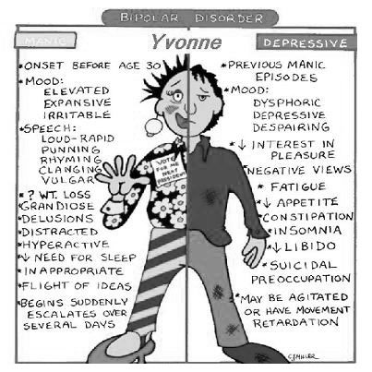

Slide 84
Mania
Behavior severe enough to cause marked impairment in occupational activities, usual social activities, or relationships
Necessitates hospitalization to prevent harm to self or others, or there are psychotic features
Symptoms not due to substance abuse, medications or other medical condition

Slide 85
Etiology
Biological factors
  Genetic
  Neurobiological
  Neuroendocrine

Slide 86
Psychosocial & Environmental Factors
Stress
Education
Occupation
Economic status
Creativity

Slide 87
Communication With Patient Experiencing Mania
Use firm, calm approach
Use short and concise explanations
Remain neutral: avoid power struggles
Be consistent in approach and expectations
Firmly redirect energy into more appropriate areas
Act on legitimate complaints
Convey limits, consequences

Slide 88
Pharmacological Interventions
Lithium carbonate
First-line agent
  Therapeutic and toxic levels
    Therapeutic blood level: 0.8 to 1.4 mEq/L
    Maintenance blood level: 0.4 to 1.3 mEq/L
    Toxic blood level: 1.5 mEq/L and above
  Takes 7 to 14 days to reach therapeutic levels in blood

Slide 89
Initial Treatment of Acute Mania Until Lithium Takes Effect
Antipsychotics
  Slow speech
  Inhibit aggression
  Decrease psychomotor activity
Antipsychotic or benzodiazepine to prevent:
  Exhaustion
  Coronary collapse
  Death

Slide 90
Lithium: Expected Side Effects
Blood level: <0.4 to 1.0 mEq/L
Signs
  Fine hand tremor
  Polyuria
  Mild thirst
  Mild nausea
  General discomfort
  Weight gain

Slide 91
Lithium: Expected Side Effects
Blood level: <0.4 to 1.0 mEq/L
Signs
  Fine hand tremor
  Polyuria
  Mild thirst
  Mild nausea
  General discomfort
  Weight gain

Slide 92
Lithium: Early Signs of Toxicity
Blood level: 1.5 mEq/L
Signs
  Nausea
  Vomiting
  Diarrhea
  Thirst
  Polyuria
  Slurred speech
  Muscle weakness

Slide 93
Lithium: Advanced Signs of Toxicity
Blood level: 1.5 to 2.0 mEq/L
Signs
  Coarse hand tremor
  Persistent gastrointestinal upset
  Mental confusion
  Muscle hyperirritability
  Incoordination

Slide 94
Lithium: Severe Toxicity - Continued
Blood level: >2.5 mEq/L
Signs
  Confusion
  Incontinence of urine or feces
  Coma
  Cardiac arrhythmias
  Peripheral circulatory collapse
  Abdominal pain
  Proteinuria
  Oliguria
  Death

Slide 95
Lithium: Major Long-Term Risks
Hypothyroidism
Impairment of kidneys’ ability to concentrate urine
See clinic syllabus for common side effects

Slide 96
Patient and Family Teaching for Lithium Therapy
Effects of treatment
Need to monitor lithium blood levels
Side effects and toxic effects
Effects of dietary salt and dehydration
Check with physician before taking OTC medications
Take with food to decrease stomach irritation

Slide 97
Anticonvulsant Drugs
  Valproate (Depakote, Depakene)
  Carbamazepine (Tegretol)
  Lamotrigine (Lamictal)
  Gabapentin (Neurontin)
  Topiramate (Topamax)
  Oxcarbazepine (Trileptal)

Slide 98
Antianxiety Drugs
Clonazepam (Klonopin)
Lorazepam (Ativan)
Atypical antipsychotics
Olanzapine (Zyprexa)
Risperidone (Risperdal)

Slide 99
Pathophysiology/Prep Sheets

Slide 100
Case Study
Candace, age 32, recently moved to New York City from Omaha, Nebraska, where she had been working as a television reporter. She felt that Omaha had become “too boring” and wanted to experience the big city life. Candace has a history of bipolar 1 disorder, and has been maintained on lithium since she was 23 years old. Since she arrived to NYC, she has run out of her medication and has not found a health care provider to have her prescription renewed. She has been staying at an inexpensive apartment, using her savings to live on. She has been seeking employment, but it has been 2 months now, and she has been unable to find a job. She is becoming anxious because her savings are becoming depleted. She has lost weight and is having trouble sleeping.

Slide 101
Case Study continued
Today after two failed interviews, Candace went into a bar and began drinking. She ordered several rounds of drinks for everyone in the bar and told the bartender to “put it on my tab”. The bartender called the police when Candace refused to pay her tab and became loud and belligerent. He said she began shouting that she knew the mayor, and he was going to help her find a job, and if they did not leaver her alone, she was going to tell the mayor how they were treating her. She took out her cell phone and said she was calling the mayor.

Slide 102
Case Study continued
When others in the room began to laugh at her, she began cursing and saying that “they would be sorry one day that they laughed at her.” When police arrived, Candace was resistant and had to be physically restrained. The police took her to the emergency department.

Slide 103
Prep Sheet
Define the diagnosis to your patient
Etiology
  Genetic rates
  Chromosomal abnormalities
  Brief mention of NT involved
  Environmental contributors
  Psychological theories

Slide 104
Prep Sheet
Pathophysiology
  Discuss NT in detail
  Brain structural abnormalities
  Hormonal alterations

Slide 105
Prep Sheet
Laboratory & Diagnostic tests – What abnormalities would you expect and why?
Anticipated ineffective behaviors (symptoms)
  Example for schizophrenia - discuss positive, negative, affective & cognitive symptoms
Health teaching and promotion
  Discuss important concepts to enhance the patient and family’s ability to understand and cope with the disease process

Slide 106
Prep Sheet
Nursing diagnoses
  The three most important ones
Communication guidelines
Medications
  Look in your book and clinic syllabus first as this will highlight drug information better than a general drug resource
Do not rely solely on this presentation
Use outside resource in addition to the book or syllabus
Include references at the end of your paper

